Slide 2
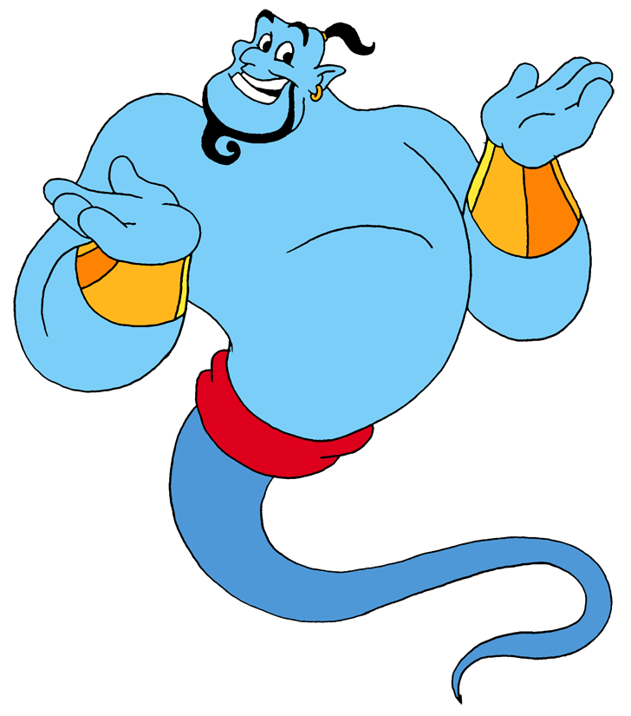
yowis

Slide 3
yowis
You are probably thinking that “yowis”, pronounced “yo-wis”, means “your wish” in Indonesian, right?
Sorry, but I can’t grant “yowis” this time because your are wrong yet again!
“Yowis” is actually the Javanese word for “sudah” which means “already done” in Indonesian!

Slide 4
yowis
If you would like me to produce another WORD Of The DAY out of thin air, “yowis” is my command!!!

