Slide 2
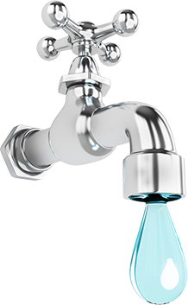
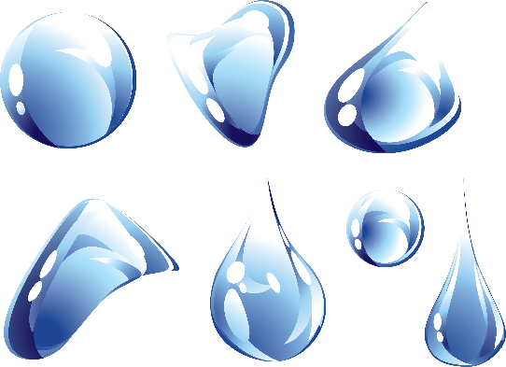
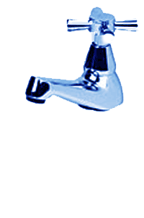
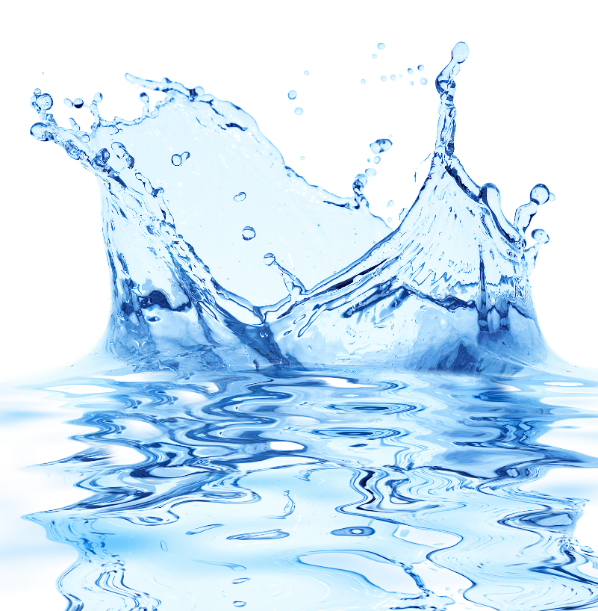
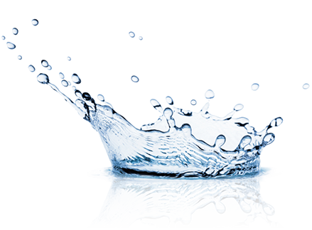
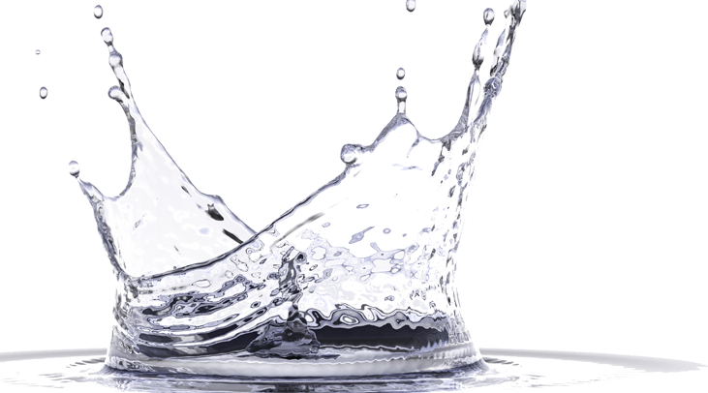
warta

Slide 3
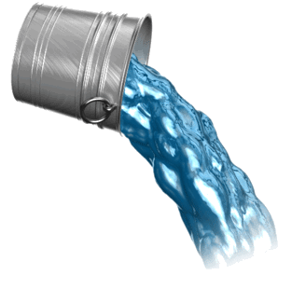
warta
You are probably thinking that “warta”, pronounced “wahr-tah”, is the Indonesian word for “water”, right? Sorry to pour cold “water” on that idea, but I have “news” for you!
The noun “warta” means “news” in Indonesian.
Being vital to all life, the state of our “water” supplies is always important “warta” these days!

