Slide 1
Uses of the “ber~” Prefix
Use-Wear-Own-Do

Slide 2
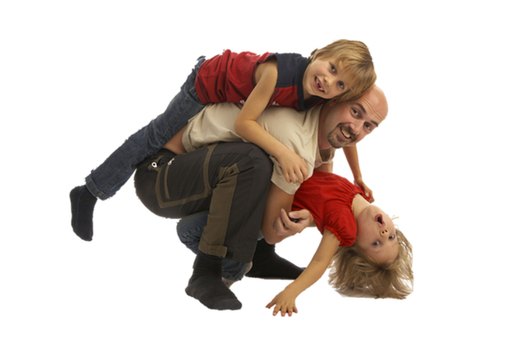
To have
Dia beranak dua orang.
He has two children.

Slide 3
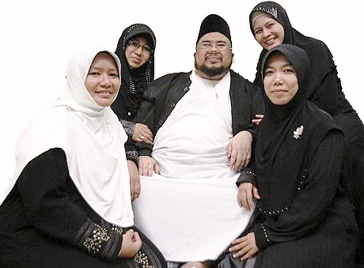
To have
Pria Muslim boleh beristeri empat (orang).
Muslim men may have four wives.

Slide 4
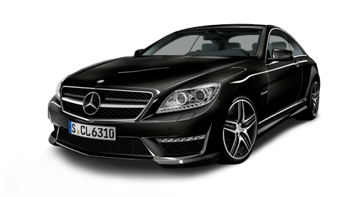
To own
Saya ingin bermobil Merecedes.
I wish to own a Mercedes car.

Slide 5
To own
Keluarga Addams berumah besar.
The Addams family have a large house.

Slide 6
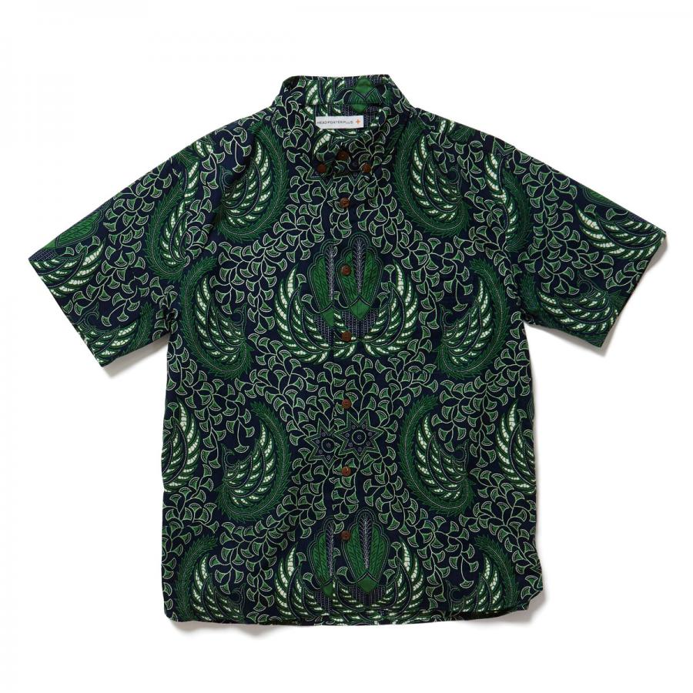
To use or wear
Orang Indonesia suka berkemeja batik.
Indonesians like to wear batik shirts.

Slide 7
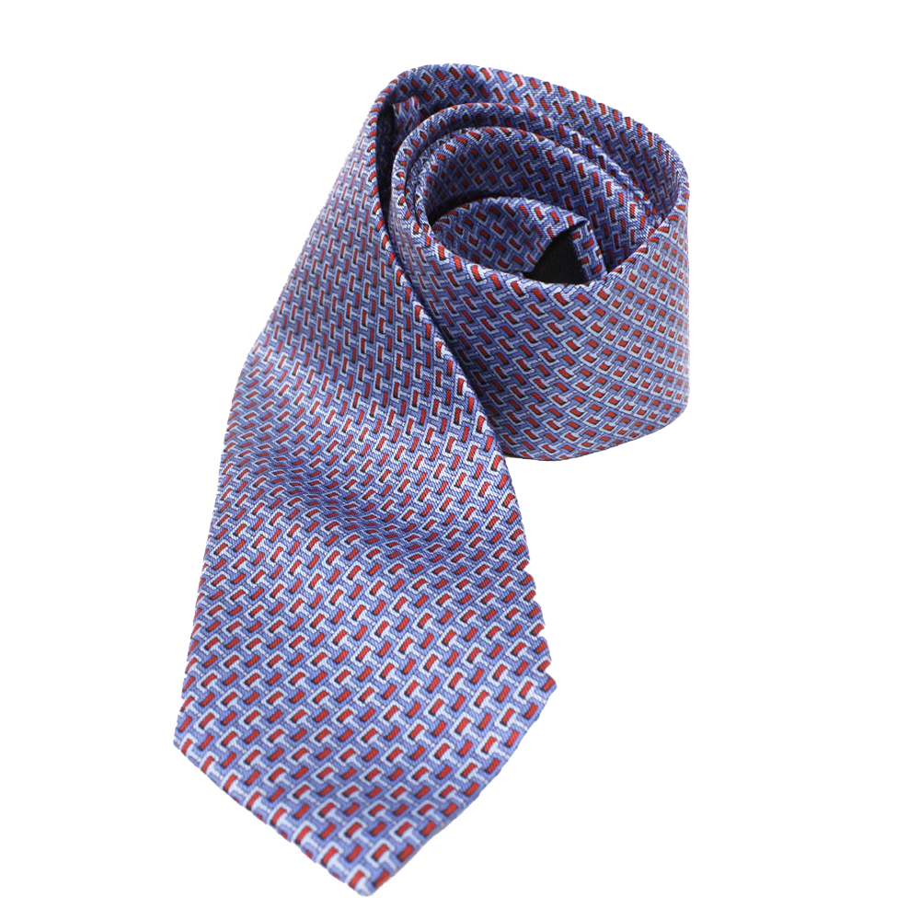
To use or wear
Saya berdasi Gucci mahal ke kantor.
I wear an expensive Gucci necktie to the office.

Slide 8
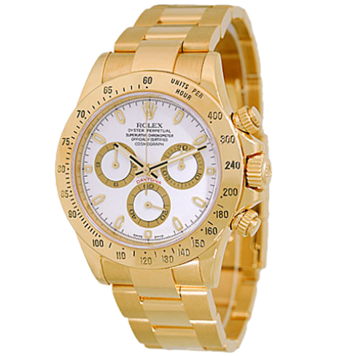
To use or wear
Orang kaya suka berjam tangan Rolex.
Wealthy people like to wear Rolex watches.

Slide 9
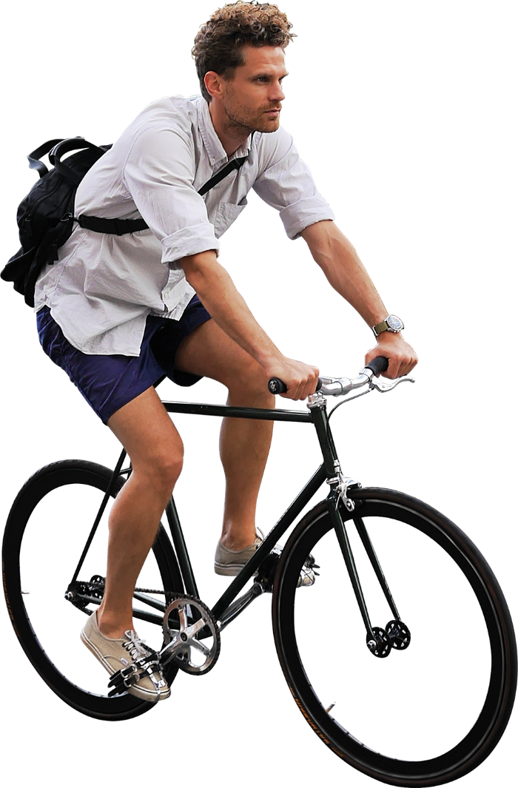
To do
Orang ini suka bersepeda untuk olahraga.
This person likes cycling for exercise.

Slide 10
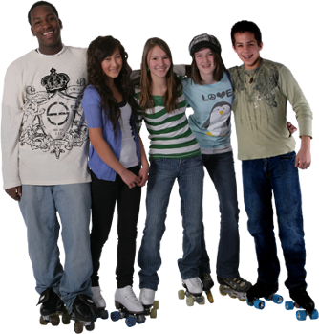
To do
Orang-orang ini suka bersepatu roda.
These people like roller skating.

Slide 11
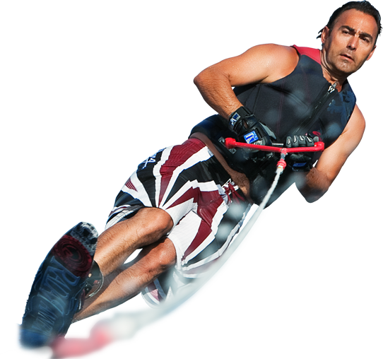
To do
Orang ini berski air.
This person is water skiing.

