Slide 2
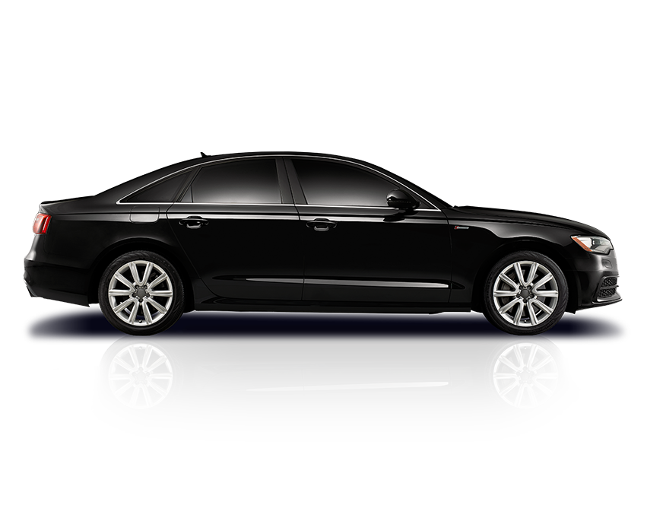
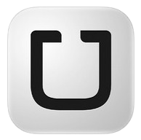
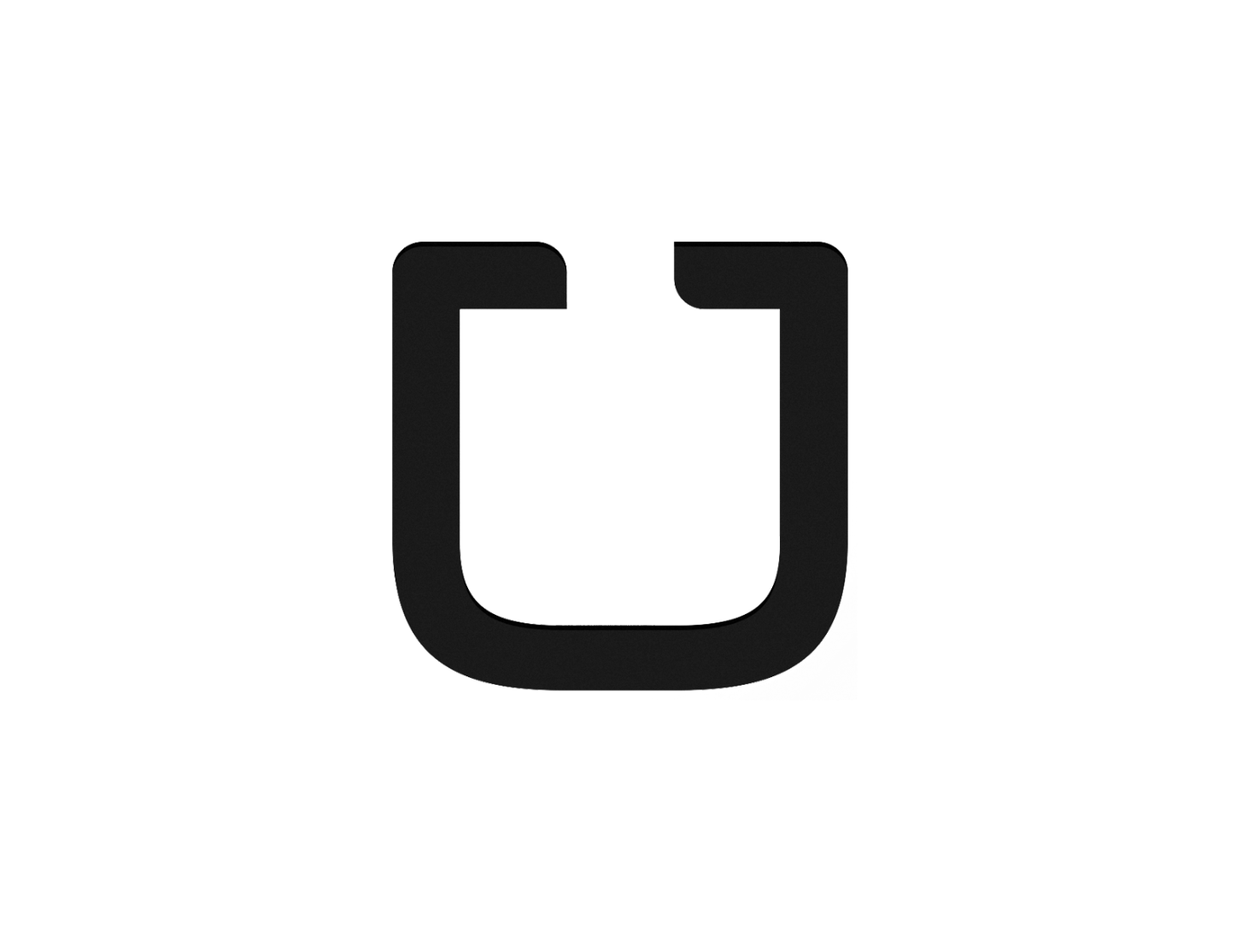
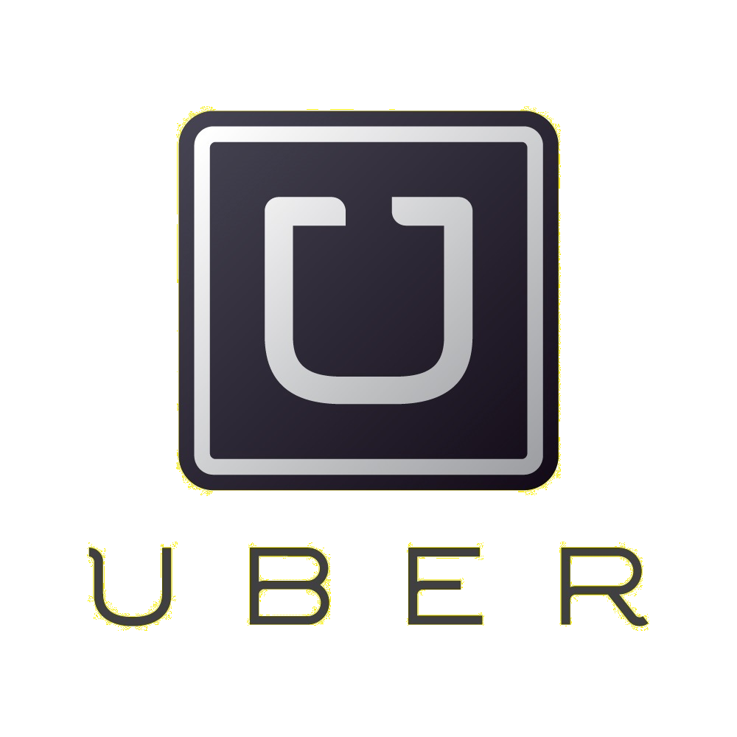
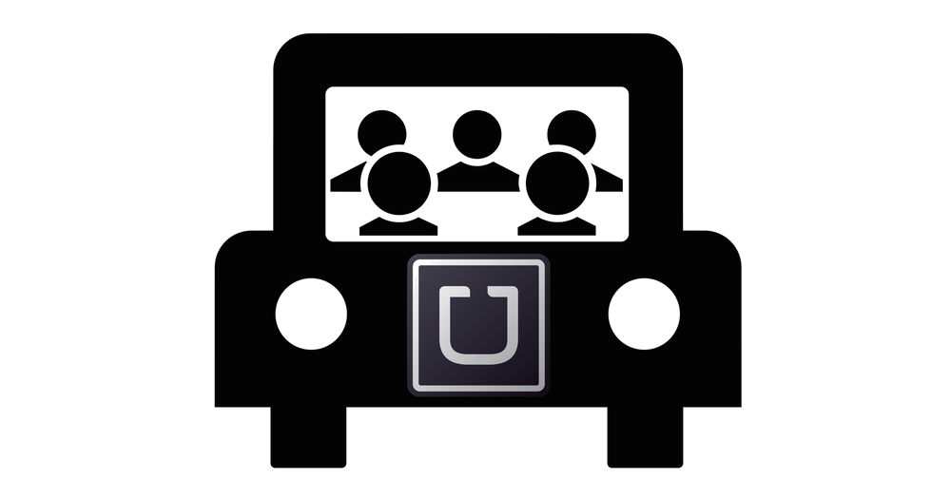
uber

Slide 3
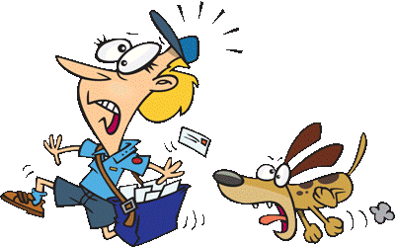
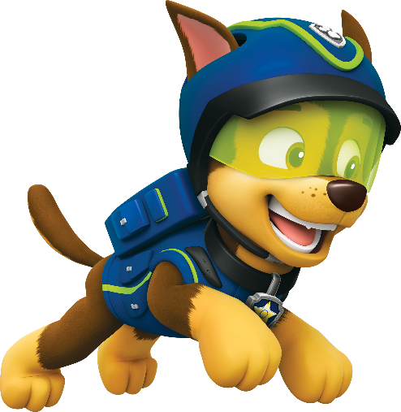
uber
You could be excused for thinking that “uber”, pronounced “oo-ber” is the Indonesian version of the world’s first ride-sharing app.
This time I’m not taking you for a “ride” because you are correct! However, the verb “uber” does have another meaning in Indonesian. It means to “chase” or “pursue”!

Slide 4
uber
With the advent of the “uber” service, people no longer need to “uber” a ride! In fact, it is now the “uber” drivers who “uber” customers for their money!

