Slide 2
tulat

Slide 3
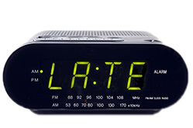
tulat
You are probably thinking that “tulat”, pronounced “too-lut”, is the Indonesian word for “too late”, right?
As usual, you are a little slow off the mark as the noun “tulat” means “the day after the day after tomorrow” or “three days from now” in Indonesian.

Slide 4
tulat
Now that you have been given three day’s advance notice, there is no excuse to be “tulat”!

