Slide 2
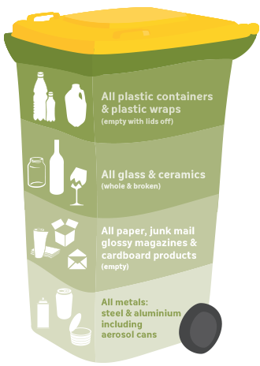
tubin

Slide 3
tubin
You are probably thinking that “tubin”, pronounced “too-bin”, is Indonesian for “throw it in the bin”, right?
Sorry to rubbish that idea, but the noun “tubin” means “the day after the day after the day after tomorrow” or “four days from now” in Indonesian.

Slide 4
tubin
Now that you have been given four day’s advance notice, I expect your homework to “tubin” on time!

Slide 5
tubin

