Slide 2
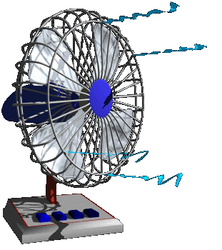
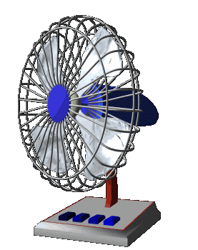
tofan

Slide 3
tofan
You are probably thinking that “tofan”, pronounced “toh-fan”, is the Indonesian word for a “toe fan”, right? Sorry to “blow away” that idea but the noun “tofan” means “cyclone” in Indonesian!

Slide 4
tofan
Let me tell you that a “tofan” would blow away a lot more than a “toe fan” would, including yourself, your car and your entire house!

