Slide 2
tiri

Slide 3
tiri
I’ll bet you’re thinking that “tiri”, pronounced “teary”, is the Indonesian for “teary-eyed”, right?
Please don’t get “teary” just because you are wrong again!
The adjective “tiri” means “step relative” in Indonesian and is placed after the relationship word.
For example, “Mike adalah bapak tiri Marcia, Jan dan Cindy Brady”.

Slide 4
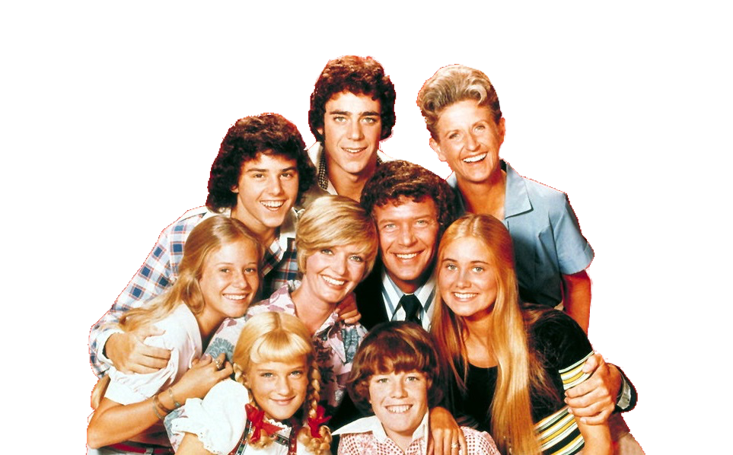
tiri
Yes, we all get a bit “teary” when we remember the world’s favourite “orangtua tiri”, Mike and Carroll Brady of The Brady Bunch.
If you want to get really “teary”, you can sit through the entire box set collection of The Brady Bunch on DVD.

