Slide 2
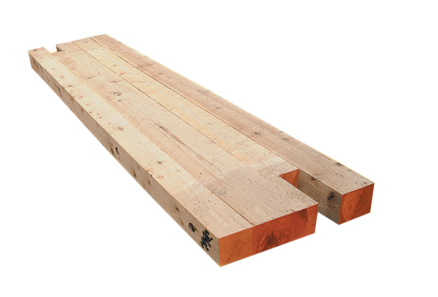
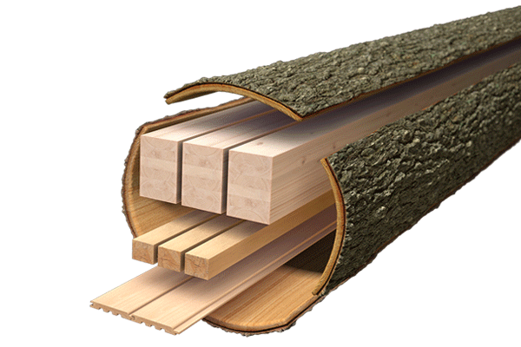
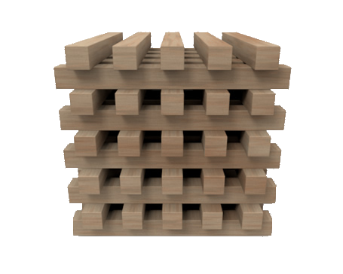
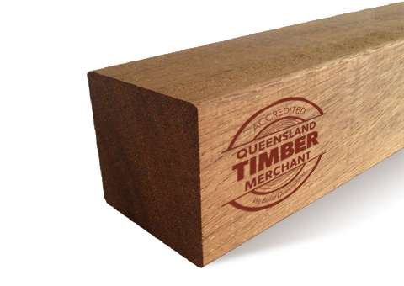
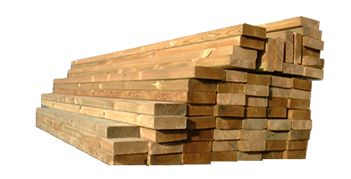
timba

Slide 3
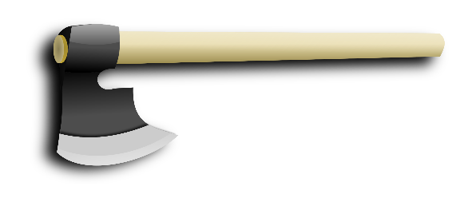
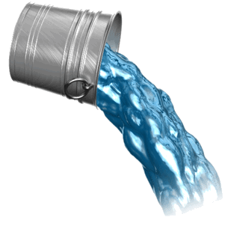
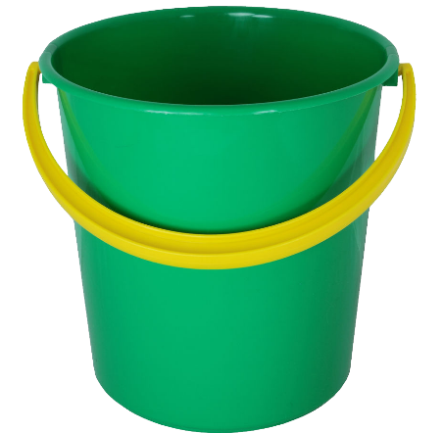
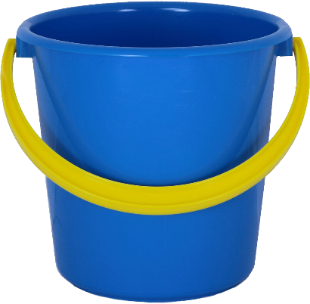
timba
You are probably thinking that “timba”, pronounced “tim-bah”, is the Indonesian word for “timber”, right? Sorry to give that idea the “axe” but the noun “timba” means “bucket” in Indonesian.
I don’t know about you, but I prefer my buckets made out plastic rather than “timba” so let’s pour cold water on that idea!

