Slide 2
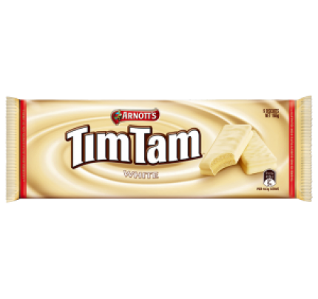
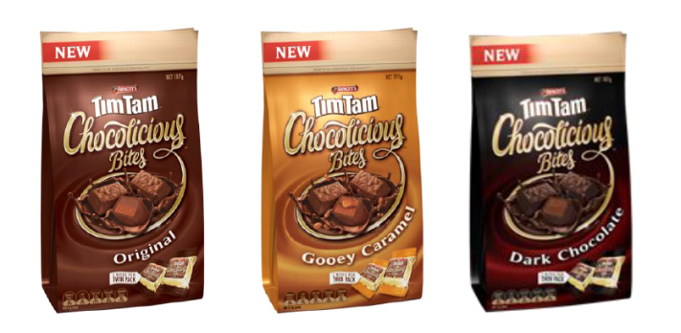
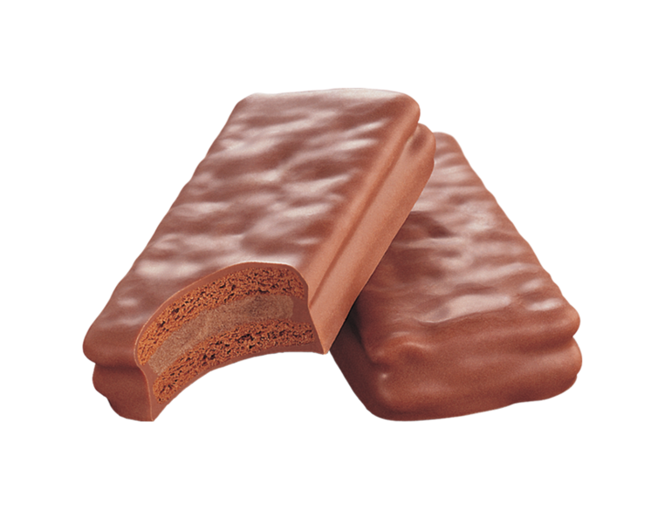
tim

Slide 3
tim
I’ll bet you’re thinking that “tim”, pronounced “tim” is the Indonesian name for “Tim Tam” biscuits, right?
Or perhaps you think it might be the Australian soccer great, Tim Cahill?
Sorry to disappoint you, but you are wrong in both instances!

Slide 4
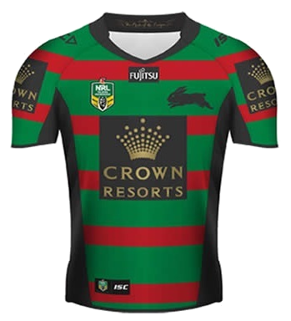
tim
The noun, “tim”, along with “regu”, pronounced “reh-goo”, both mean “team” in Indonesian.
What’s your favourite “tim”? Mine is the South Sydney Rabbitohs.
Hopefully, in 2017,
they will again be
the “tim” to beat!

Slide 5
tim
As for Indonesia, they are a soccer-crazy nation with their favourite competition being the Liga Premier Inggris. Can you guess what the three most popular “tim” are amongst Indonesian fans?

