Slide 2
tanglung

Slide 3
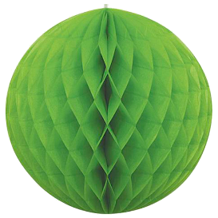
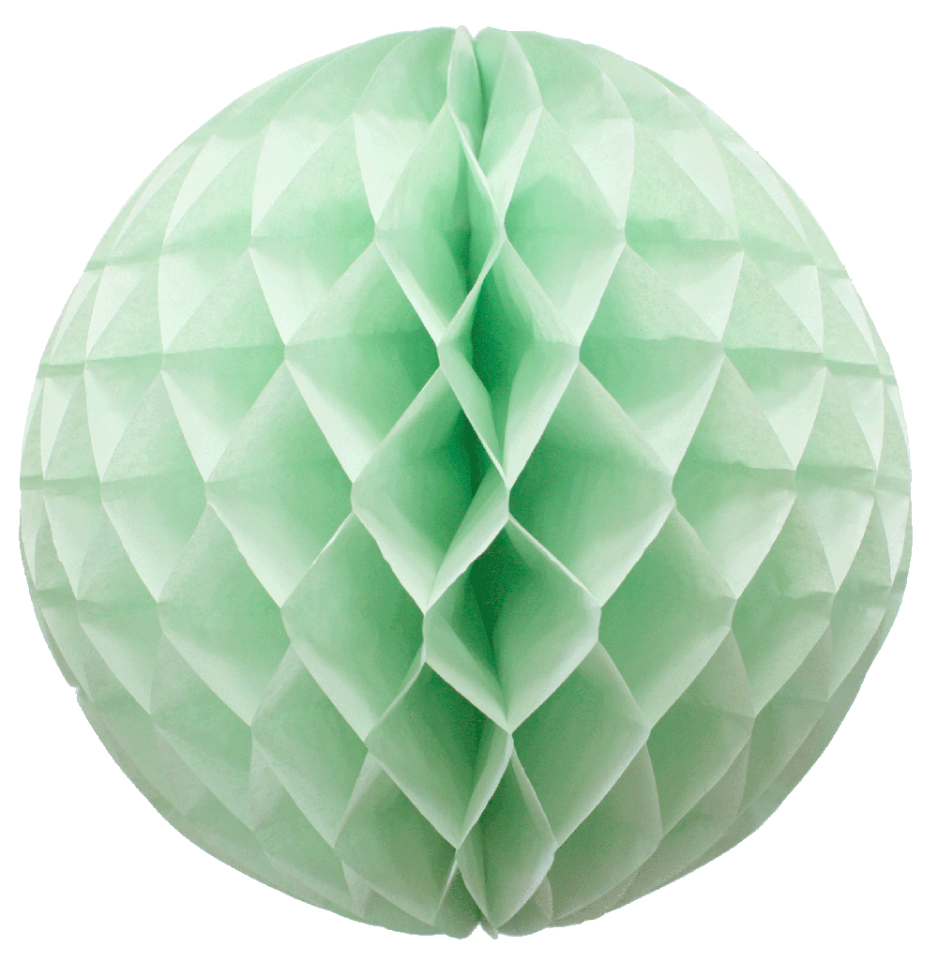
tanglung
You are probably thinking that “tanglung”, pronounced “tongue-loong” means “tongue” and “lungs” in Indonesian, right? This really doesn’t make much sense, does it?
I feel your confusion, so allow me to throw some light on the matter. The noun “tanglung” means “paper lantern” in Indonesian.

Slide 4
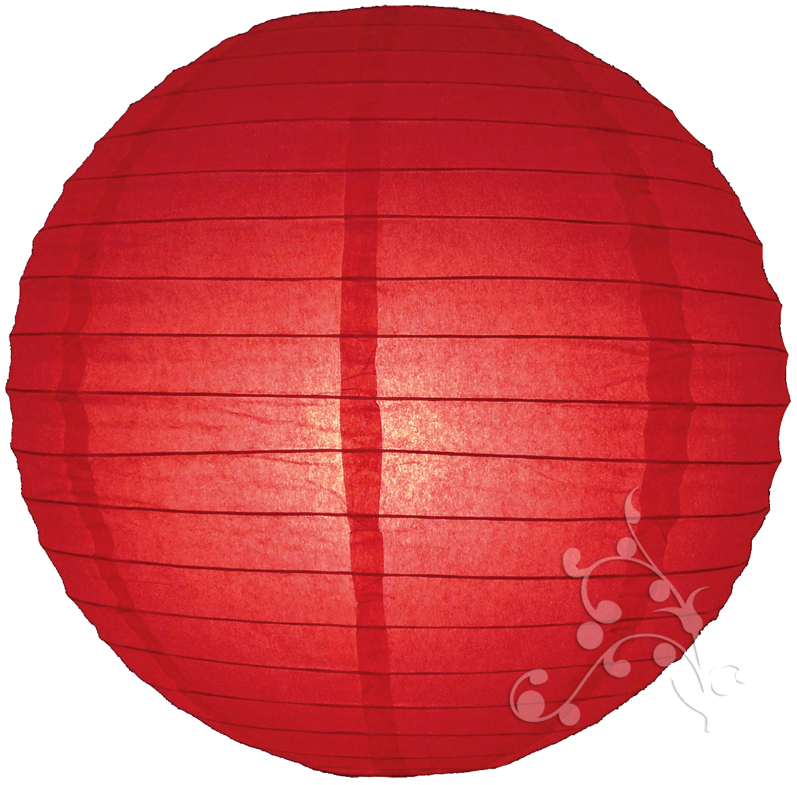
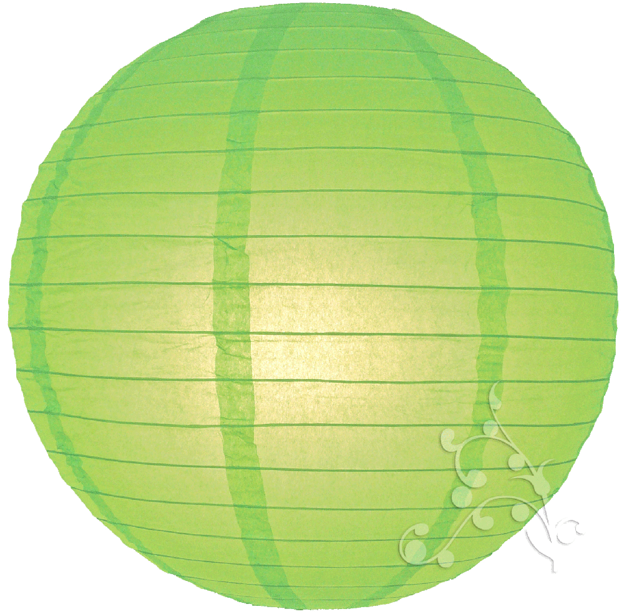
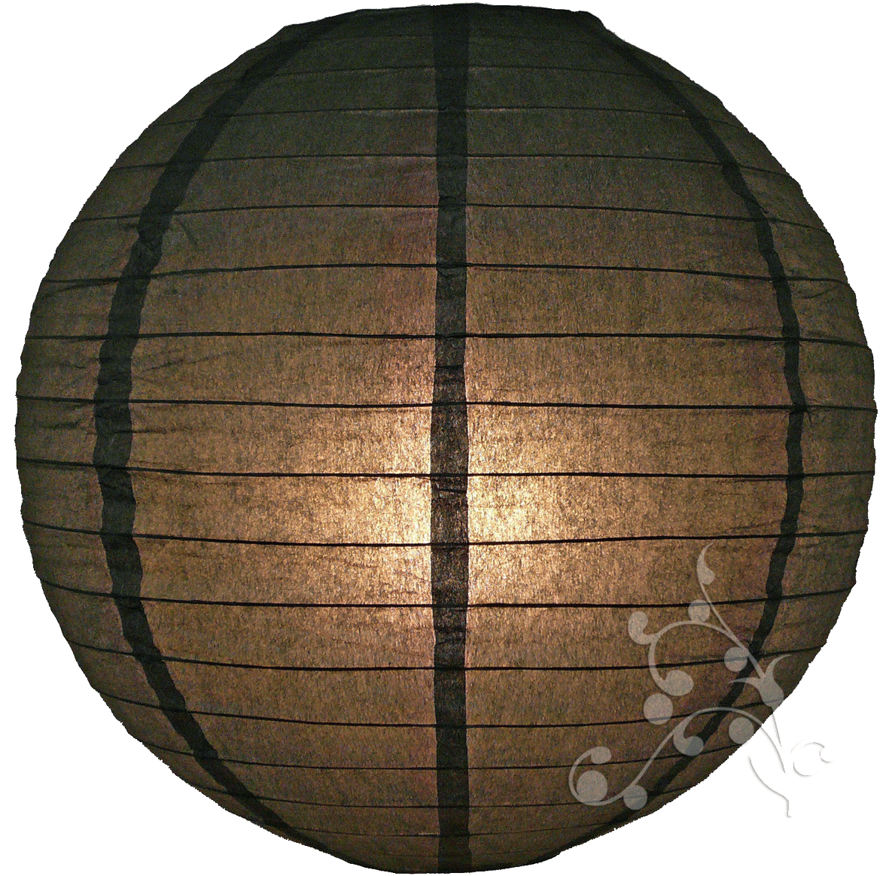
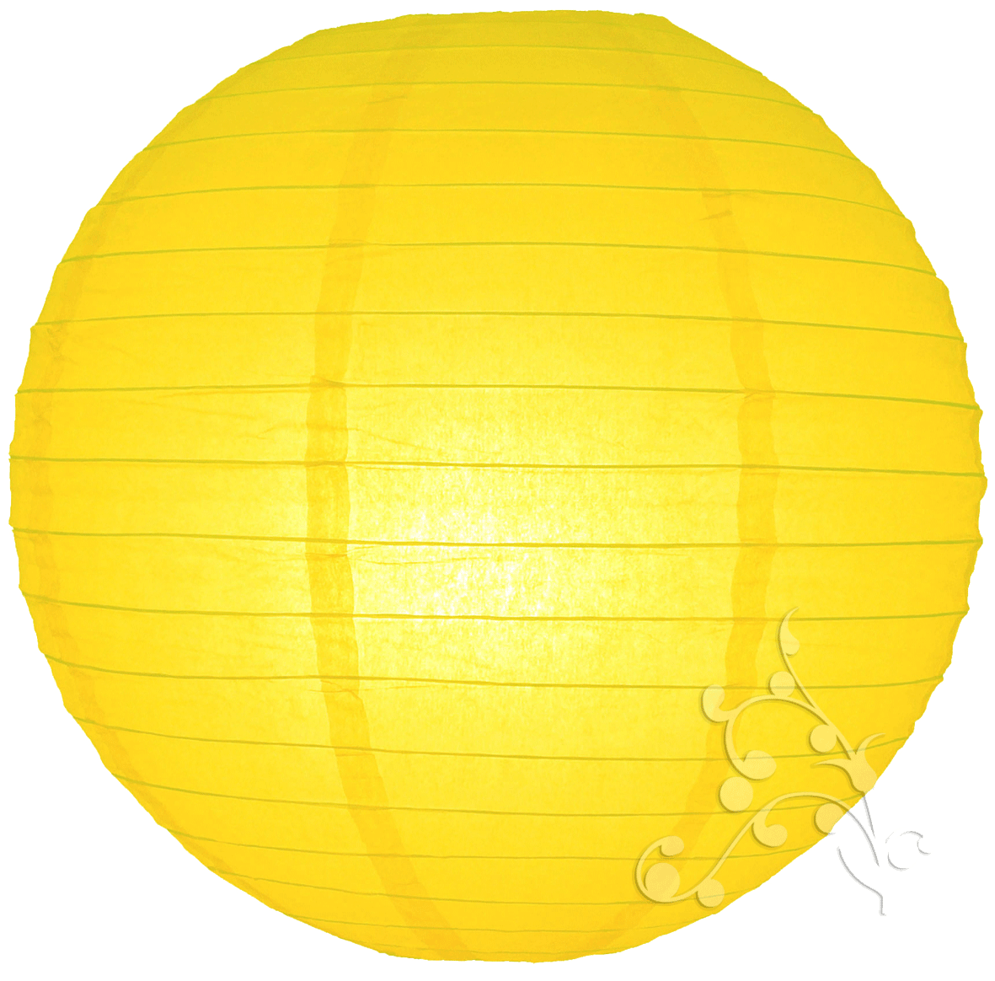
tanglung
Throughout Indonesia many “tanglung” start appearing during Chinese New Year celebrations along with other bright decorations and fireworks.

