Slide 2
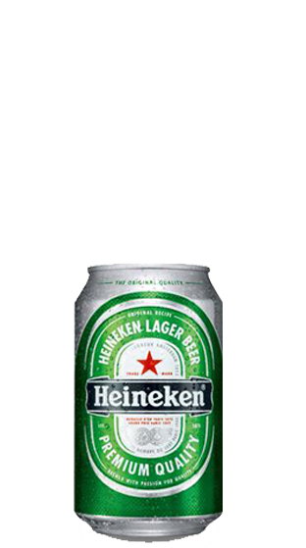
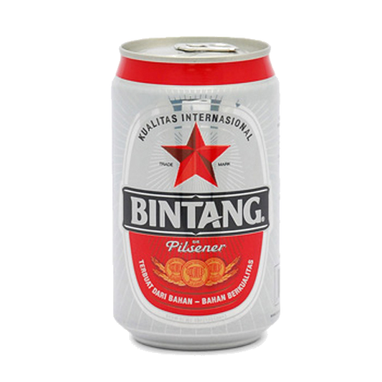
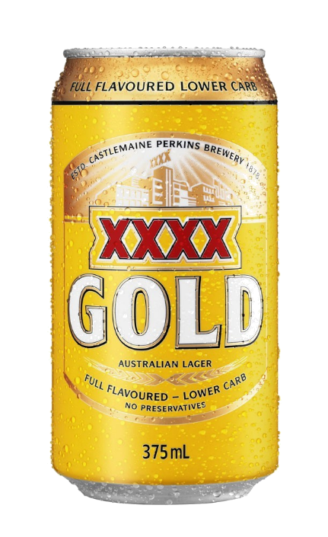
takbir

Slide 3
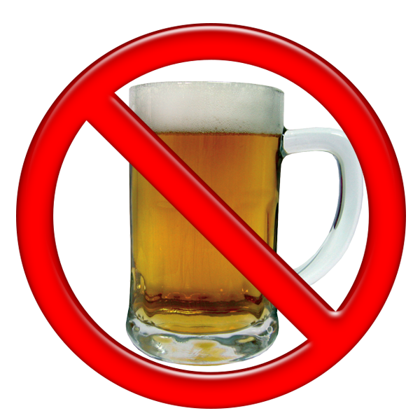
takbir
You may not know that “tak” is short for “tidak” which means “no” or “not” in Indonesian. To add to that, “bir” means “beer” in Indonesian.
Therefore, you could be excused for thinking that “takbir”, pronounced “tuck-beer”, means “no beer” in Indonesian.

Slide 4
takbir
The word “takbir” refers to the common Islamic-Arabic phrase “Allah Hu Akbar” which is an affirmation of the “Greatness of God”.

Slide 5
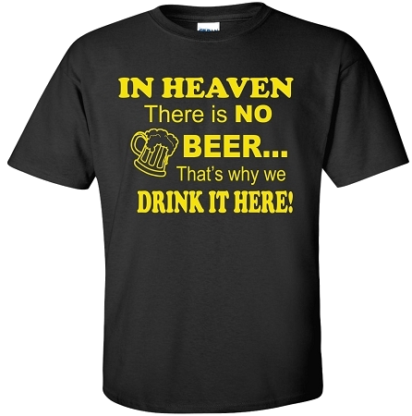
takbir
As Muslims are forbidden from drinking alcoholic beverages, the makers of “Bintang” beer in Indonesia have come up with a “zero” alcohol beer that is able to be consumed by the majority Muslim population.

Slide 6
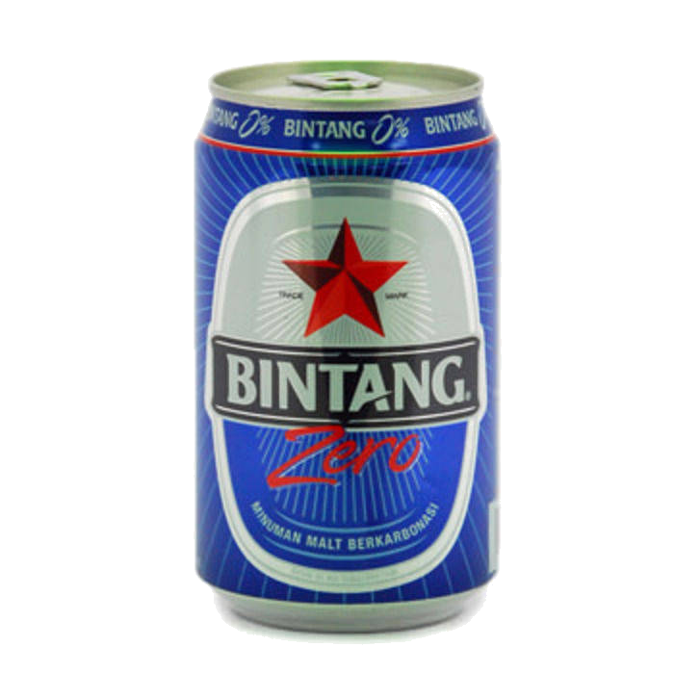
takbir
Allow me to introduce you to “Bintang Zero” , which is marketed as a carbonated “malt” beverage.
Personally, I would rather drink a “malted” milkshake given this choice!

