Slide 2
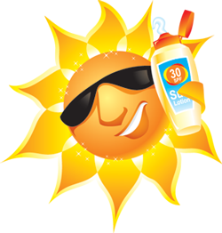
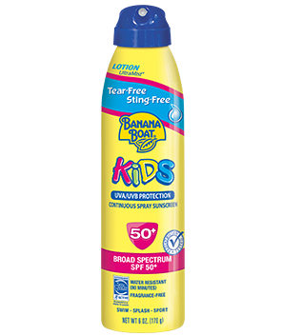
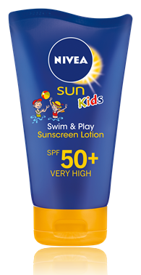
suntik

Slide 3
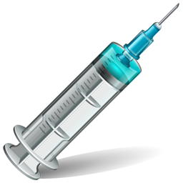
suntik
You are probably thinking that “suntik”, pronounced “soohn-tik”, is the Indonesian word for “sun safe”, products, right?
Sorry, but no “tick” ( ) of approval for you this time because the verb “suntik” means “to inject” in Indonesian.

Slide 4
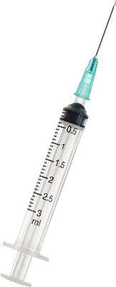
suntik
If you don’t play it sun safe there’s a big possibility in your adult years that your doctor will need to “suntik” you prior to removing cancerous cells from your skin!

