Slide 2
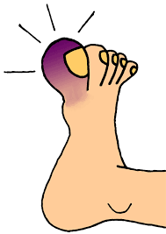
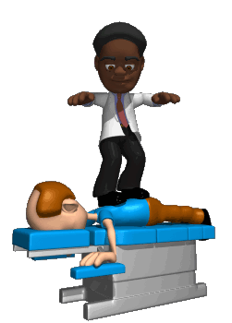
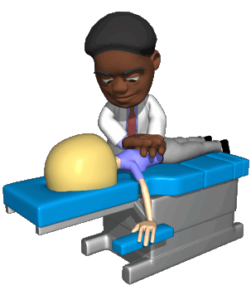
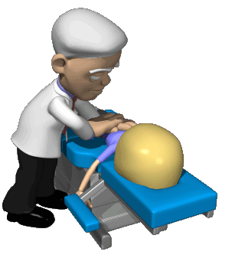
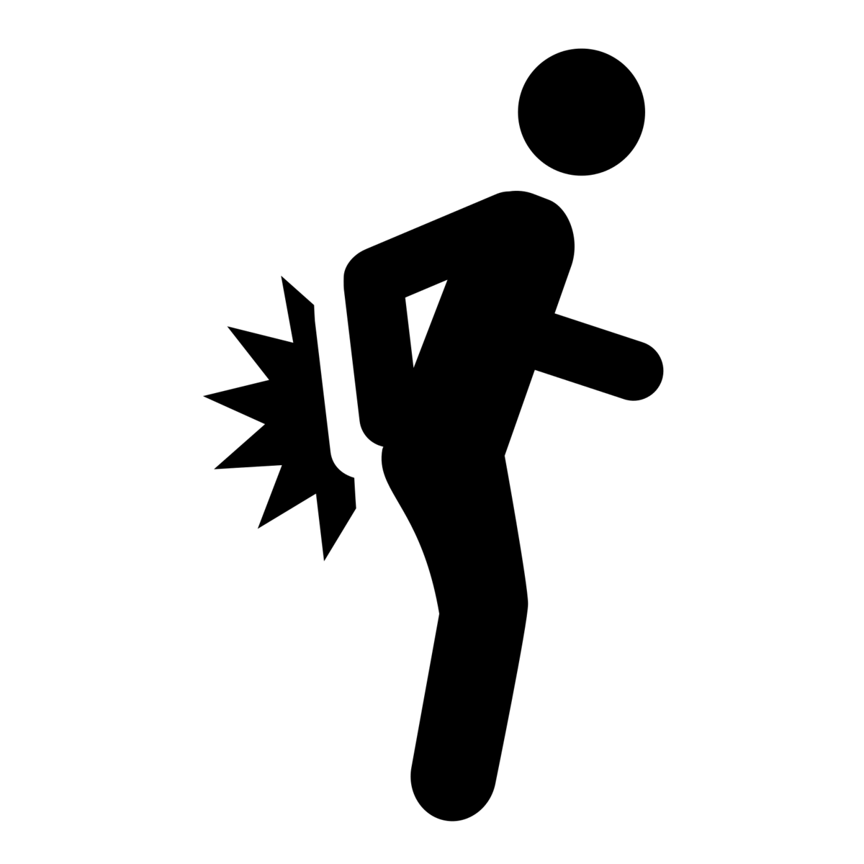
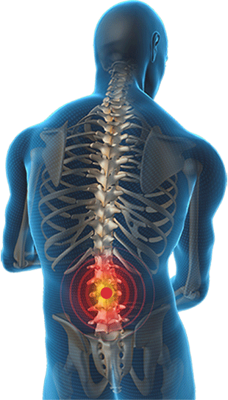
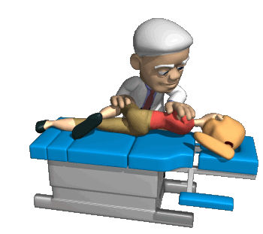
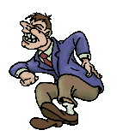
sore

Slide 3
sore
You are probably thinking that “sore”, pronounced “sore-ray”, is the Indonesian word for “sore” or “soreness”, right ?
Please don’t be “sore” with me, because I am very “sorry” to inform you that the noun “sore” means “afternoon” in Indonesian. In fact, to be precise, it is the period of the day between 3:00p.m. until sunset.

Slide 4
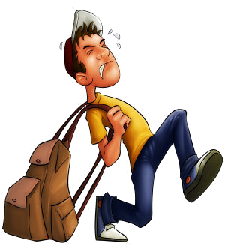
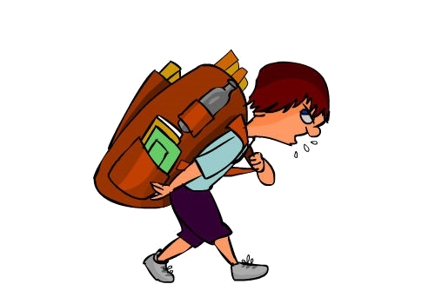
sore
I’ll bet that you’re not “sorry” when “sore”, comes along and you can go home from school ! The person who said, “It’s better to be safe than sore,” seriously needs to rethink his philosophy!

