Slide 2
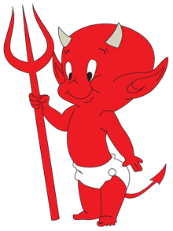
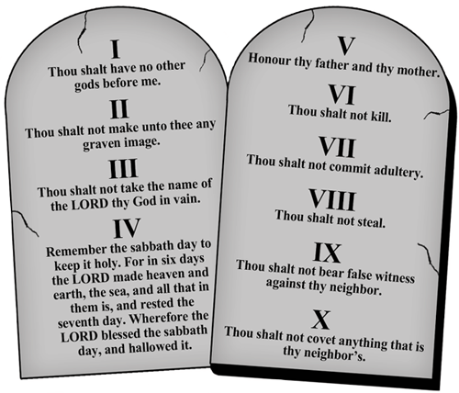
sinar

Slide 3
sinar
You probably think that “sinar”, pronounced “sin-are”, is the Indonesian word for “sinner” , right?
Sorry to add to your sins, but “Thou art wrong” yet again!
The word “sinar” means “ray” in Indonesian as in the “rays” of the sun or “sinar matahari”.

Slide 4
sinar
If you are a “sinar”, you can redeem yourself by religiously studying your Word of the Day. Doing this will provide you with a “ray” of hope !

