Slide 2
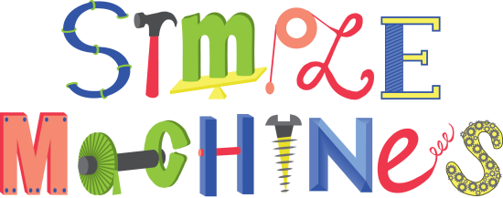
simpul

Slide 3
simpul
You must surely be thinking that “simpul”, pronounced “sim-pull” means “simple” in Indonesian, right?
Sorry to disappoint you, but you’ve made a “simple” mistake!
The noun “simpul” actually means “knot” in Indonesian.
Now that’s “knot” too “simpul” for you, is it?

Slide 4
simpul
If the Word of the Day is “knot” for you, you must be a very “simpul”, person!

