Slide 2
setor

Slide 3
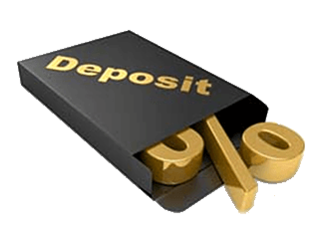
setor
You are probably thinking that “setor”, pronounced “seh-tore”, is the Indonesian word for “department store”, right?
Before you dash off to spend your hard-earned money, I need to inform you that the verb “setor” means to “deposit” money in Indonesian.

Slide 4
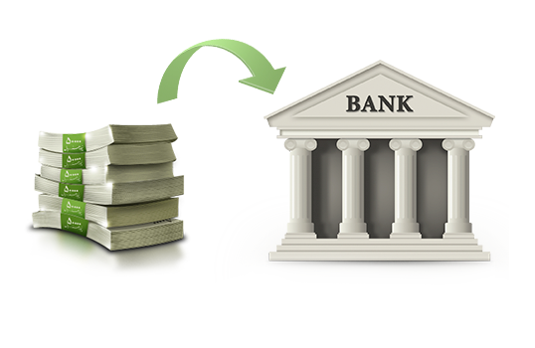
setor
Wouldn’t it be better to“setor” your money in the bank and watch it grow rather than spending it at the “store” and watching it fly out the window?

