Slide 2
senter

Slide 3
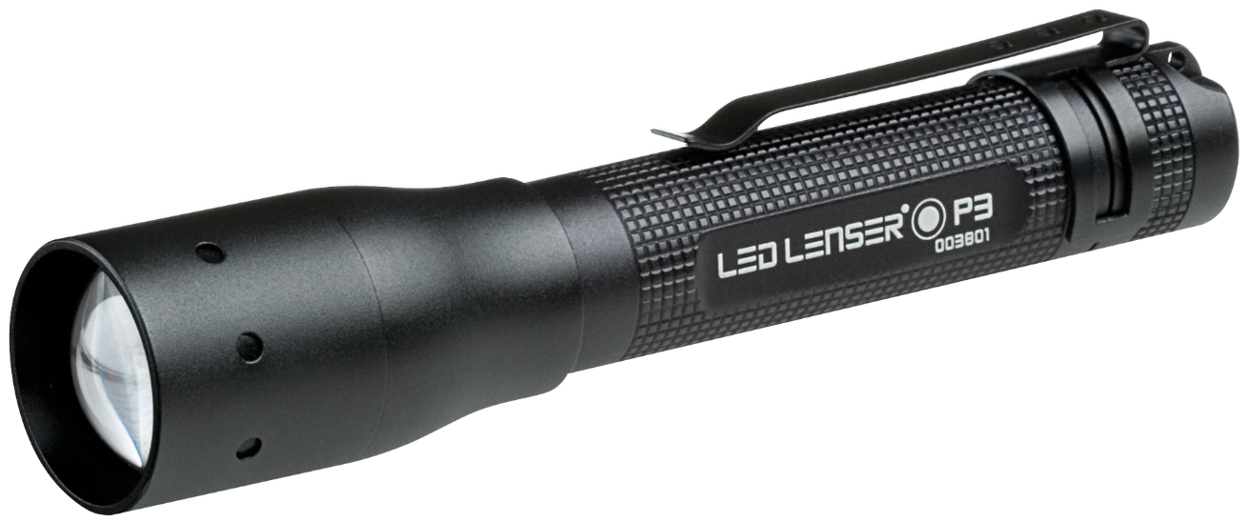
senter
You could be excused for thinking that “senter”, pronounced “sen-ter”, is the Indonesian word for “centre”.
Sorry to end that “flight of fancy” but the noun “senter” means “torch” in Indonesian.

Slide 4
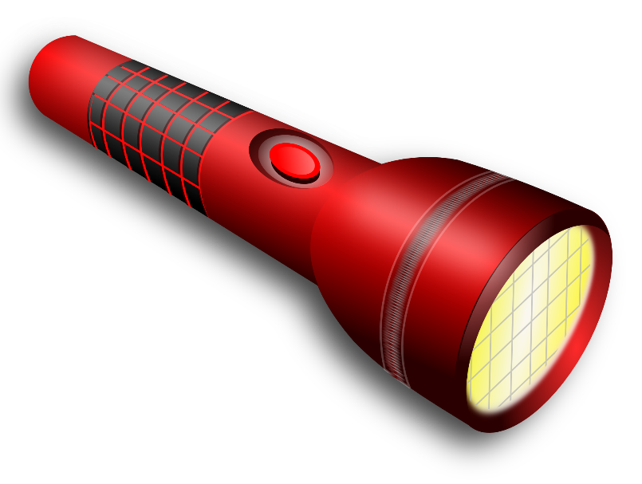
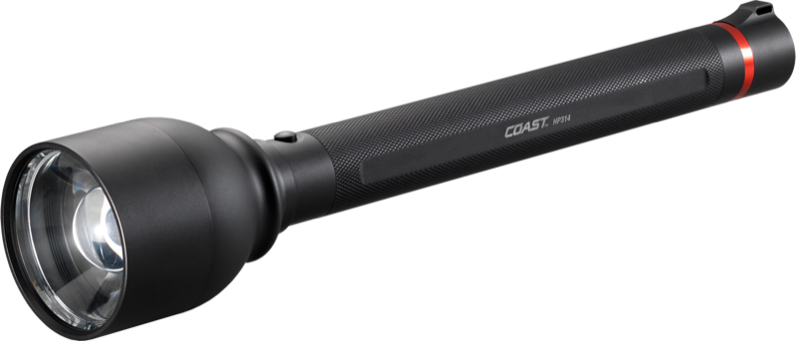
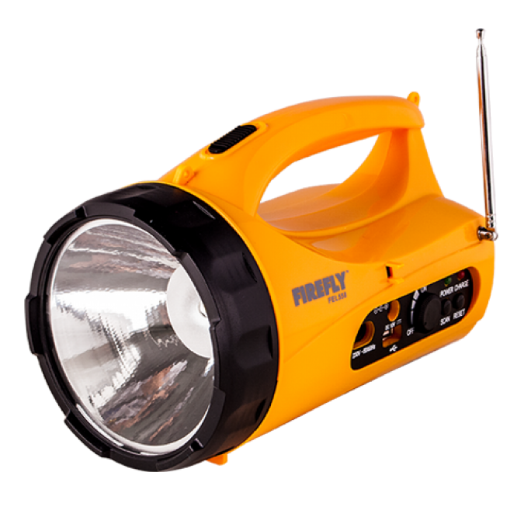
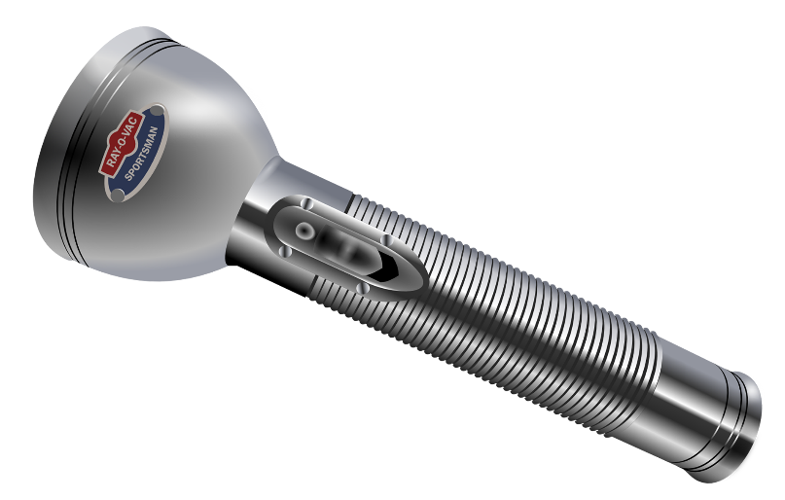
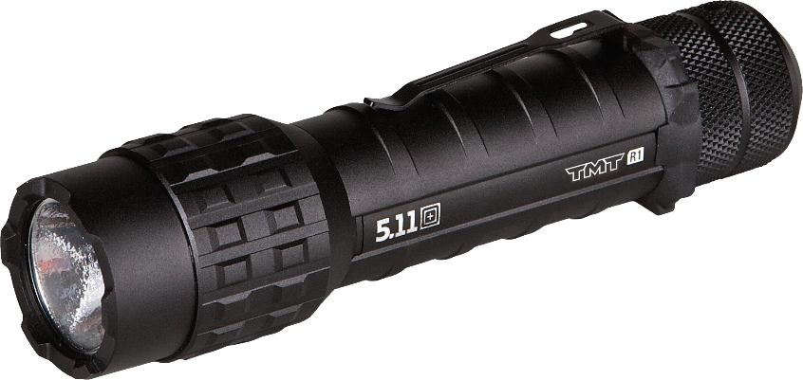
senter
If you succeed in your studies of Indonesian, it could light a shining path to many future career opportunities which could see you become the “senter” of attention amongst prospective employers.

