Slide 2
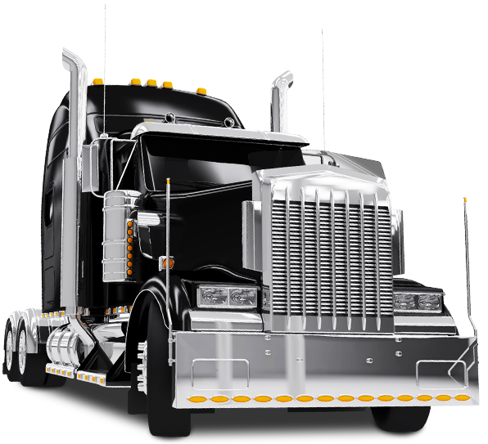
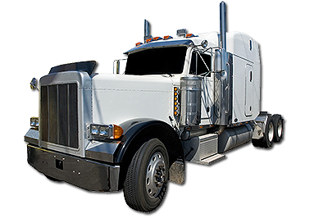
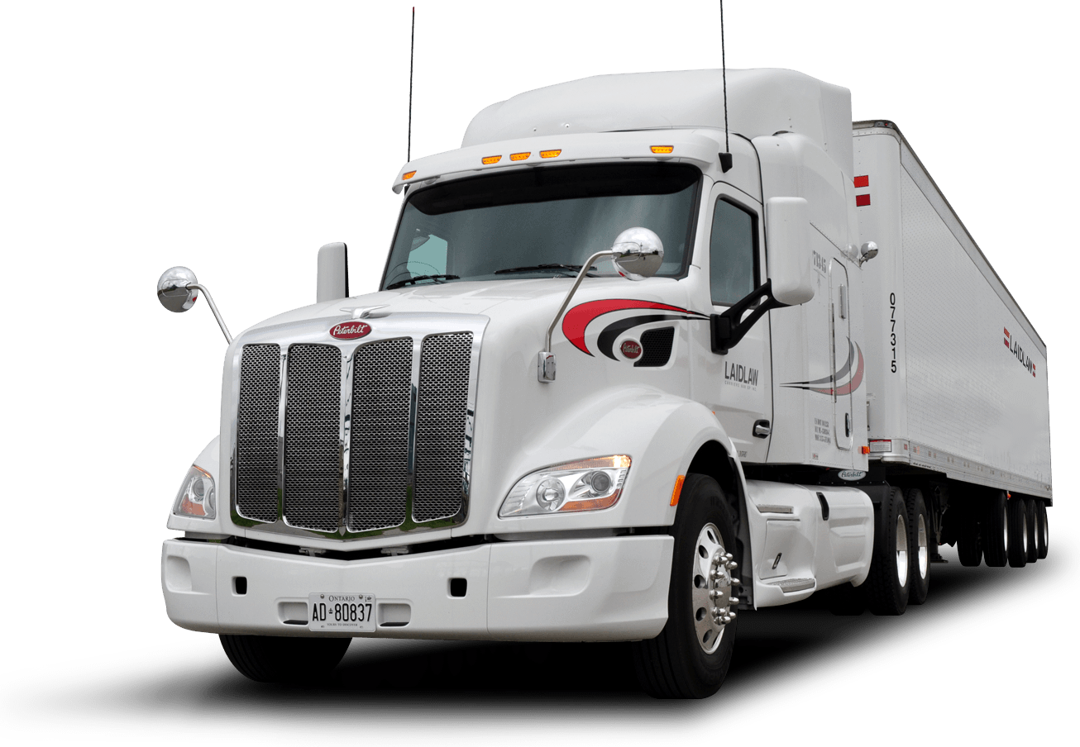
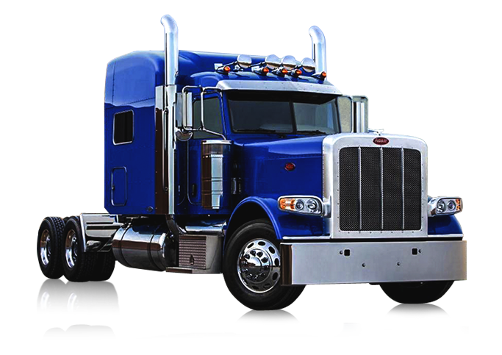
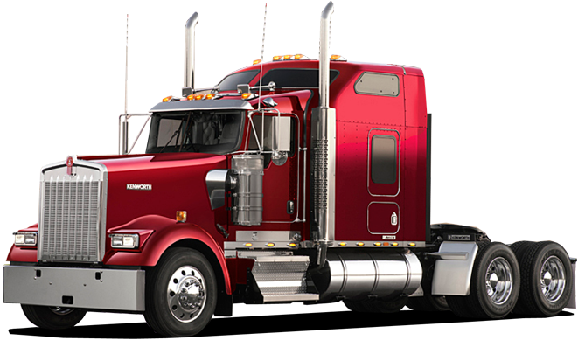
semi

Slide 3
semi
You are obviously thinking that “semi”, pronounced “seh-mih”, is the Indonesian word for “semi trailer”, right?
Sorry to let the air out of your tyres but you are not even “semi” correct!
The noun, “semi” means “autumn” in Indonesian!

Slide 4
semi
Autumn or “musim semi” is the season when trees start to shed their leaves or “daun”, pronounced “dah-oon”.
It is also the season when people tend to feel a little “daun”!

