Slide 2
selamat

Slide 3
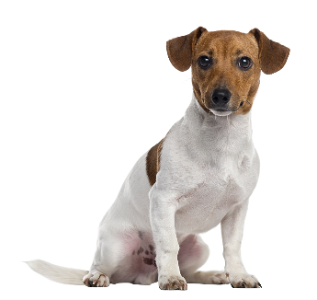
selamat
You are probably thinking that “selamat”, pronounced “sell-a-mut” means “to sell a dog” in Indonesian, right?
Sorry to “muzzle” that idea but “selamat” is the universal Indonesian greeting word that precedes all greetings or congratulatory comments in Indonesian. On its own, “selamat” means “congratulations”.

Slide 4
selamat
Let’s give “selamat” to the Word of the Day.

Slide 5
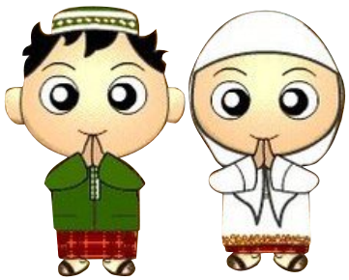
selamat
Each day it takes you on a magical carpet ride as you explore new and interesting Indonesian vocabulary.
Selamat belajar bahasa Indonesia!

