Slide 2
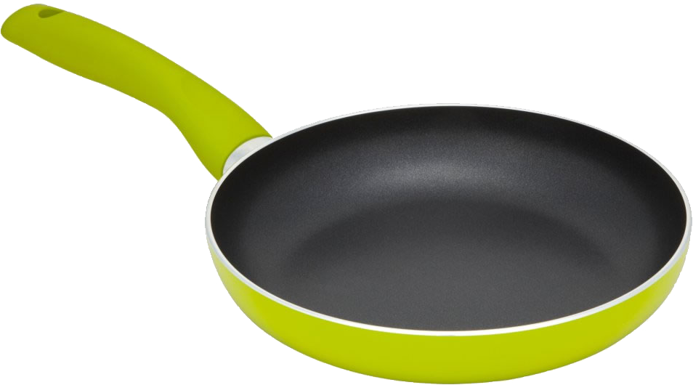
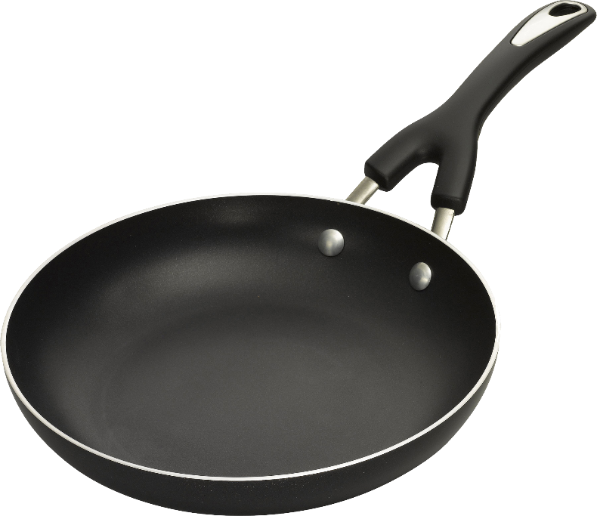
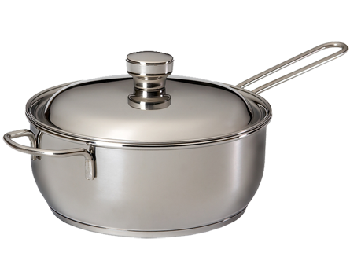
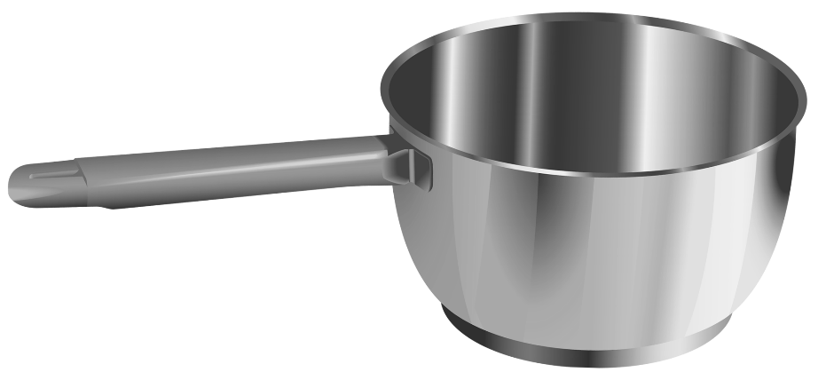
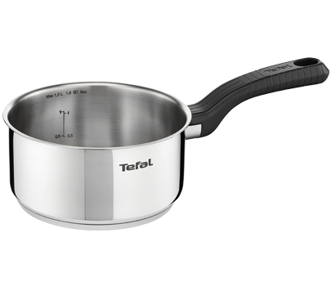
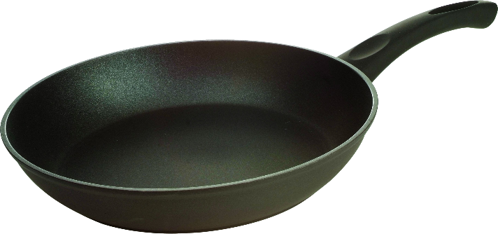
sampan

Slide 3
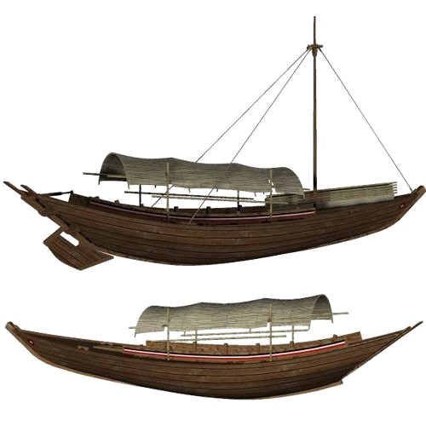
sampan
You must surely be thinking that “sampan”, pronounced “some-pun”, is the Indonesian word for “some pans”, right?
Sorry to “pan” that idea, but the noun “sampan” means a traditional wooden boat in Indonesian.

Slide 4
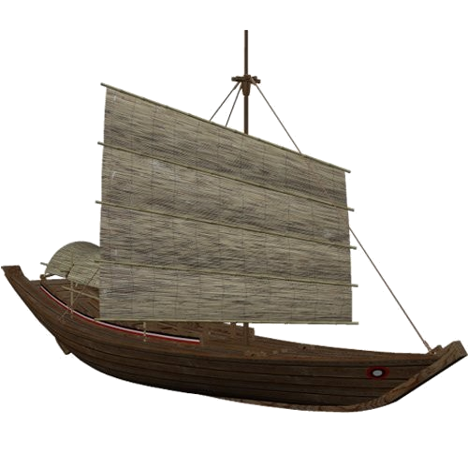
sampan
When sailing on a “sampan”, it would be wise to take “some-pans” along just in case the “sampan” starts to leak water.

