Slide 2
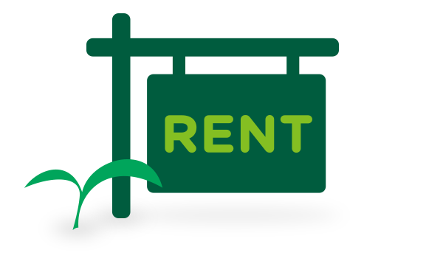
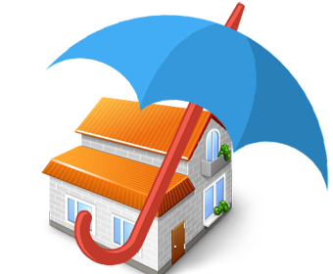
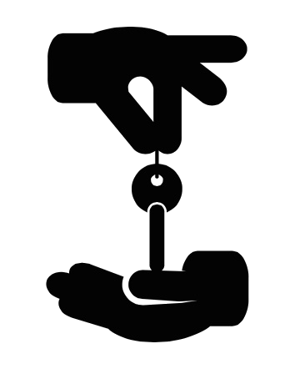
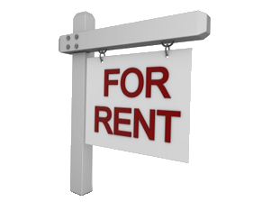
renta

Slide 3
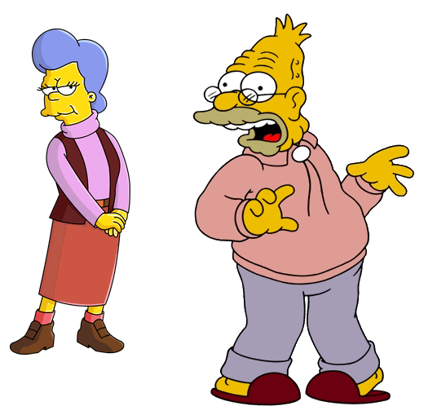
renta
You are probably thinking that “renta”, pronounced “ren-tah”, is the Indonesian word for “renter”, right? Well, if that’s the case, you’ve been “evicted” yet again!
The adjective “renta”, preceded by “tua”, is used to describe someone who is “very old”, “weak” or “frail” in Indonesian.

Slide 4
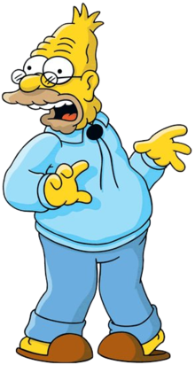
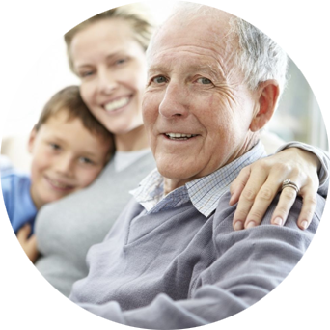
renta
In Indonesia, people who are “tua renta” are looked after by their own children or immediate family.
In Australia, however, people who are “tua renta” tend to “rent” a place in an Aged Care Facility and rely on their pension and assets to pay the “rent”.

