Slide 2
puing

Slide 3
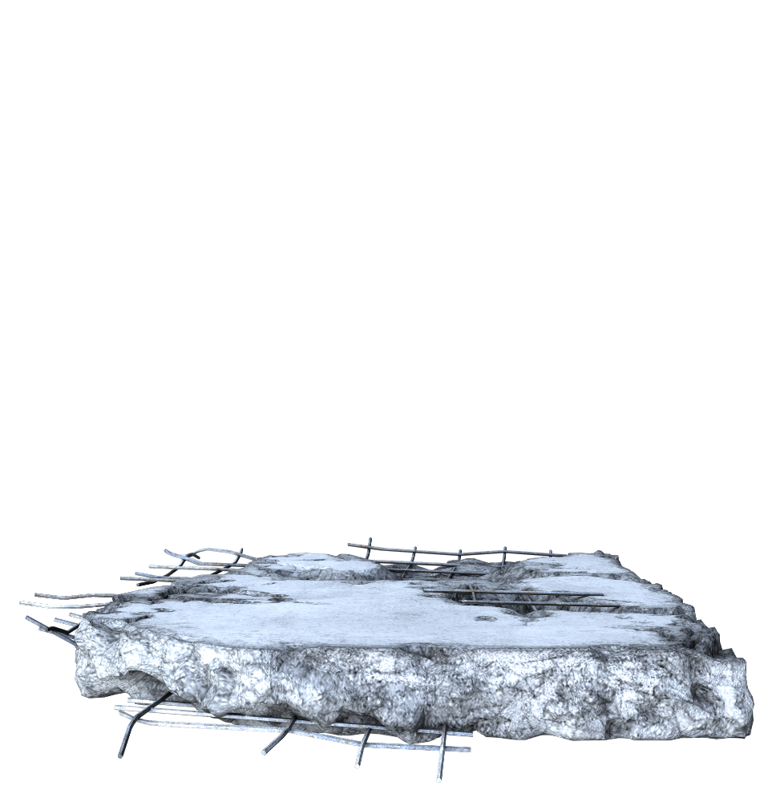
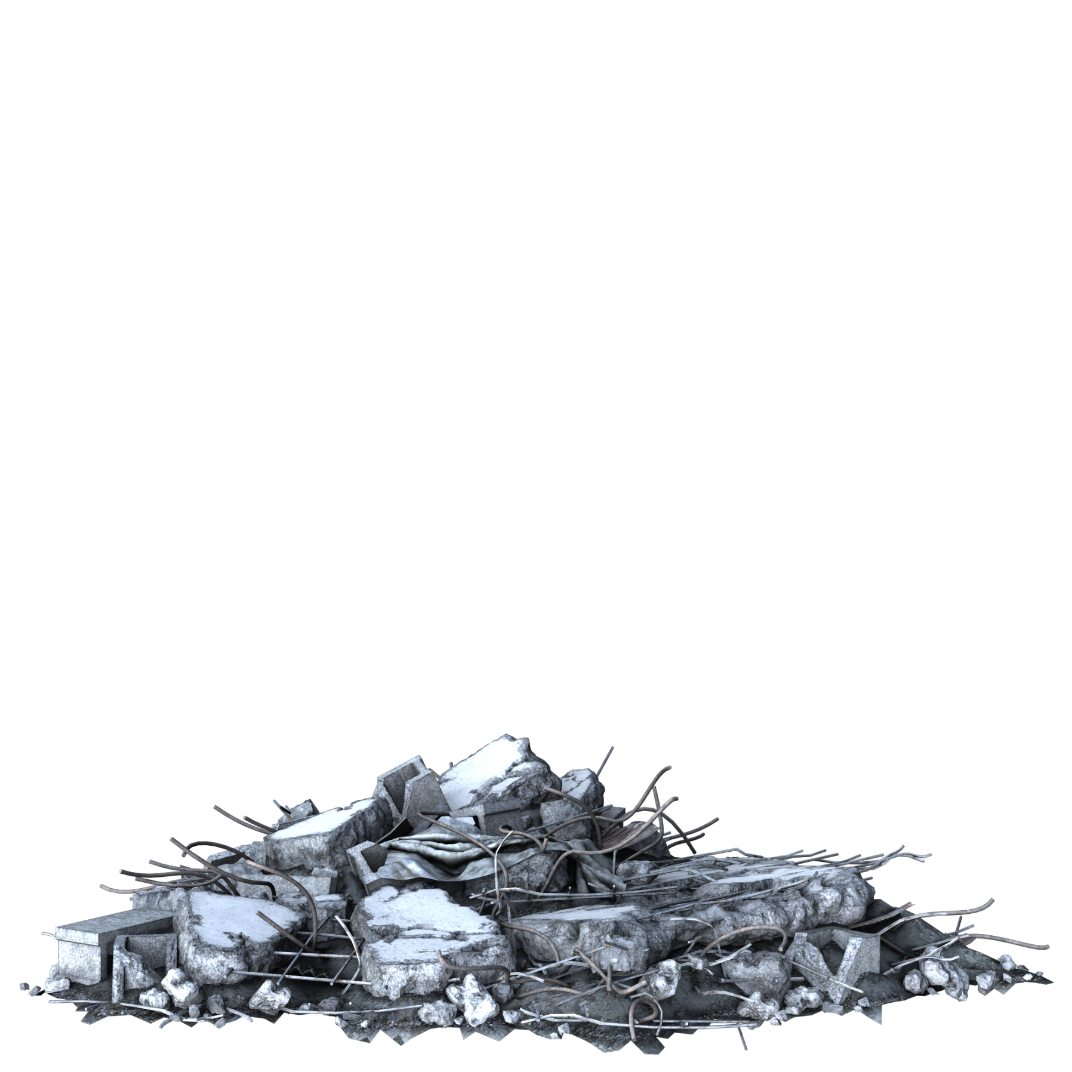
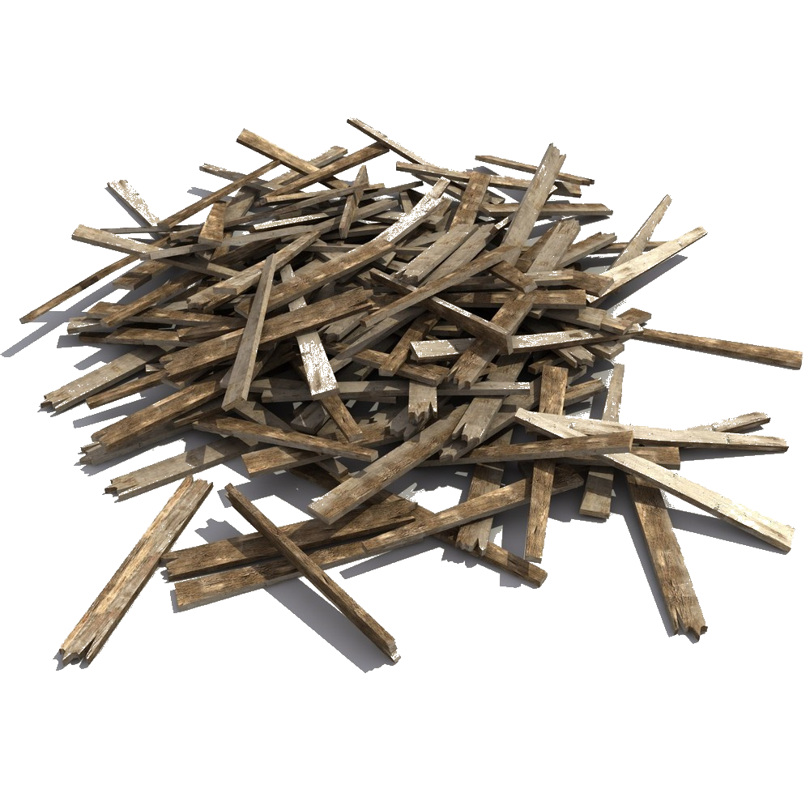
puing
You could be excused for thinking that “puing”, pronounced “puh-ing”, is the Indonesian word for “pooing”.
The noun “puing” means “debri” or “rubble” (resulting from a destructive force) in Indonesian.

Slide 4
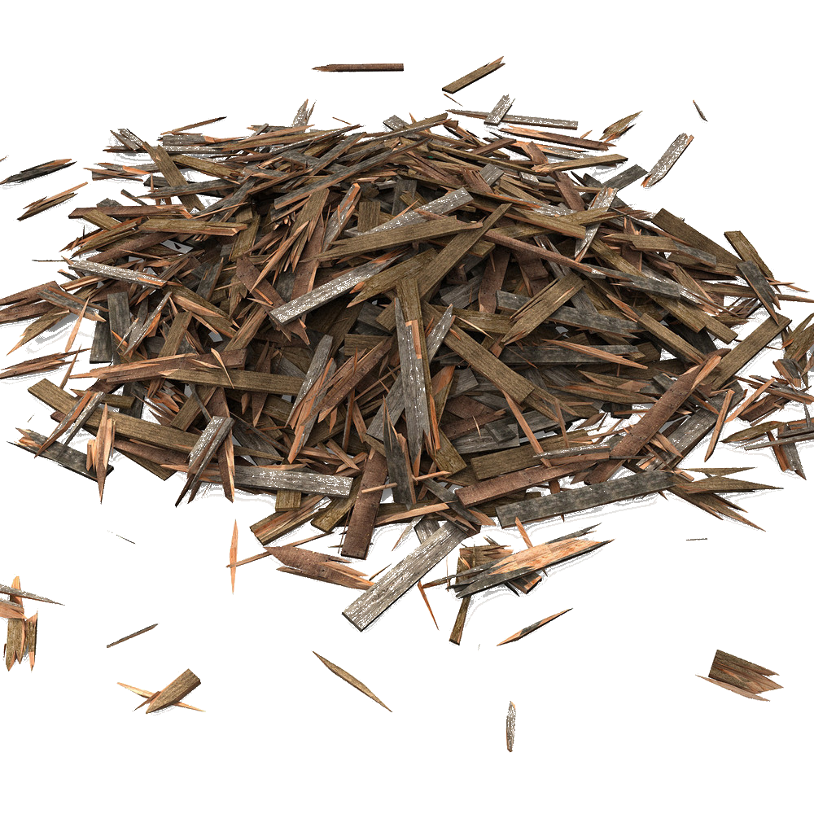
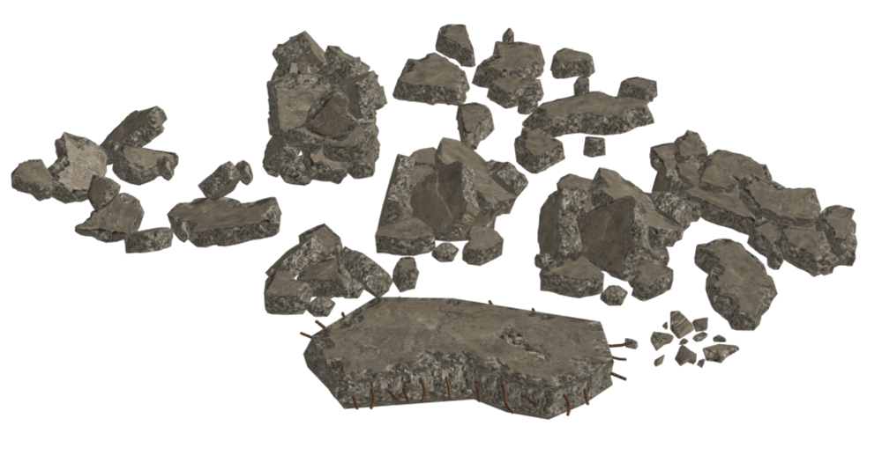
puing
Being home to over 100 active volcanoes, Indonesia experiences a massive clean-up of “puing” following frequent eruptions, earthquakes and tsunamis.

