Slide 2
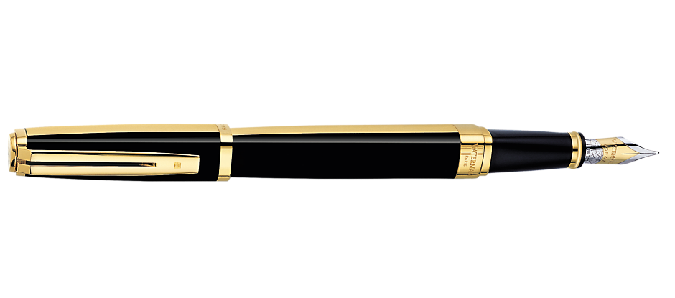
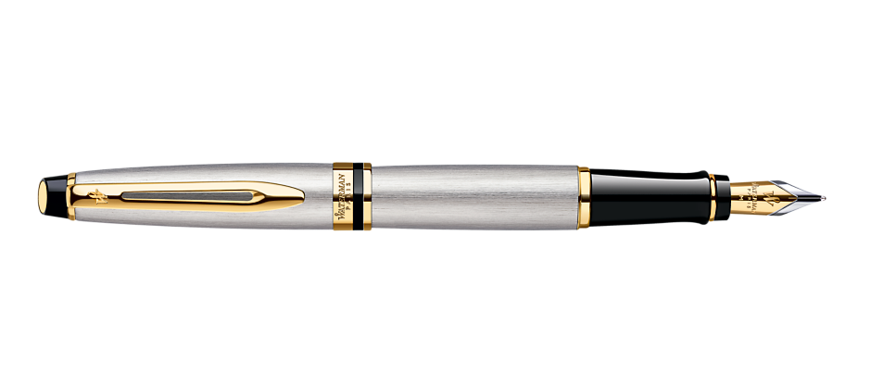
penyu

Slide 3
penyu
I am guessing that you think the Indonesian word “penyu” , pronounced “pen-you”, means “your pen” right? Don’t get me wrong, but you’re not “write” yet again!
Allow me “pen you” the correct response…
The noun “penyu” means “turtle” in Indonesian.
Now, now … there’s no need to go back into your shell. We all make mistakes sometimes!

Slide 4
penyu
When you go to your next class, tell your teacher that, “Mr Athans ‘tortoise’ about ‘turtles’ in Indonesian today.”

