Slide 2
pancing

Slide 3
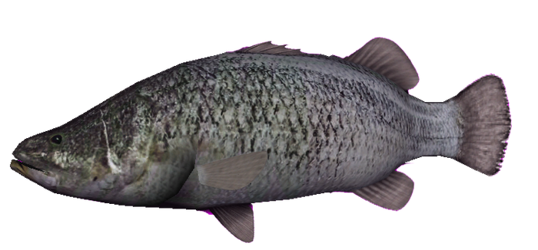
pancing
You could be excused for thinking that “pancing”, pronounced “punching”, is the Indonesian word for “punching”.
Sorry to land the “knockout” blow, but the verb “pancing” means “fishing” in Indonesian.
I’ve heard of the term “fighting fish”, but this is ridiculous!

Slide 4
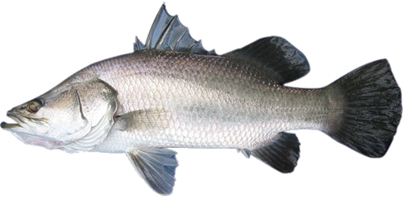
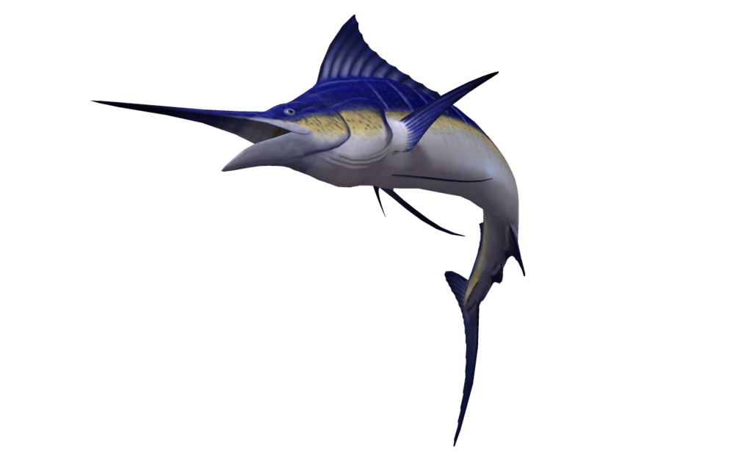
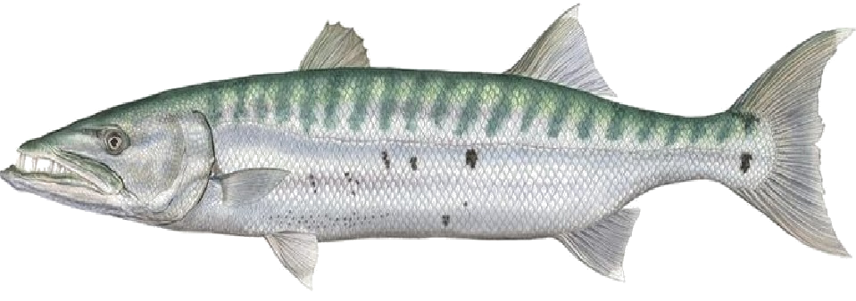
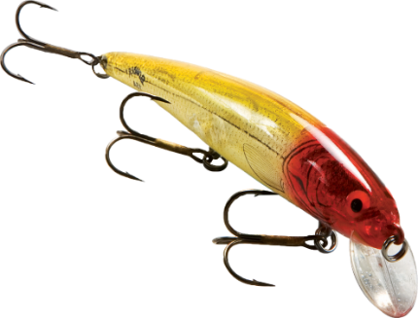
pancing
I don’t know about you, but when taking on “fighting fish” I prefer to use a good lure instead of boxing gloves. I find my “left hook” is more effective this way!

