Slide 2
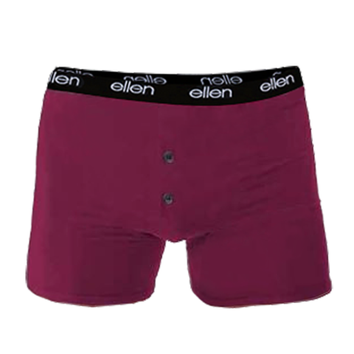
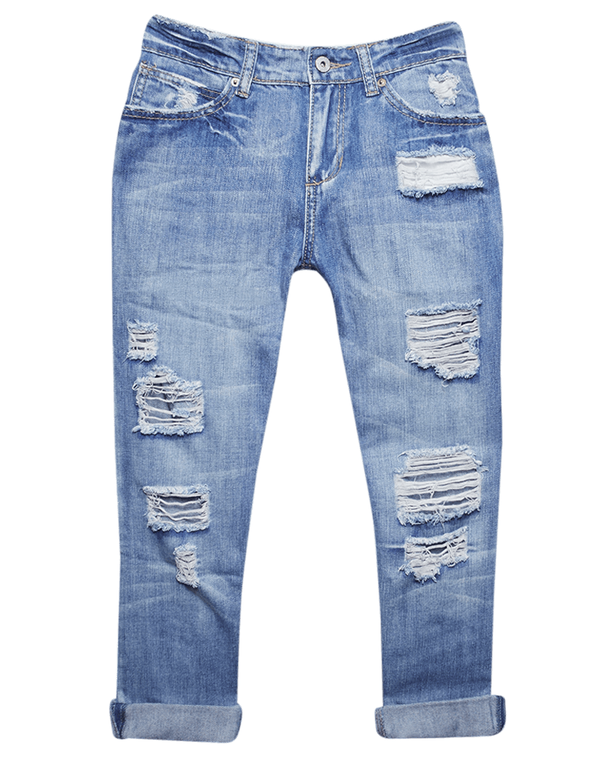
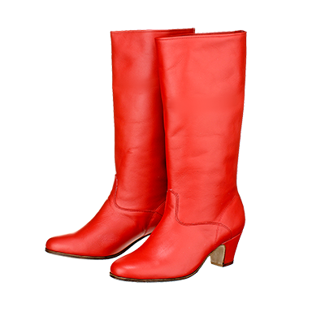
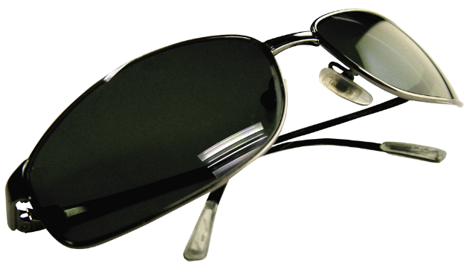
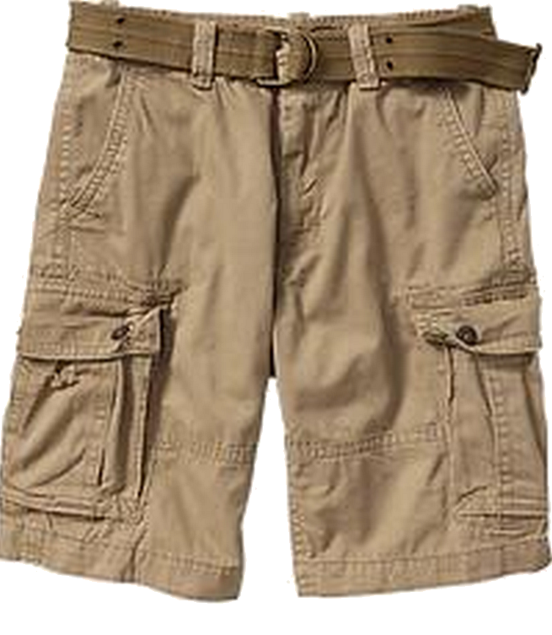
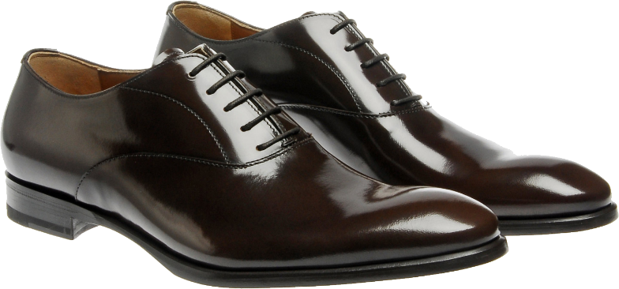
pair

Slide 3
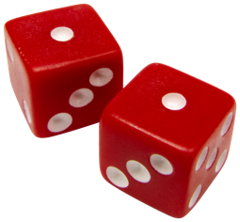
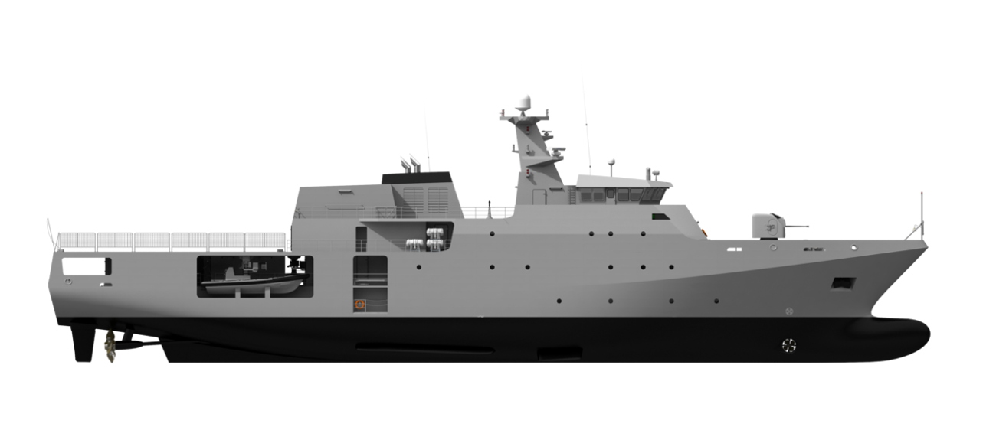
pair
You must be thinking that “pair”, pronounced “par-ear”, is definitely the Indonesian word for “pair”, right?
Sorry to let you down, but you’ve rolled snake-eyes yet again!
The noun “pair” , believe it or not, means “patrol boat” in Indonesian!

Slide 4
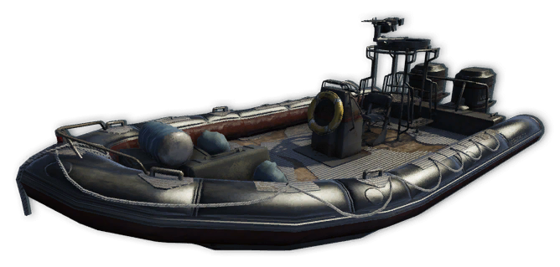
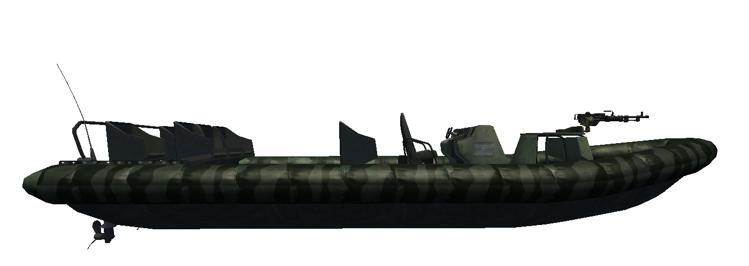
pair
If you’re ever on duty on an Indonesian “pair”, you better come prepared with a “pair” of everything!

