Slide 2
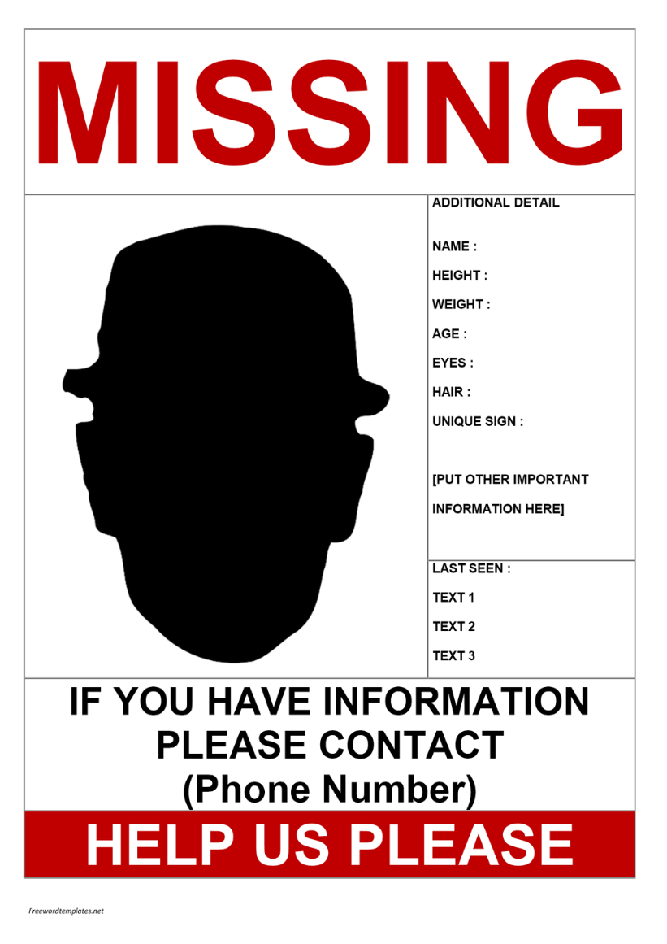
losmen

Slide 3
losmen
You are probably thinking that “losmen”, pronounced “loss-men”, is the Indonesian word for “missing person”, right?
If that’s the case, that’s another “loss” to you. The noun “losmen” is the Indonesian for a small, non star-rated hotel which offers only basic facilities.

Slide 4
losmen
These days it’s getting harder and harder to find “losmen”, because many are upgrading their facilities and rebranding themselves as budget hotels.
This is bringing about the “loss” of the “losmen” in Indonesia!

