Slide 2
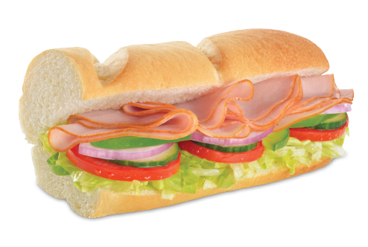
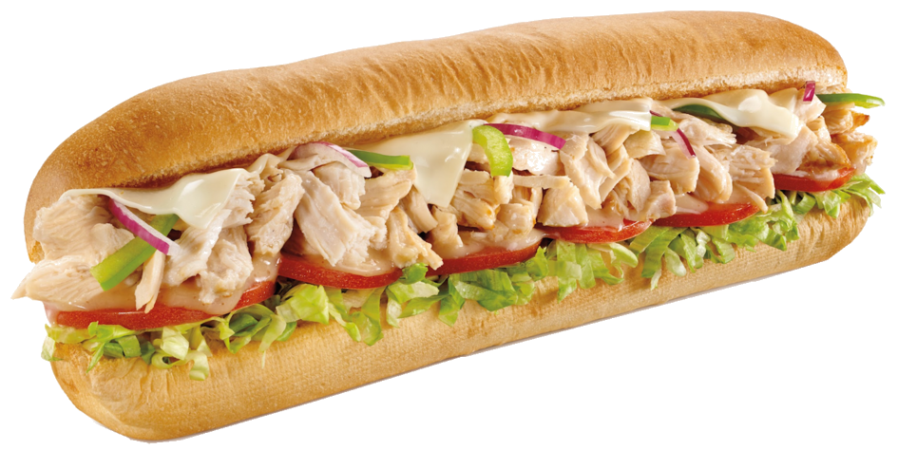
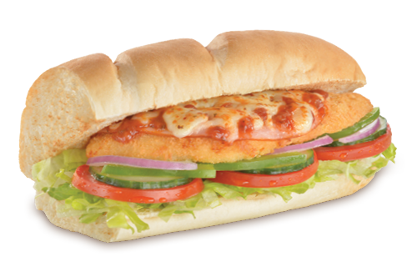
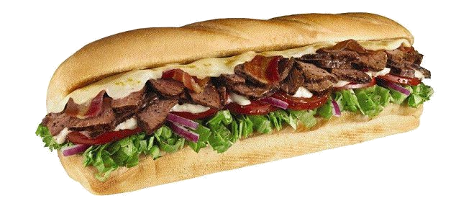
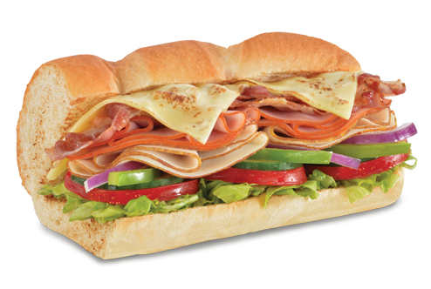
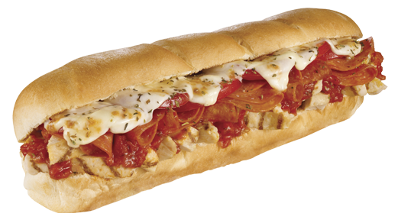
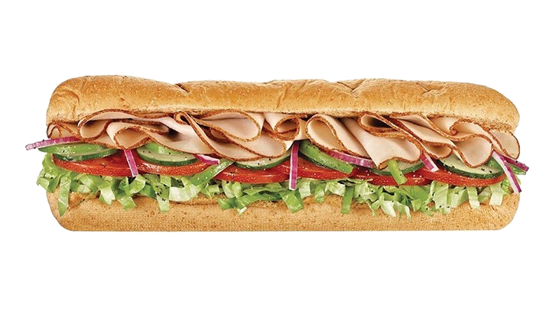
longgar

Slide 3
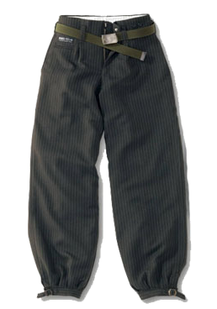
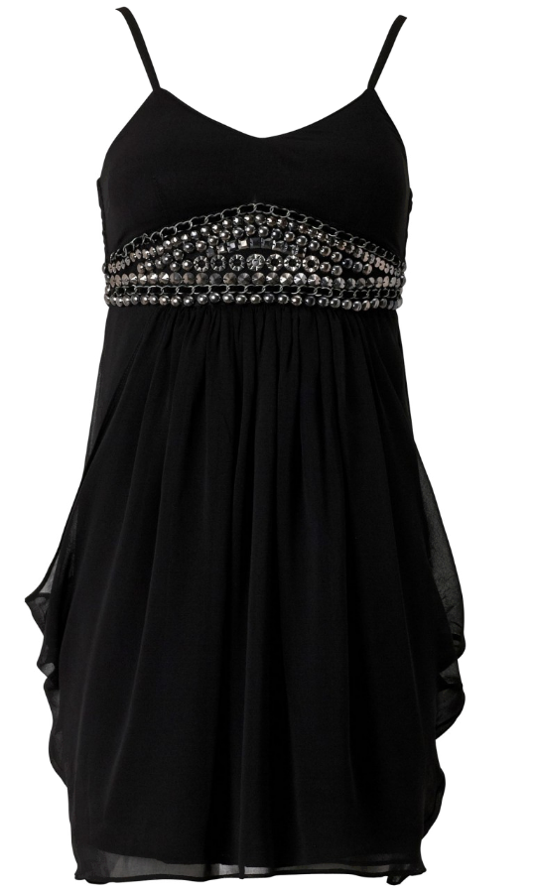
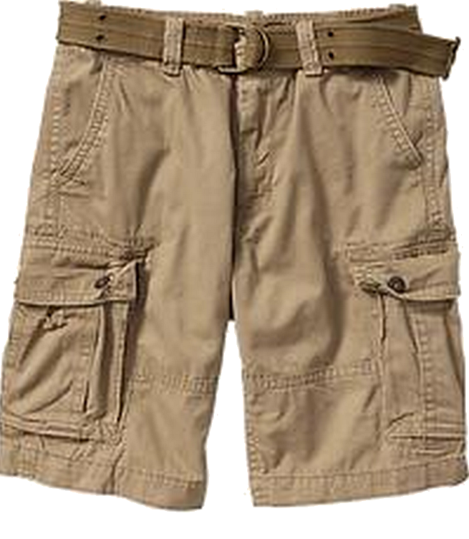
longgar
You are probably thinking that “longgar”, pronounced “long-gar”, is the Indonesian word for “longer”, right ?
Well, if you think that, the long and the short of it is that you are incorrect yet again!
The adjective “longgar” is used to describe clothing that is “baggy” or “loose-fitting”.

Slide 4
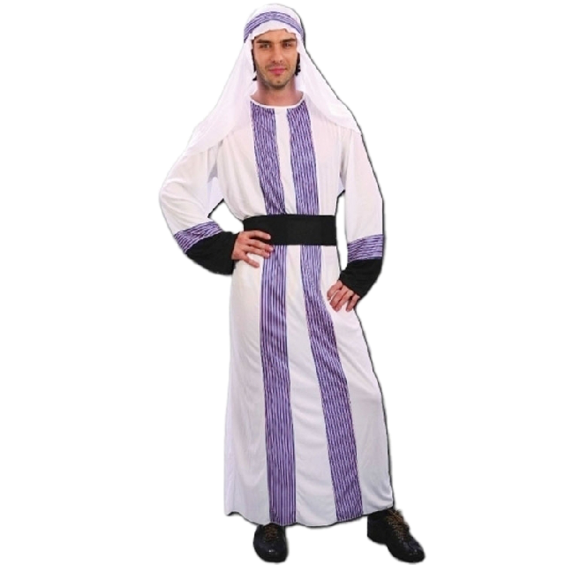
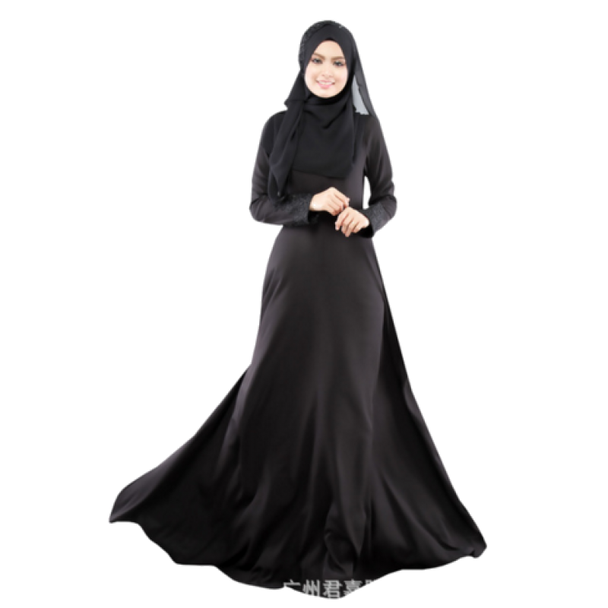
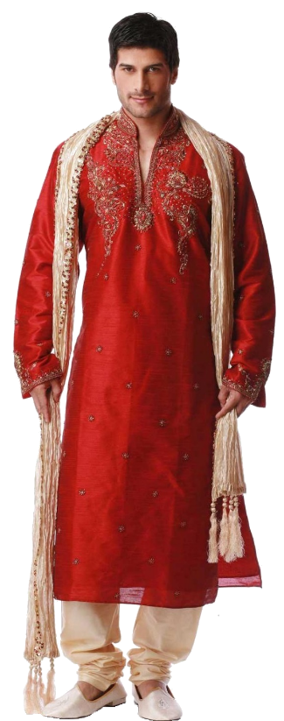
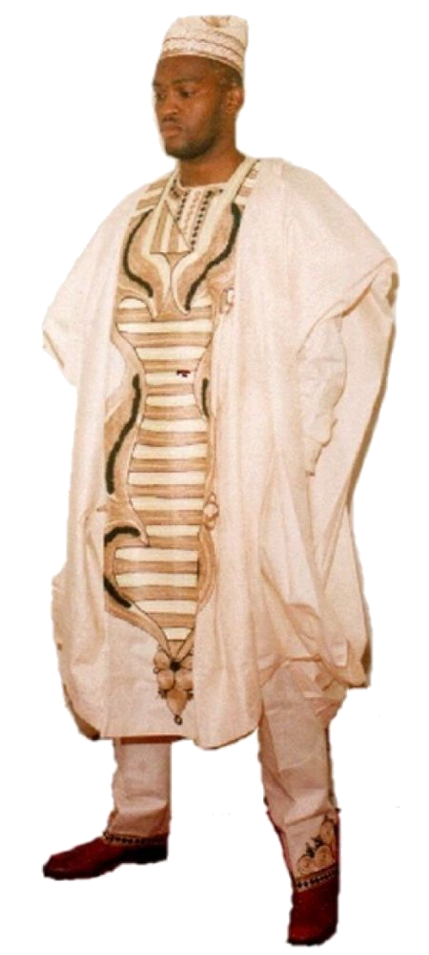
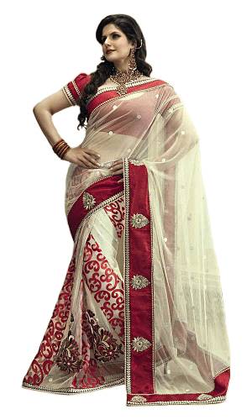
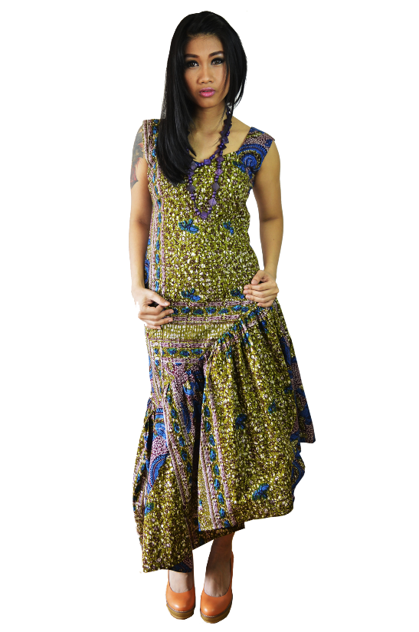
longgar
In many cultures around the world, loose-fitting clothing is the norm rather than the exception!
Just as western people like their Subway subs “longer”, many cultures prefer their clothing “longgar”!

Slide 5
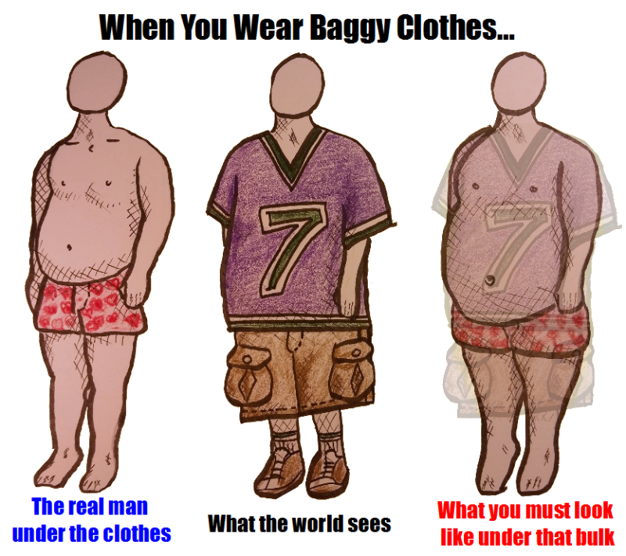
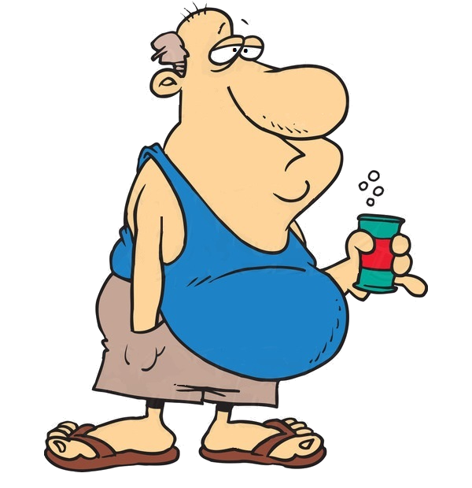
longgar
In western countries like Australia, there could be other factors influencing why our clothing is becoming “longgar” and “longgar”!
I don’t need no baggy clothes! I ain’t got nothin’
to hide!

