Slide 2
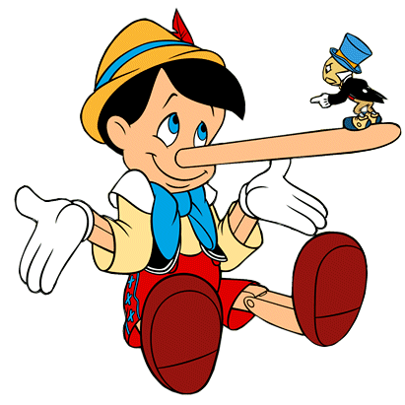
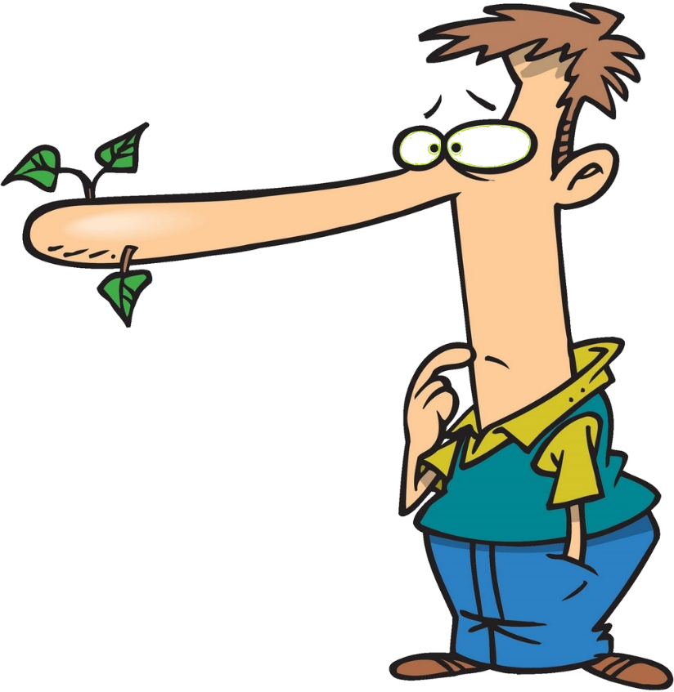
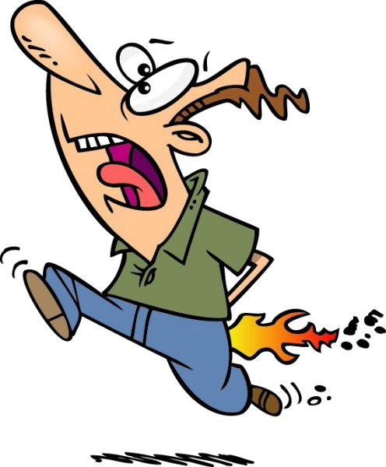
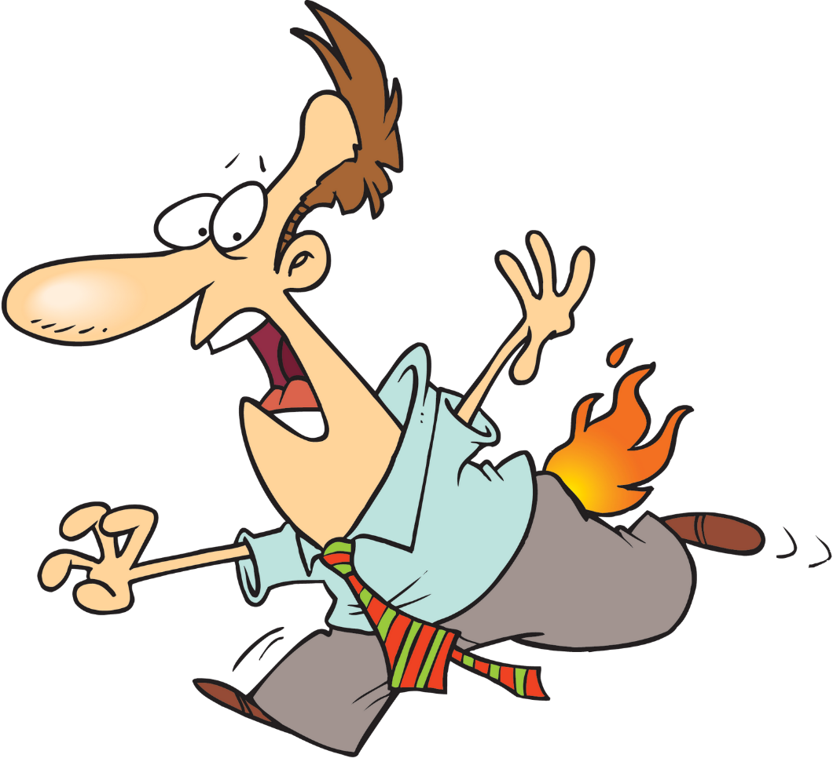
liar

Slide 3
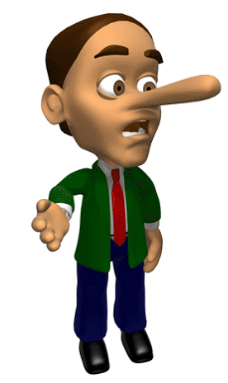
liar
You are probably thinking that “liar” , pronounced “lee-are”, means “liar” in Indonesian, right?
Well, let me tell you, nothing could be further from the truth!
As you can see, my nose hasn’t grown nor have my pants caught fire!

Slide 4
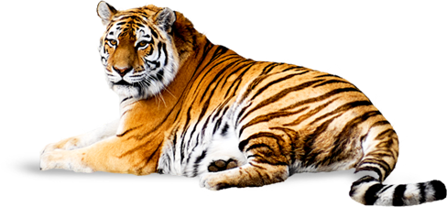
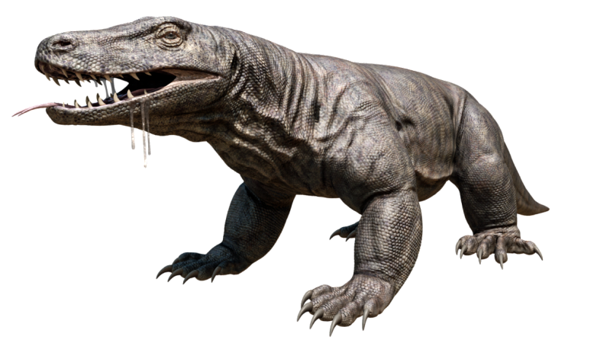
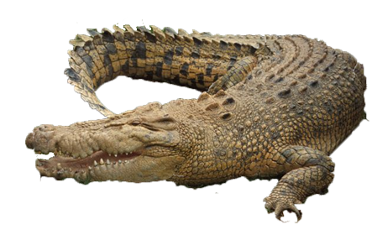
liar
The adjective “liar” means “wild” in Indonesian and can be used to describe both “wild” animals and badly-behaved humans.

Slide 5
liar
I hope you’re neither “liar” nor a “liar”.
One way or another, you’ll eventually be found out!

