Slide 2
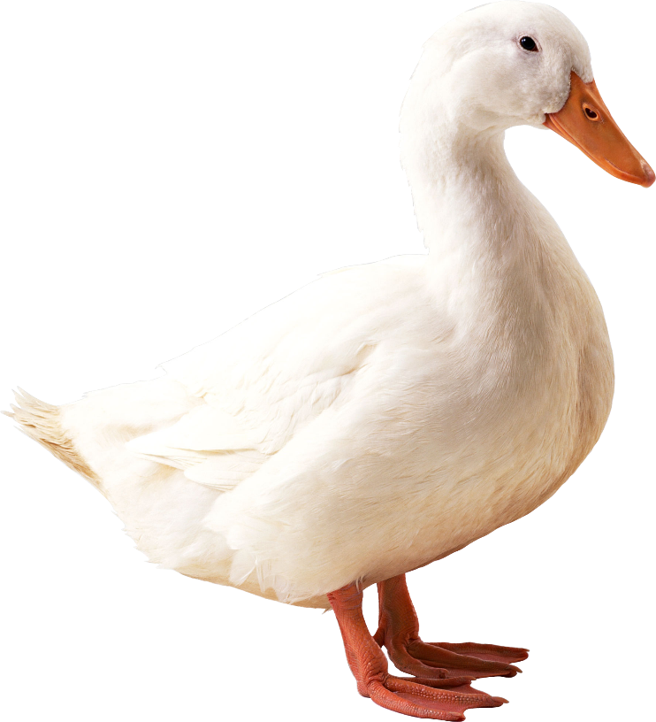
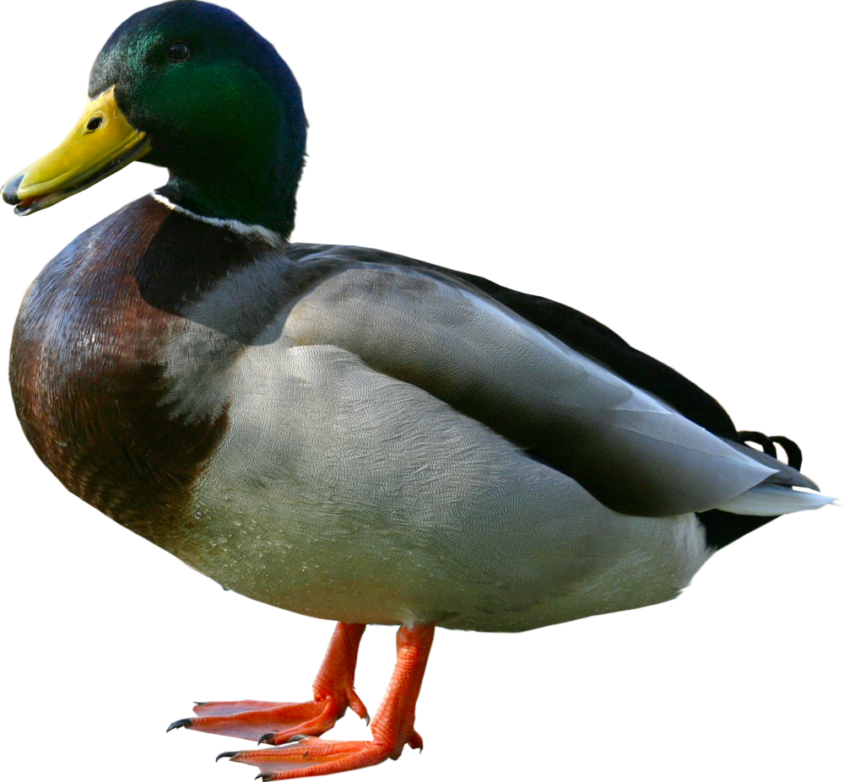
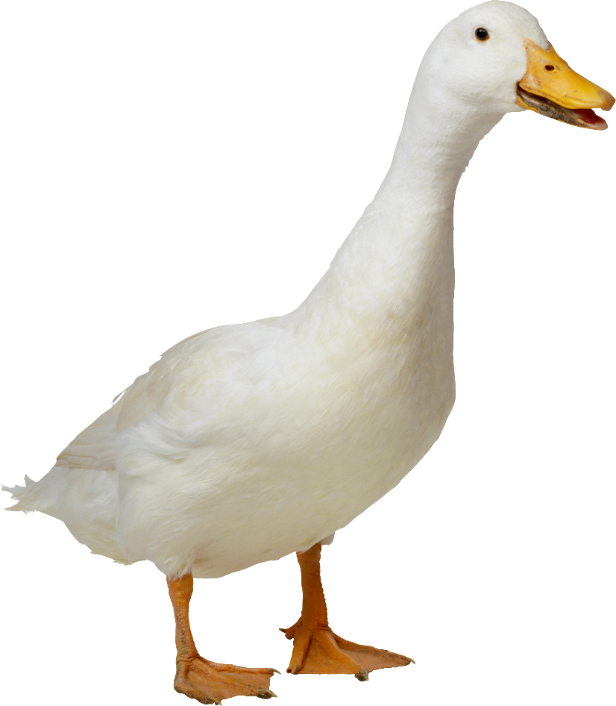
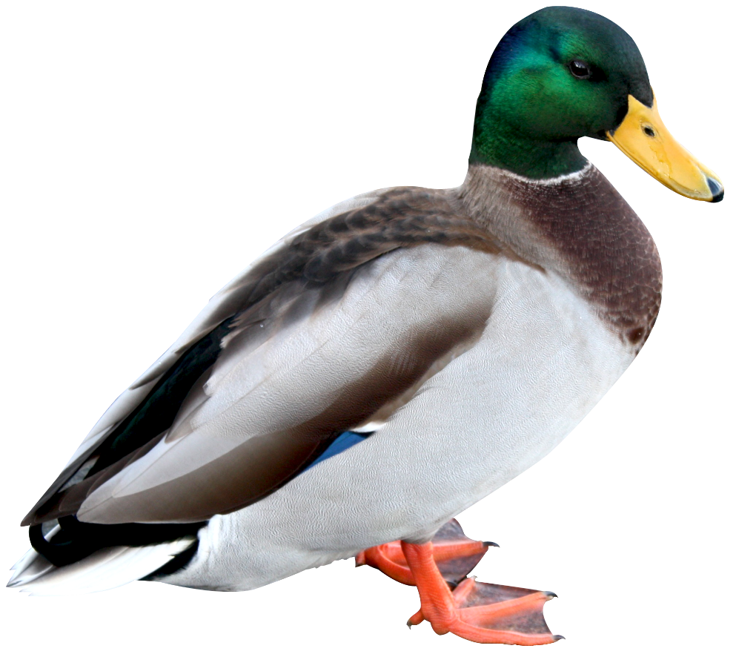
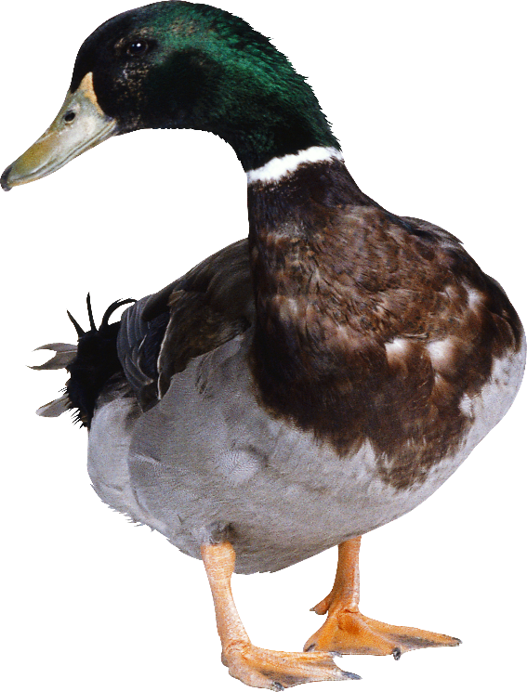
landak

Slide 3
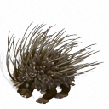
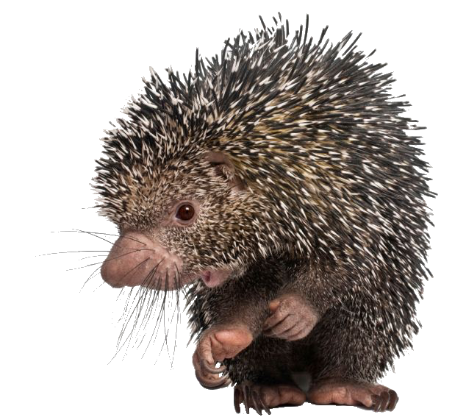
landak
You probably think that “landak”, pronounced “lun-duck”, is the Indonesian word for a “land duck”, right? I get your point but it appears that you have missed “the point”!
You see, the noun “landak” is a “hedgehog” or “porcupine” in Indonesian.
Never, ever “pin” your hopes on trying to outsmart me!

