Slide 2
lampit

Slide 3
lampit
You are probably thinking that “lampit”, pronounced “lump-it”, is the Indonesian for the expression “Like IT or Lump IT!” or “Take IT or Leave IT!” , right?
Well, I think I’ll sit this one out, because the noun “lampit” or “tikar” is a traditional sitting or sleeping mat woven from the leaves of the pandanus palm (but nowadays from plastic).

Slide 4
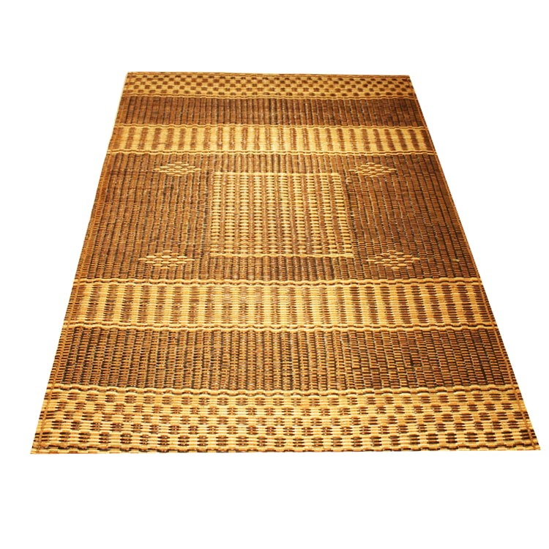
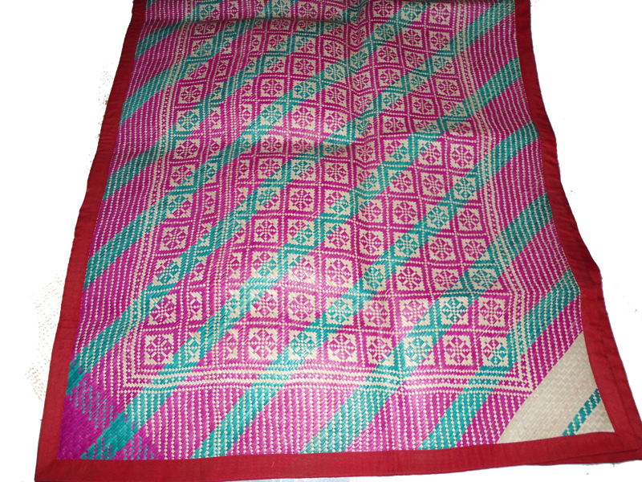
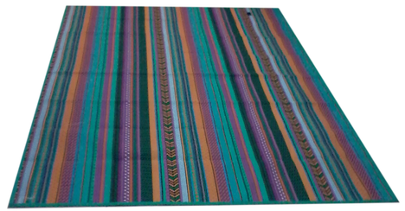
lampit
So why “lump it” when you can sit or even sleep on it as millions of Indonesians do every day! Given the choice, I’d rather sleep on a “lampit” than “lump it”!

