Slide 2
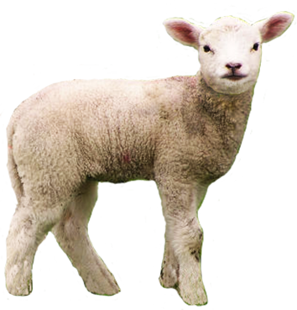
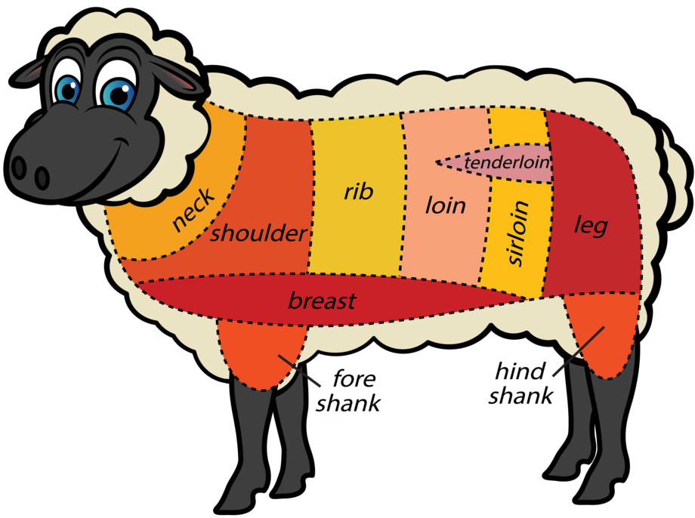
lambat

Slide 3
lambat
You are probably thinking that “lambat”, pronounced “lum-but”, is the Indonesian word for a “lamb’s rump”, right?
As usual, you are a little slow off the mark as the noun “lambat” means “slow” and the verb “terlambat” means “late” in Indonesian.

Slide 4
lambat
If you’re “terlambat” to school at Browns Plains SHS, you can expect a 10-minute litter duty at lunchtime!
That’s more environmentally friendly than a kick up the “rump”!

