Slide 2
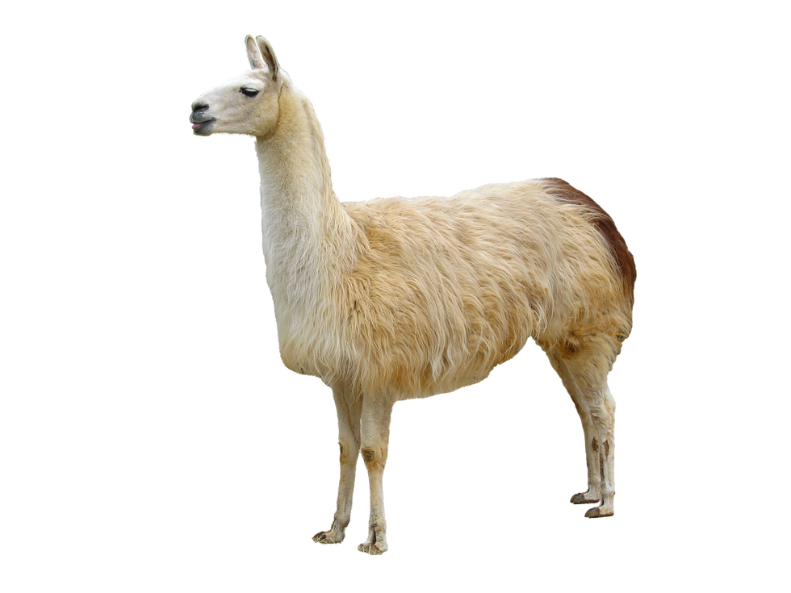
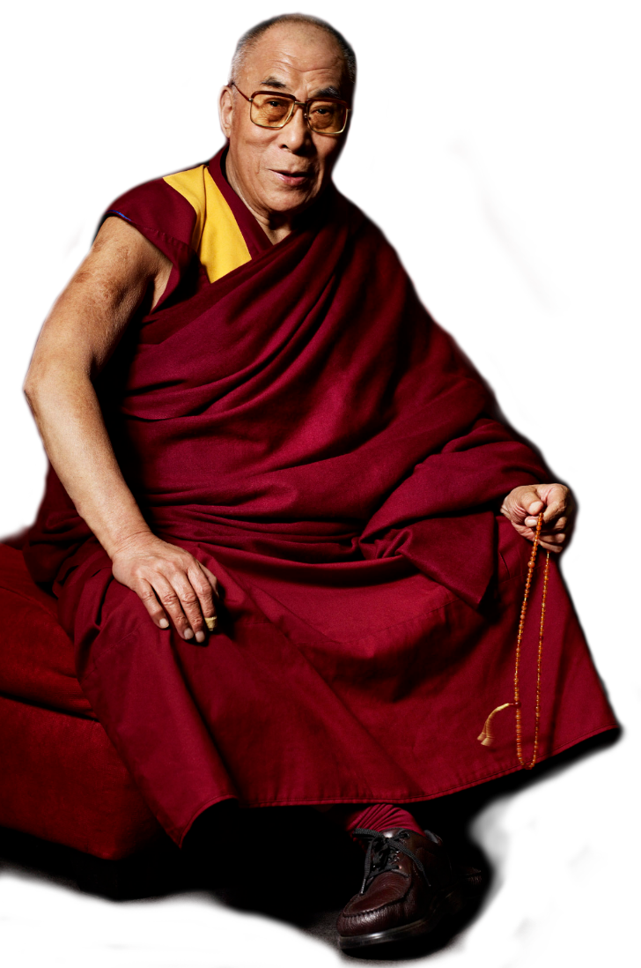
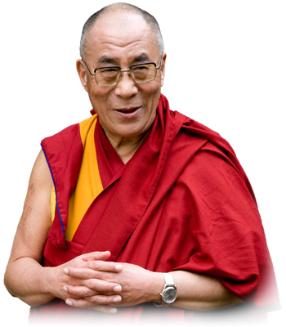
lama
The one “l” lama,
He’s a priest.
The two “l” llama,
He’s a beast.
And I will bet
A silk pyjama
There isn’t any
Three “I” lllama.
By Ogden Nash
Lllama

Slide 3
lama
I can see you’re thinking that “lama”, pronounced “lah-mah”, is either a Tibetan monk or some goat-like species, right?
If you’re still trying to figure it out then you, like Ogden Nash, are taking far too llllllong!
The noun “lama” means “a long time” in Indonesian.

Slide 4
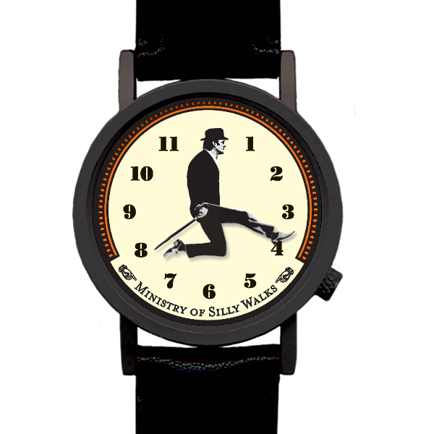
lama
Indonesians tend to be very patient and rarely complain that something takes “terlalu lama” or “too long”. They therefore have little appreciation of our obsession with always being on time!

