Slide 2
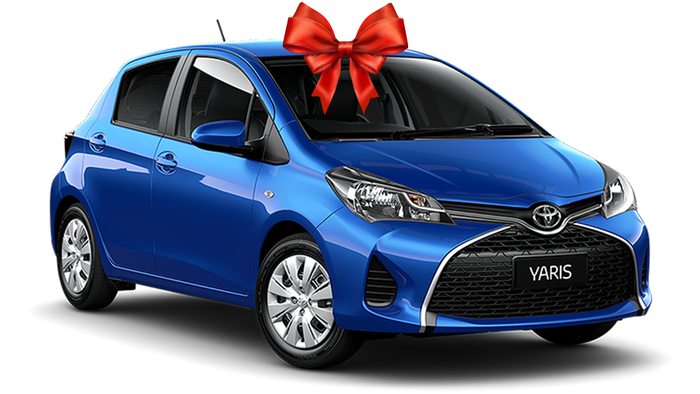
kawin

Slide 3
kawin
You are probably thinking that “kawin”, pronounced “car-win”, is the Indonesian word for “winning a car”, right? Sorry, but you lose yet again!
The verb “kawin” means “to marry” in Indonesian.

Slide 4
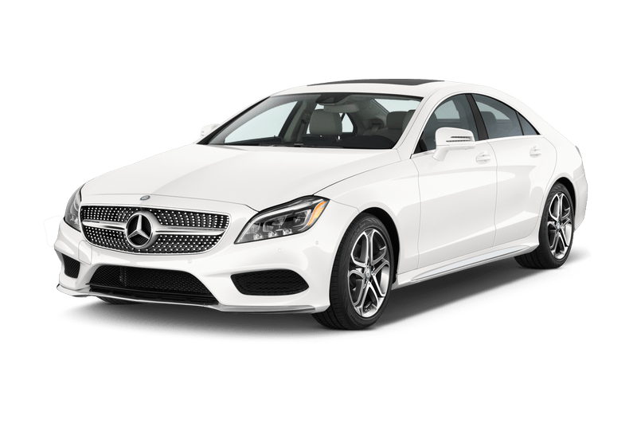
kawin
With the cost of weddings and the price of new cars these days, your only hope of owning a new car anytime soon might be to “kawin”!

