Slide 2
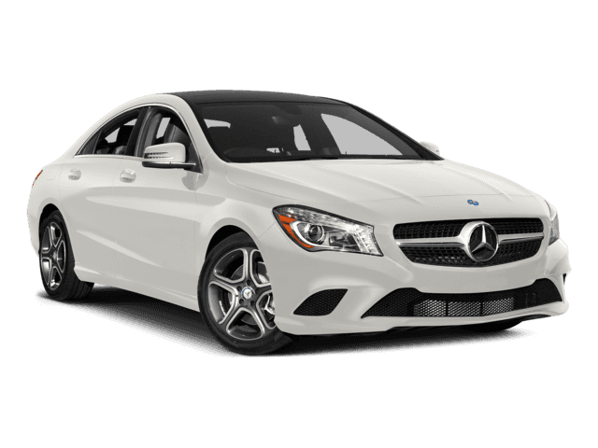
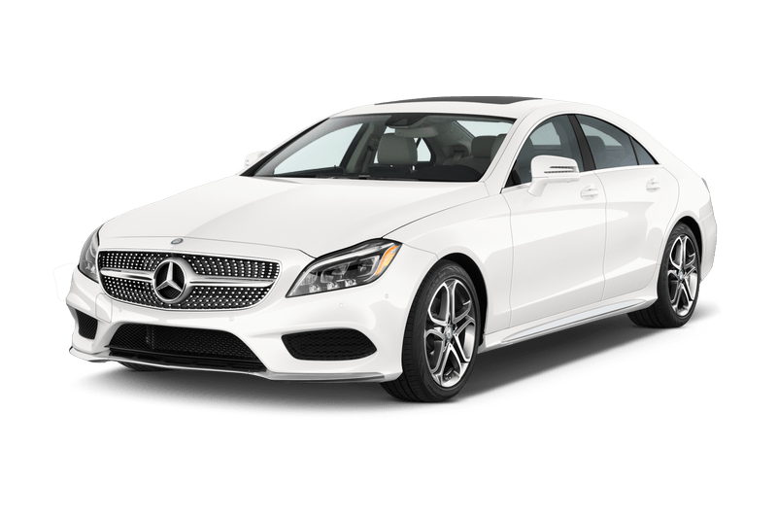
kartu

Slide 3
kartu
You are probably thinking that “kartu”, pronounced “kar-two”, is the Indonesian word for “two cars”, right? Sorry, but you are driving the wrong way down a one-way street if you think that!
The noun “kartu” is used to describe any form of “card” in Indonesian.

Slide 4
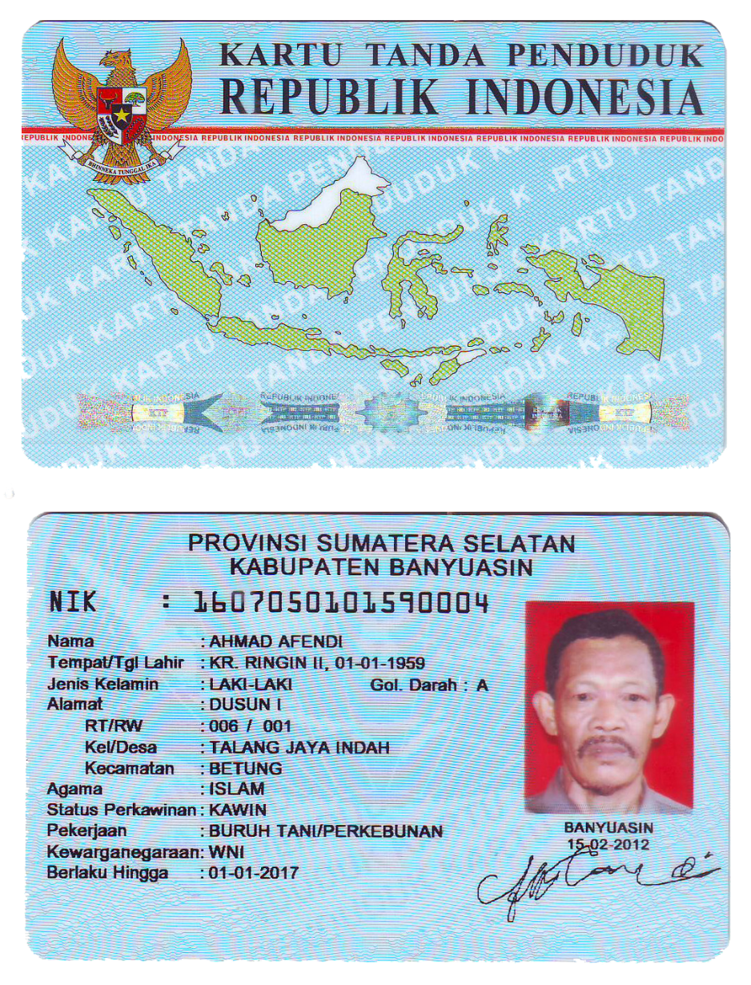
kartu
Like any other country, Indonesia has the full range of greeting, ceremonial or congratulatory cards.
However, the most important card for all Indonesian citizens is the “Kartu Tanda Penduduk” (KTP) or National Identity Card.
Indonesians must produce this card as proof of identity for a multitude of different transactions, including to buy a ‘car or two’!

