Slide 2
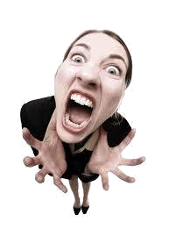
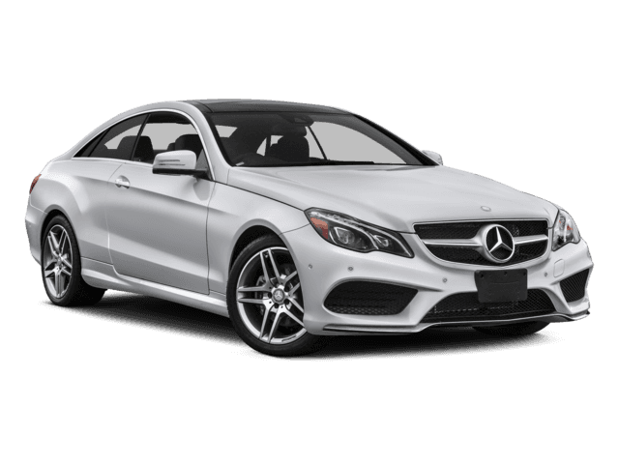
kafir

Slide 3
kafir
You probably think that “kafir”, pronounced “car-fear”,
means “fear of cars” in Indonesian, right?
As usual you are incorrect, so allow me to “steer” you in the right direction!
The adjective “kafir” means “non-believer” and is used by Indonesians to describe anyone without a religion.

Slide 4
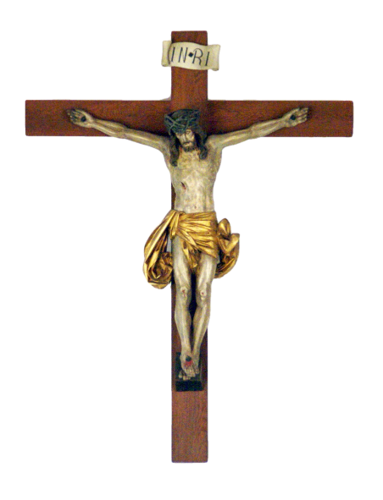
kafir
In Indonesia everyone must follow one of the five officially-recognised religions and it is shown on all official documents including your Driver Licence.
If you want to identify yourself as a “kafir” in Indonesia, you may as well have a “fear of cars” because you won’t be driving one!

