Slide 2
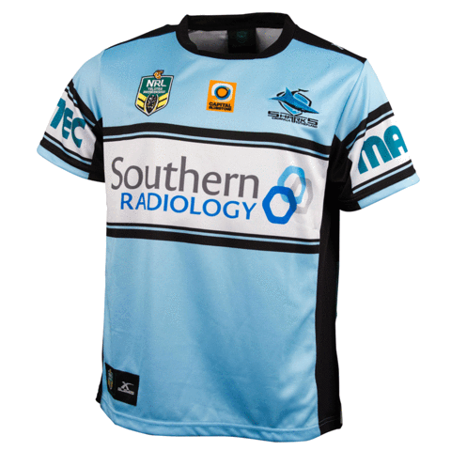
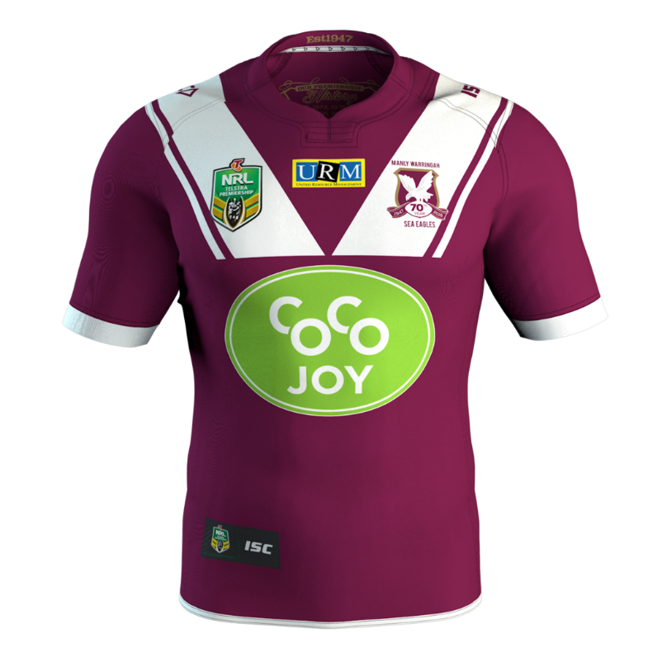
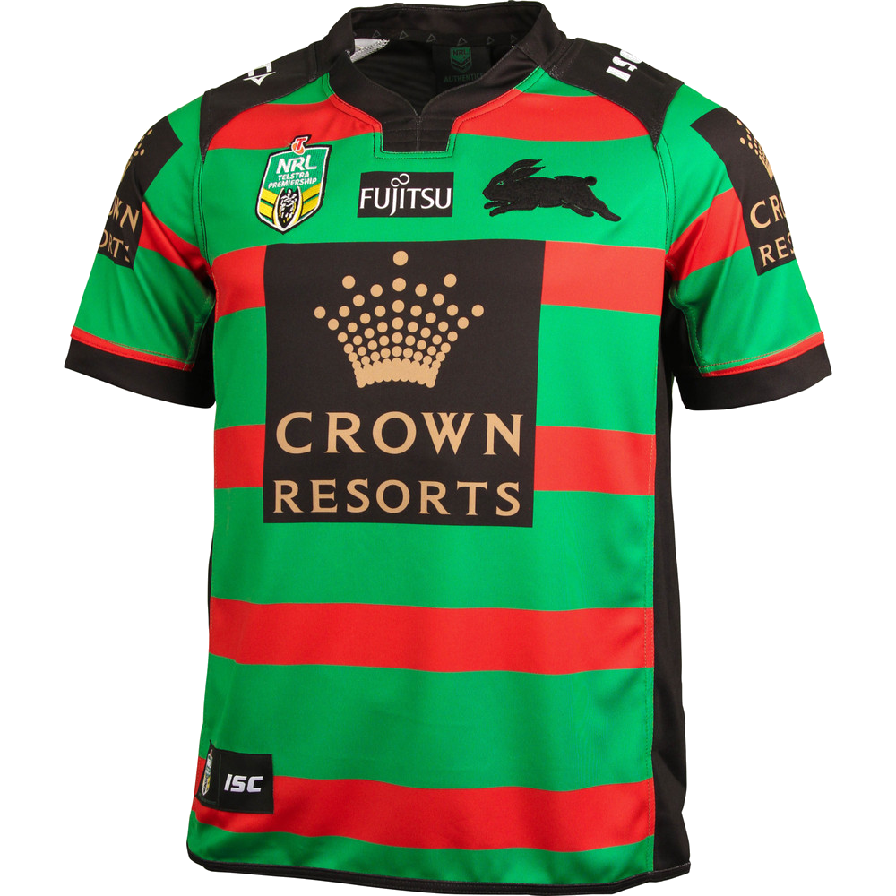
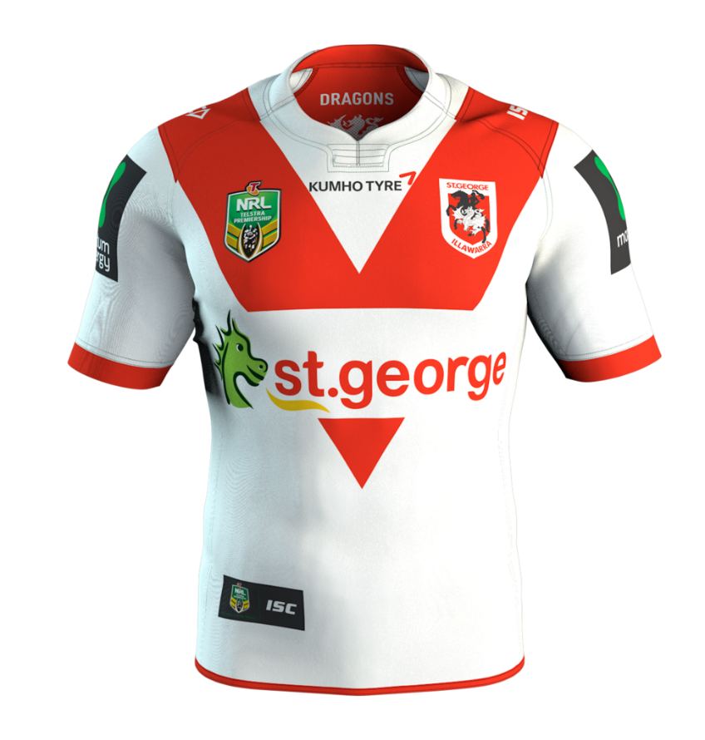
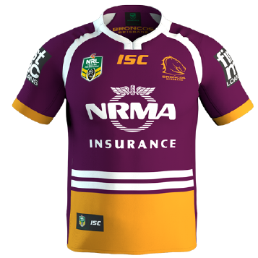
jumpa

Slide 3
jumpa
You are probably thinking that “jumpa”, pronounced “joom-pah”, is the Indonesian word for “jumper”, right?
Well, I’m not going to “jump” on that bandwagon because the verb “jumpa” means “to meet” in Indonesian.
The way things are panning out, I predict South Sydney to “jumpa” Manly Warringah in the 2017 NRL Grand Final.

