Slide 2
jas

Slide 3
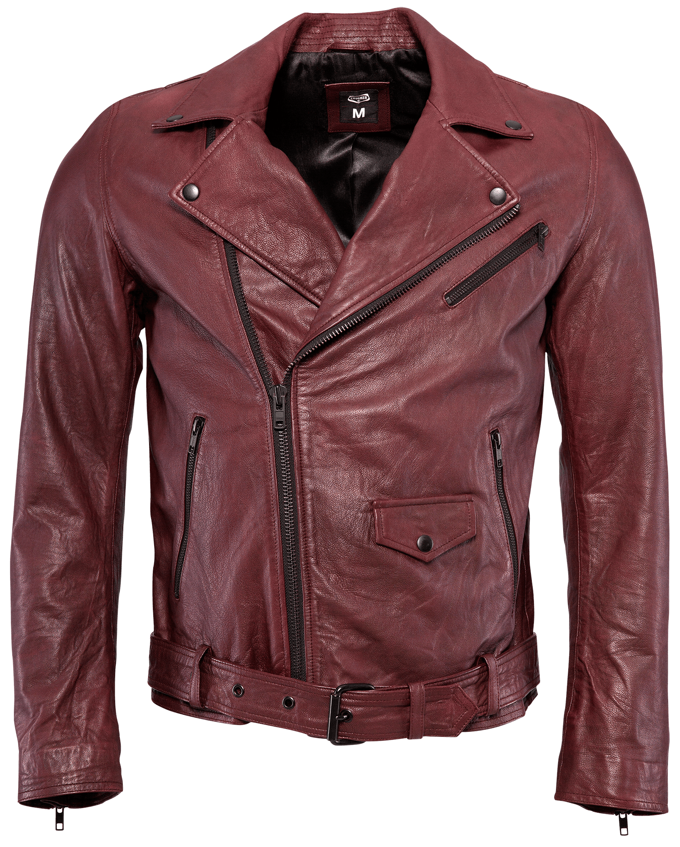
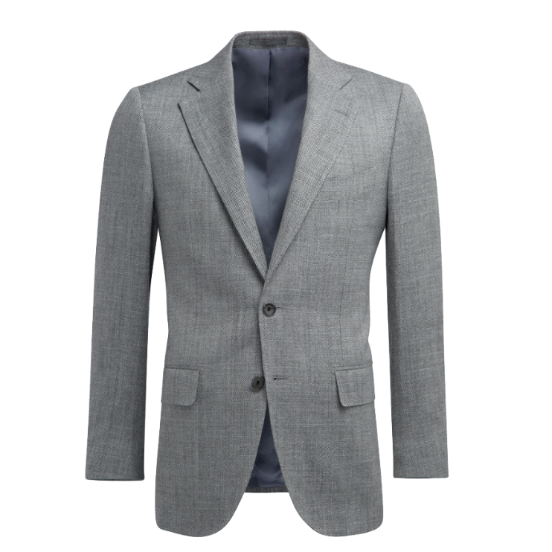
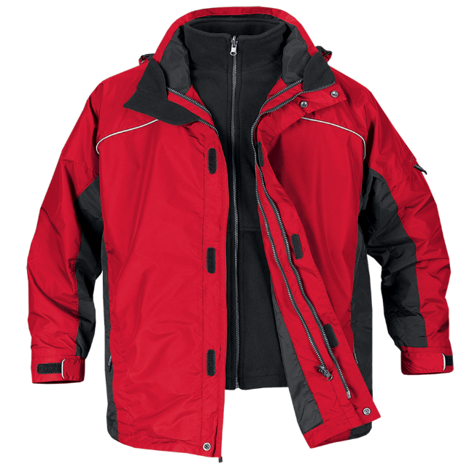
jas
You are probably thinking that “jas”, pronounced “juss” is the Indonesian word for “just”, right ?
Sorry to tell you that you have “just” missed out yet again! The noun “jas” means “jacket” or “coat” in Indonesian.

Slide 4
jas
Someone should open up a new chain of clothing stores specialising in only jackets and jeans and call it “Jas Jins” !

