Slide 1
Study Indonesian: Enhance your career
An ability to speak an Asian language is a huge advantage for Australians.
Prepare for the Asian Century

Slide 2
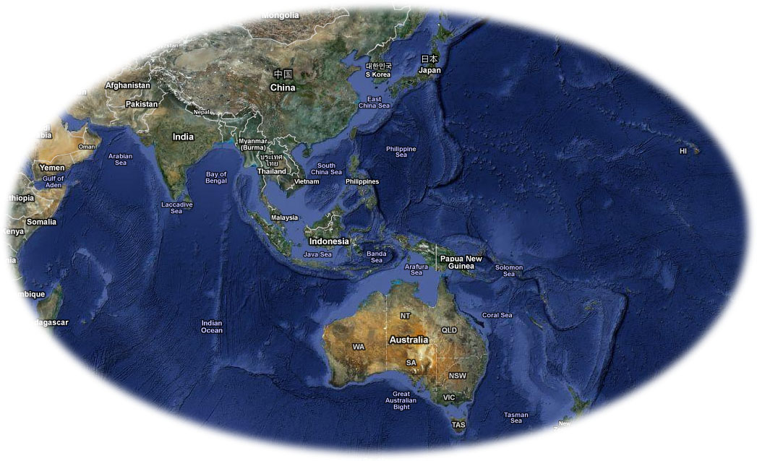
60% of the world’s population lives in the same longitude belt as Western Australia, generating about 50% of the world’s wealth.

Slide 3
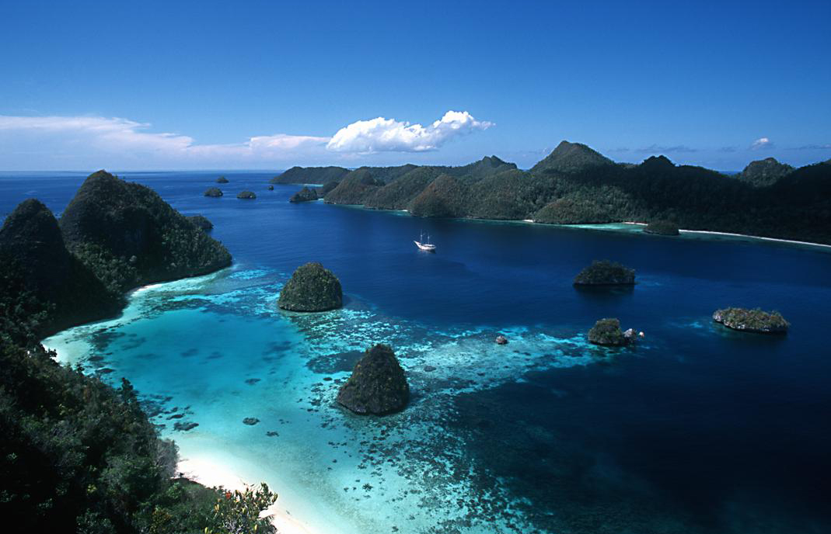
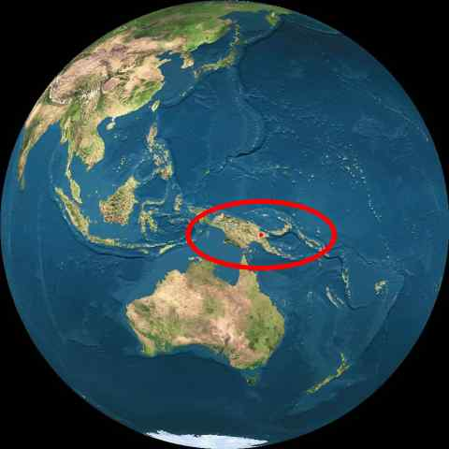
Indonesia: Wonder World
Indonesia is only 500 km from Australia’s northern shores
Tropical jungles, volcanoes, vibrant cities, traditional villages, fascinating ancient and modern cultures
240 million human beings
An economy growing at 6.5% per year
Massive need for development
400 Australian businesses operating in Indonesia
Australian Govt needs Indonesian speakers to service the many links we have (or need) with our neighbour

Slide 4
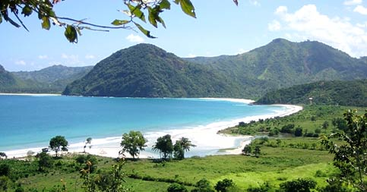
What’s in it for you?
By studying Indonesian, successful students demonstrate to employers:
persistence – sticking power – you can’t fake foreign language skills - any worthwhile skills takes practice and perseverance
mental and cultural flexibility – learning any other language demands cognitive versatility, tolerance for difference and
superior communication skills
international readiness especially if you do in-country studies

Slide 5
What’s in it for you?
By being a more open-minded person,
other-interested, not just self-interested
You are a more valuable and thinking citizen
You make the world a better place
You will have a wider-ranging, more exciting life
When you’ve learned one foreign language, all others are that much easier

Slide 6
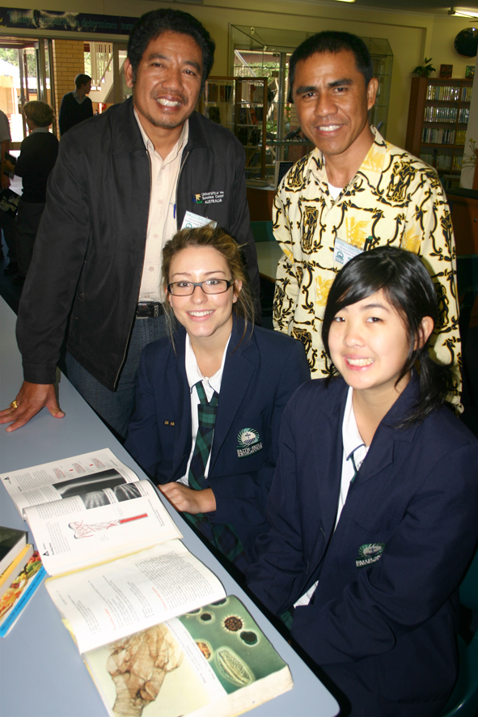
Opportunities
Add Indonesian language to your professional studies - stand out from the crowd
Indonesian + education
Indonesian + engineering
Indonesian + public services
Indonesian + community development + health
Indonesian + journalism
Indonesian + business
Indonesian + tourism
Indonesia will forever be important to Australia.

Slide 7
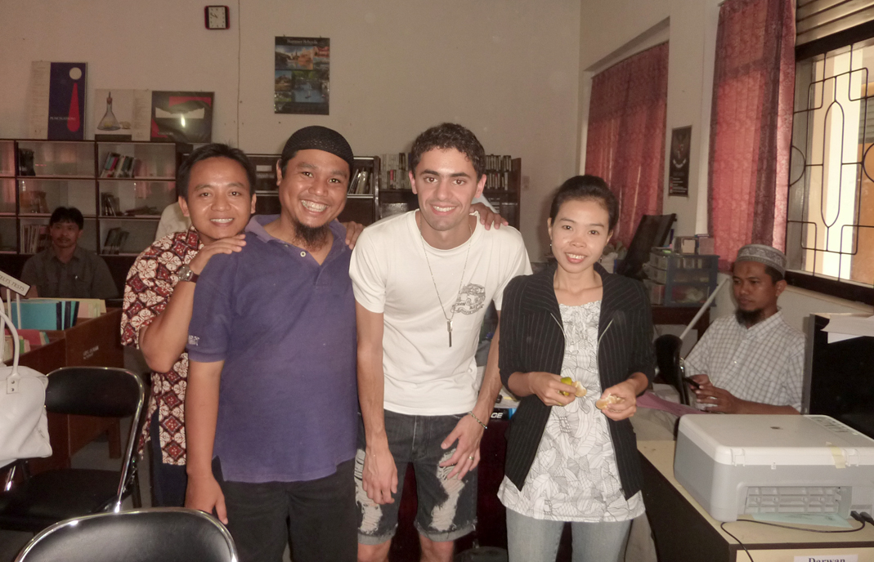
Indonesian leads to careers in…
Foreign Affairs & Trade
Defence
Immigration
Armed services
Media (foreign correspondent)
Education and research
Community development
Aid
Engineering
Forestry
Geology
Environmental conservation
Fisheries
Fauna and flora protection
International business
Tourism
Climate change
The arts
Surf & expeditionary industries

Slide 8
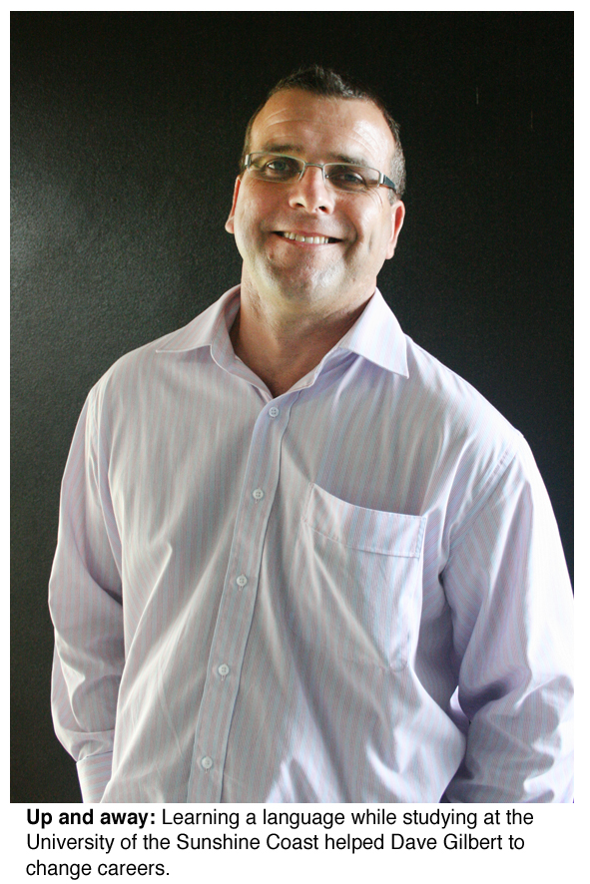
Indonesian + mining
“I started as a diesel mechanic.”
Now Dave Gilbert
is General Manager
for Eastern Australia
and Southeast Asia
divisions of AGC-Ausclad companies.
“I’d still be building roads if I hadn’t made the effort to study international business and Indonesian language at USC. Languages are so important if you want to do business internationally.”

Slide 9
A National Imperative – not an option
The Commonwealth of Australia has commissioned Ken Henry to report in a White Paper on
Australia’s Future in the Asian Century
Major political parties and top business bodies agree :
Asia-skilling Australians is an urgent national interest priority
Whether you do just two courses to get the basics, four courses for a Minor (or a Graduate Diploma in Arts) or a full Major, kick your Asia literacy into gear with some Indonesian language study! Gain the skills to teach or trade
or simply to interact in Indonesian.

Slide 10
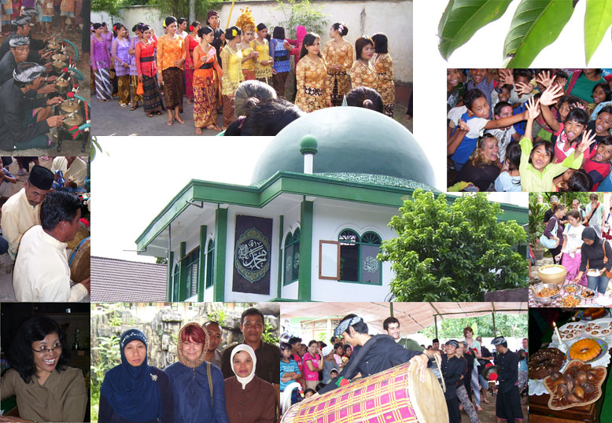
Continue on to the Lombok program
Many first year students go straight to the intensive in-country course in Lombok over summer.
See their reports on this peak life experience at: http://your.usc.edu.au/wacana/lombok

Slide 11
The Lombok program
Chelsea 2010: “It was amazing. By the end of the 6 weeks, you had people who didn't know a word beforehand, really passionate about it [the language] and using it as much as they possibly could with the locals.”
http://your.usc.edu.au/wacana/lombok

Slide 12
The Australia Indonesia Youth Exchange Program
Chelsea Merry from USC and Nathan O'Leary were both selected for 2011. Nathan had to decline because he was accepted into Australian Airforce Intelligence and had to start training but Chelsea went to South Sulawesi and had the time of her life. She's now finished a Masters degree in International Development in Melbourne and in June2012 has been appointed East Timor director with the Oaktree Foundation.

Slide 13
The Australia Indonesia Youth Exchange Program
Chelsea Merry 29 Sept 2012
Hi Phil! Iya silakan menggunakan namaku untuk promosi ini! I have just returned from a two week work trip to Timor-Leste; a trip which one again reinforced language abilities as an invaluable asset! During the trip when a Tetun translator was unavailable I conducted meetings in Indonesian and made connections with important contacts that moved beyond the barriers of language. The two weeks ran smoothly and our team saw incredible results both in meeting with existing partners and scoping out new development projects to support. A large part of that success I owe to my language abilities without which our team would have faced many logistical and relational obstacles. Even now after returning I am inspired to maintain and improve my language because it will be absolutely key to building and maintaining good working relationships with our partners in Timor. Cheers, Chelsea

Slide 14
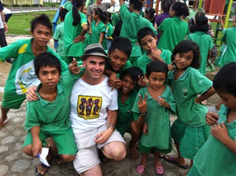
Indonesian language
Indonesian uses the same letters as English and has a totally consistent spelling system.
It is one of the easiest languages in which to gain a quick social proficiency.
One year of university Indonesian language study equips you to interact successfully with Indonesians on the streets, in markets, schools and homes.

Slide 15
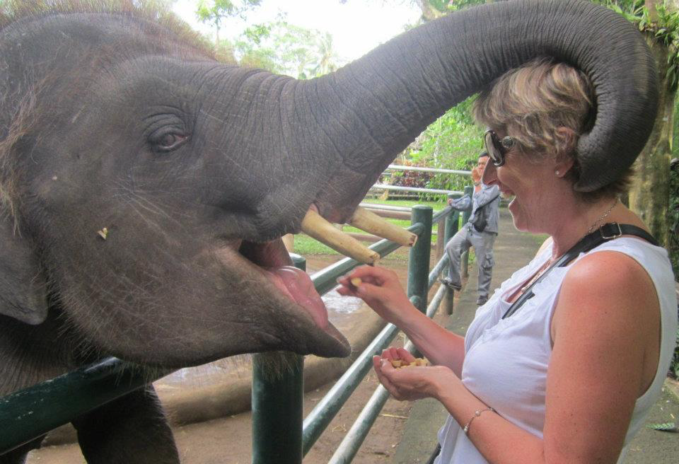
Ah, c’mon now,
give it a go!

Slide 16
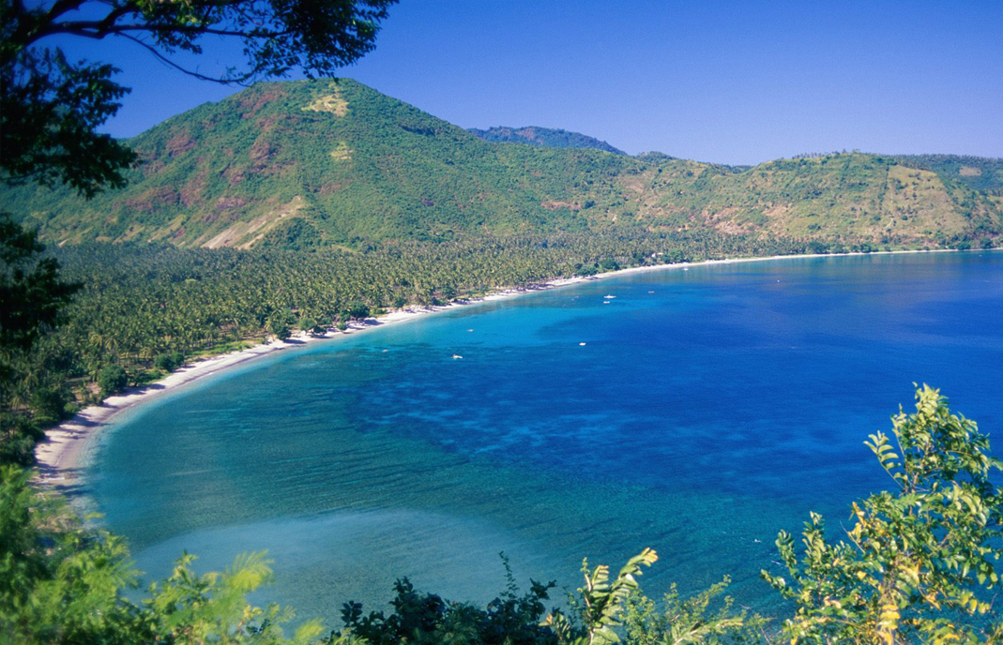
Indonesian at USC
Too good an opportunity to miss
Ayo belajar bahasa Indonesia!
Phillip Mahnken
http://your.usc.edu.au/wacana
pmahnken@usc.edu.au

