Slide 2
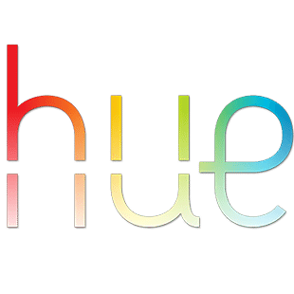
hiu

Slide 3
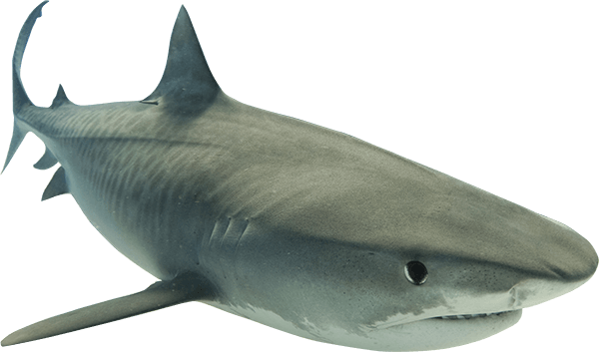
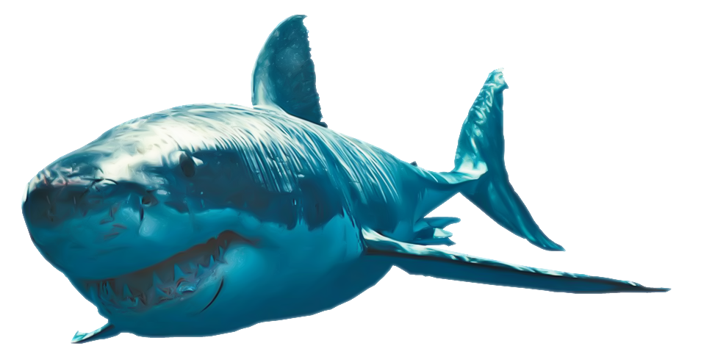
hiu
You probably think that “hiu”, pronounced “he-oo”, means “colour hues” in Indonesian, right? Well, your complexion will take on a different “hue” when I tell you that the noun “hiu” means “shark” in Indonesian.

Slide 4
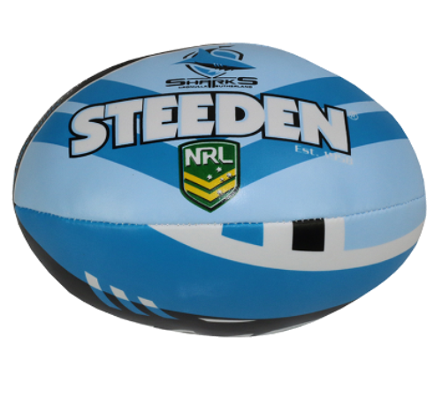
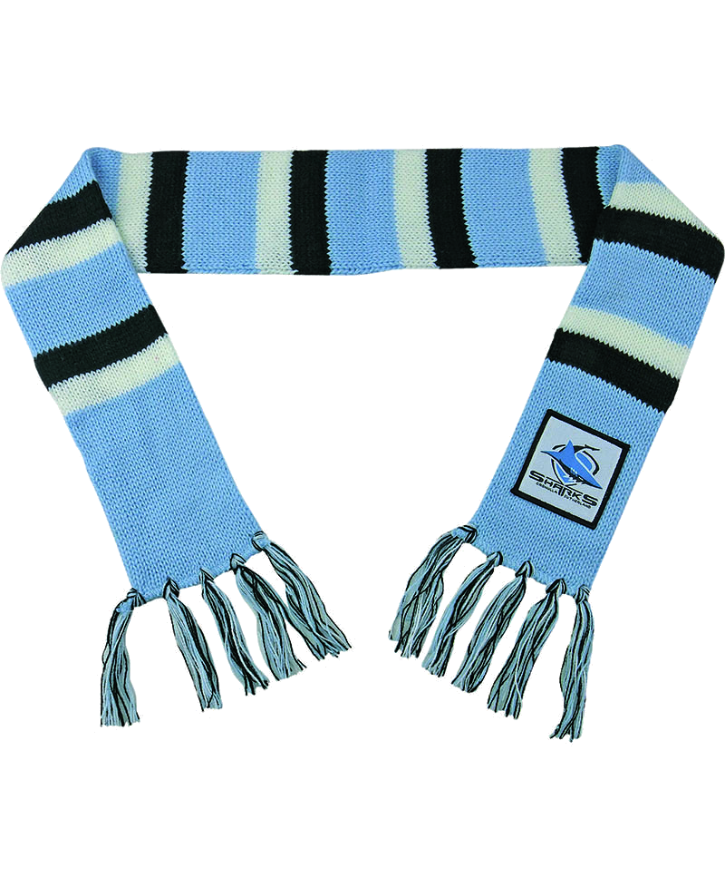
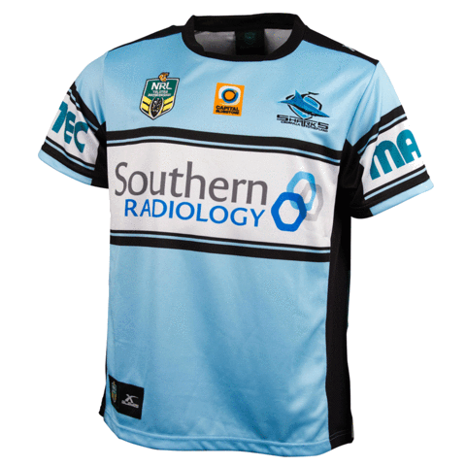
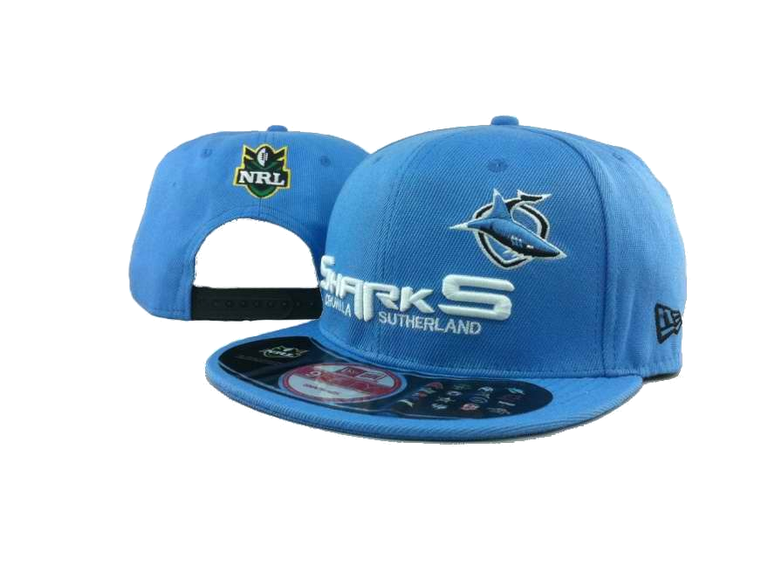
hiu
However, I’m sure you’ll weather the “Storm”… just like the Cronulla Sharks did in the NRL Grand Final.

Slide 5
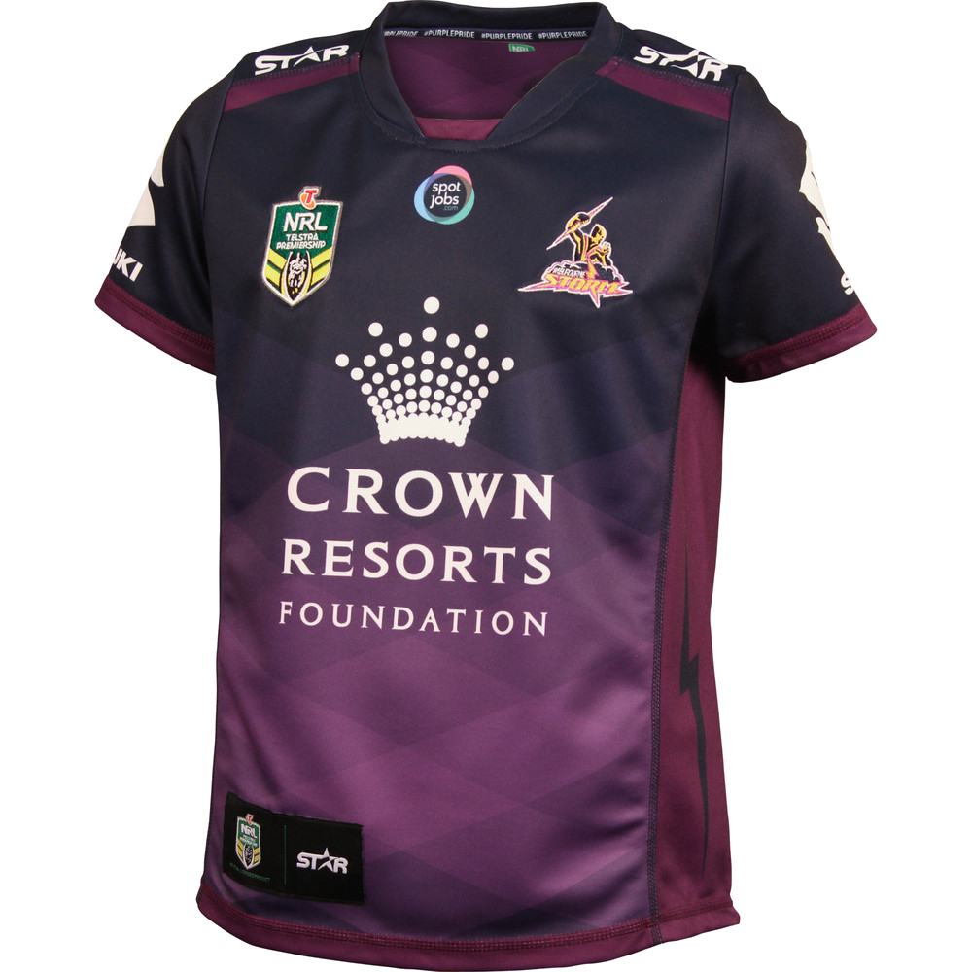
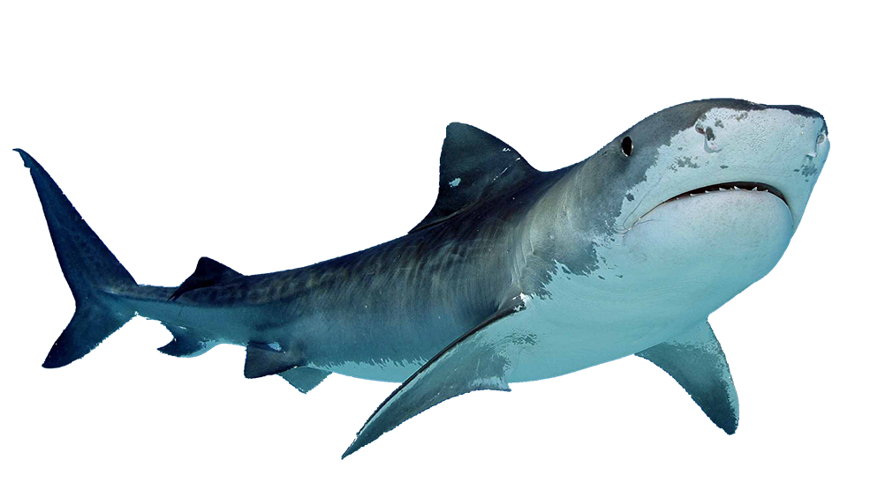
hiu
I knew Melbourne would succumb to a shark-feeding frenzy!!!

Slide 6
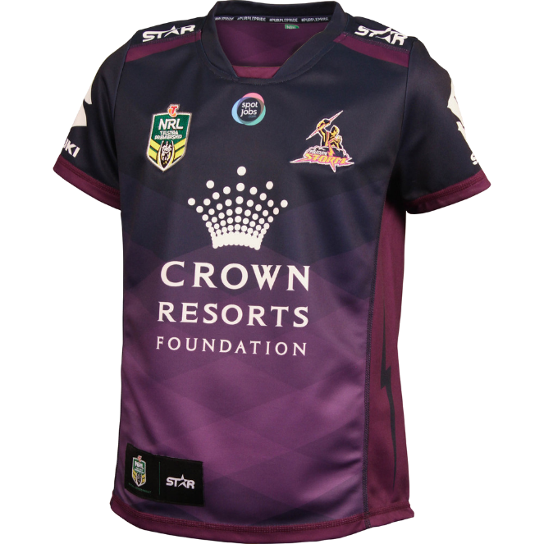
hiu
Just circling in for the final kill !!!

