Slide 2
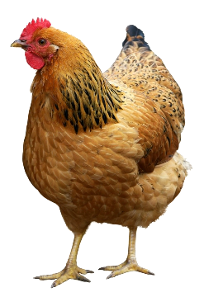
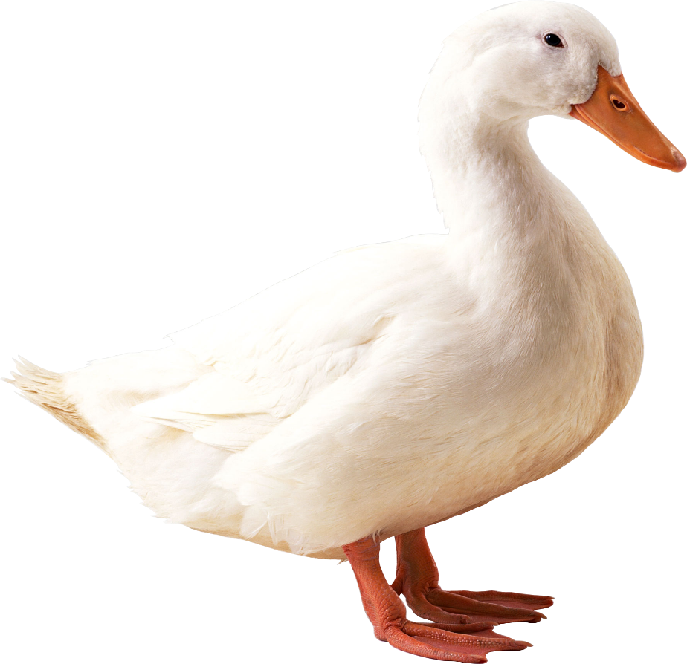
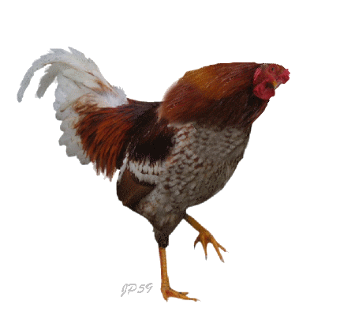
hendak

Slide 3
hendak
You are probably thinking that “hendak” , pronounced “hen-duck” means “poultry” in Indonesian, right?
Well, you better “duck” for cover because you are wrong yet again.
The Indonesian verb “hendak” means “to wish to do something”.

Slide 4
hendak

Slide 5
hendak
If you would like me to produce another WORD Of The DAY, your “hendak” is my command!!!

