Slide 2
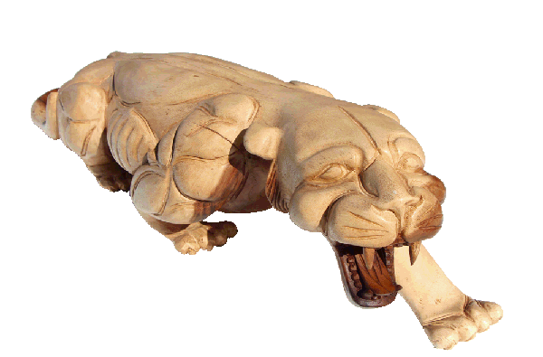
harimau kayu

Slide 3
harimau kayu
If you look back through your Words of the Day, you will see that we have already covered these two words! Yes, the noun “harimau” means “tiger” and the noun “kayu” means “wood”.
However, when placed side-by-side. The noun “kayu” (wood) turns into the adjective “wooden” which describes the noun “harimau”.

Slide 4
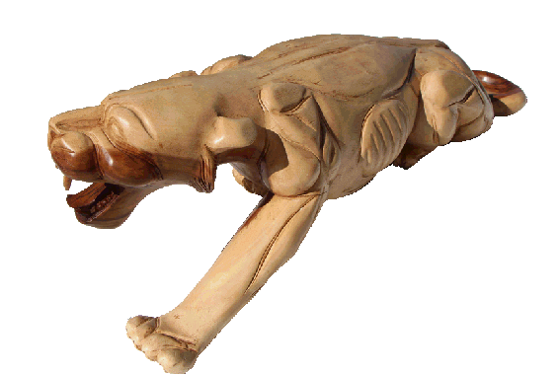
harimau kayu
So this time, there is no trickery! A “harimau kayu” just happens to be a “wooden tiger” ! You can find wood carvings of tigers all over Bali next time you go to Indonesia.

Slide 5
harimau kayu
No need to get too excited! You didn’t really think I was going to let you off that easily, did you? “Harimau Kayu” could possibly have one other meaning in Indonesian! Can you guess what it might be???

Slide 6
Harimau Kayu

Slide 7
Harimau Kayu
Yes, if spelt with capitals, an Indonesian might think that this is the Indonesian name of the famous American golfer “Tiger Wood(s)”.
Indonesians tend to leave the final “s” off when saying foreign words because there are very few native Indonesian words that actually end in “s”.
Also, in Indonesian, plurals do not end in “s” … they simply double the word! For example, “harimau-harimau” means “tigers”!
Go get them, Tiger!

