Slide 2
gading

Slide 3
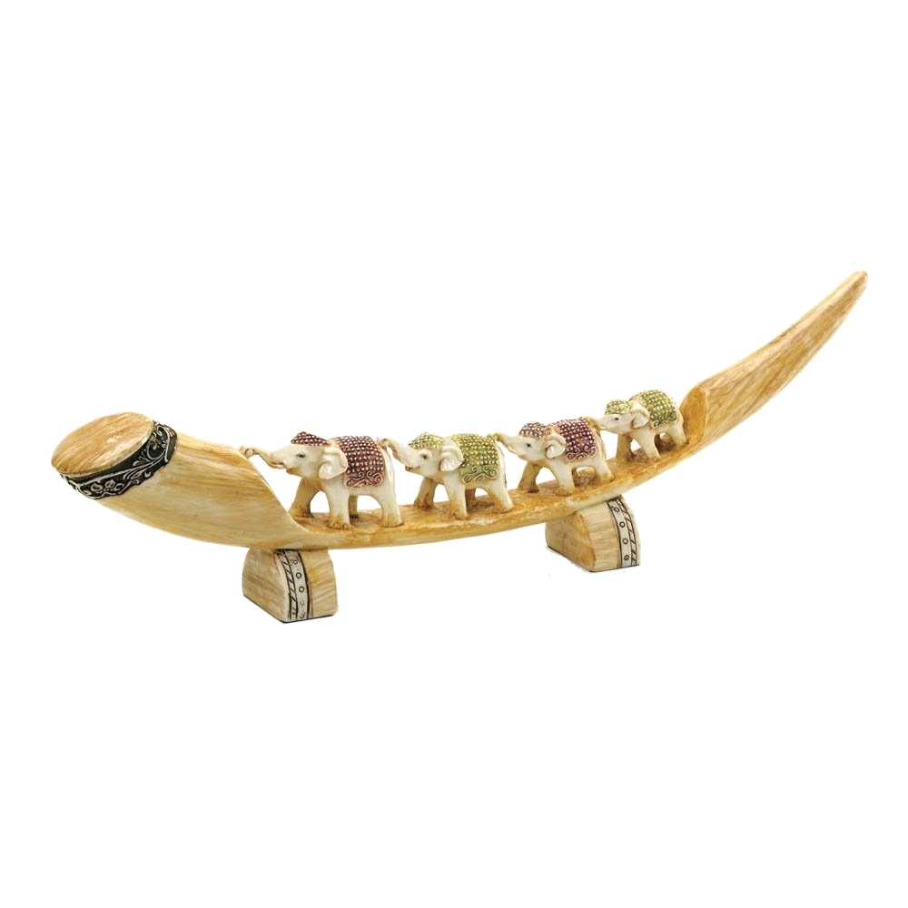
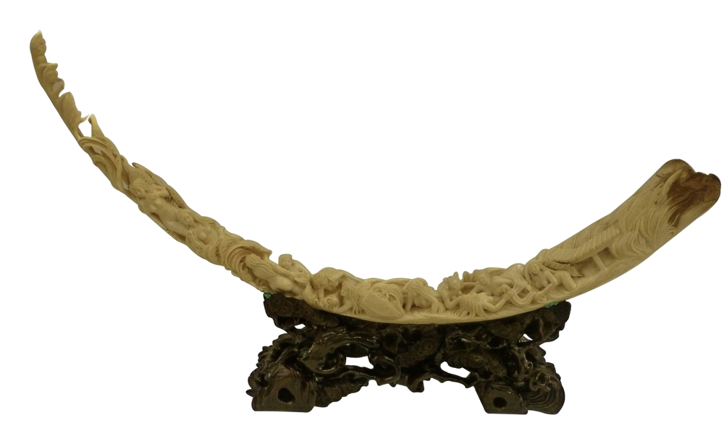
gading
You are probably thinking that “gading”, pronounced “guard-ing”, is the Indonesian word for “security guard” , right?
Sorry, but I’ve caught you “off-guard” yet again! The noun “gading” can mean either “ivory” or “elephant tusk” in Indonesian.

Slide 4
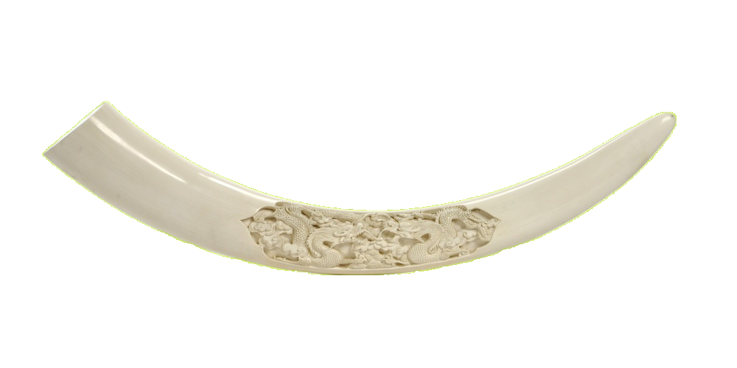
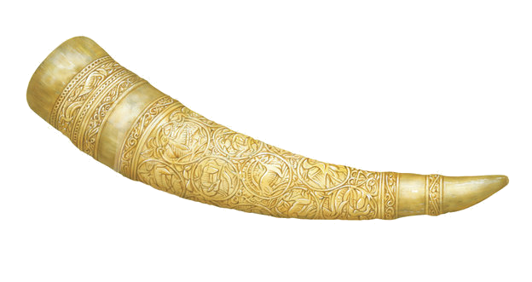
gading
Elephant tusks sell for a fortune on the black market which encourages poachers in both Africa and Asia to kill elephants for their tusks.

Slide 5
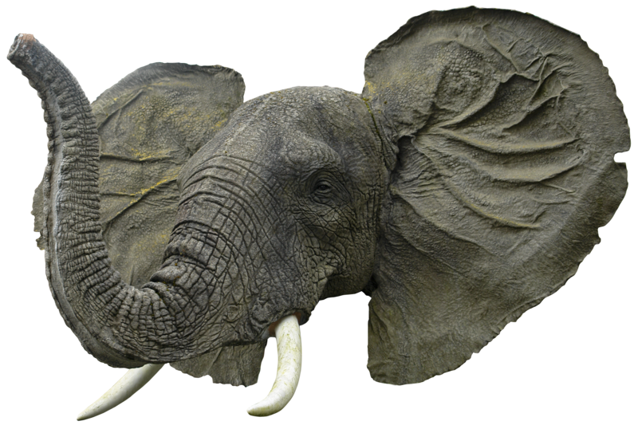
gading
We need to be “guarding” the elephants and their “gading” from poachers by putting a stop to the illegal ivory trade.
NO ONE IN
THE WORLD
NEEDS AN
ELEPHANT TUSK
EXCEPT AN
ELEPHANT

Slide 6
gading

