Slide 2
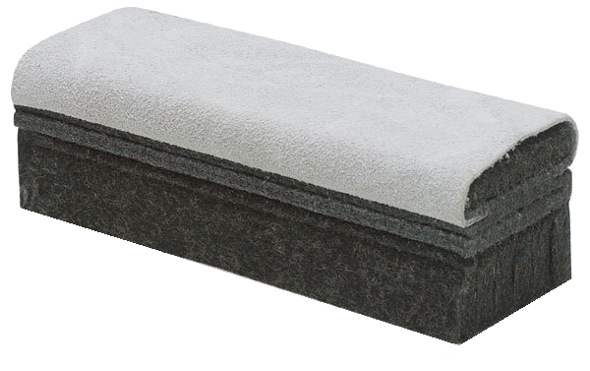
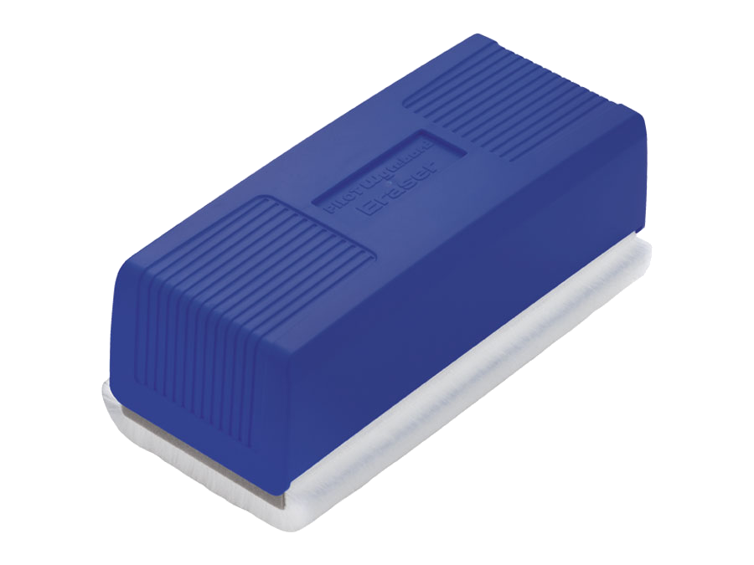
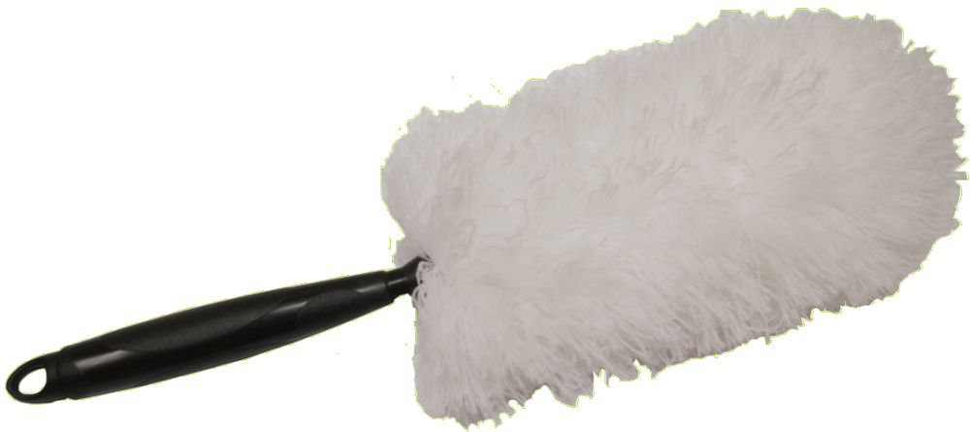
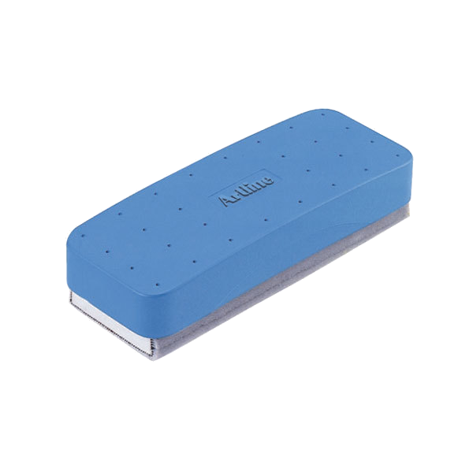
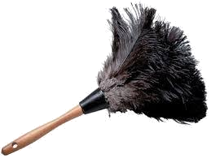
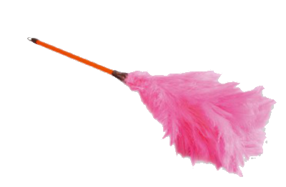
dusta

Slide 3
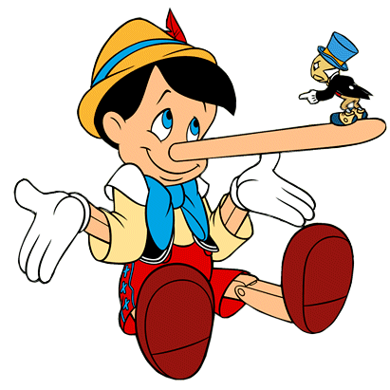
dusta
You are probably thinking that “dusta” , pronounced “doo-sta”, is either some form of “duster” or “board eraser” in Indonesian, right?
I would be lying if I told you that this was true because the noun “dusta” is a “lie” in Indonesian. That’s the truth, I ain’t lyin’!

Slide 4
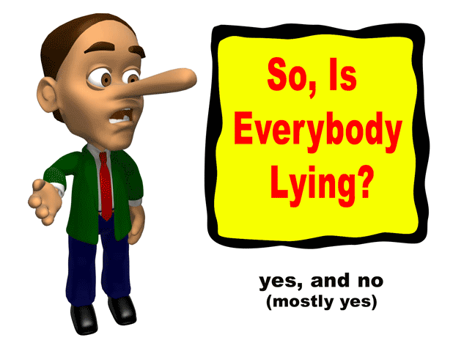
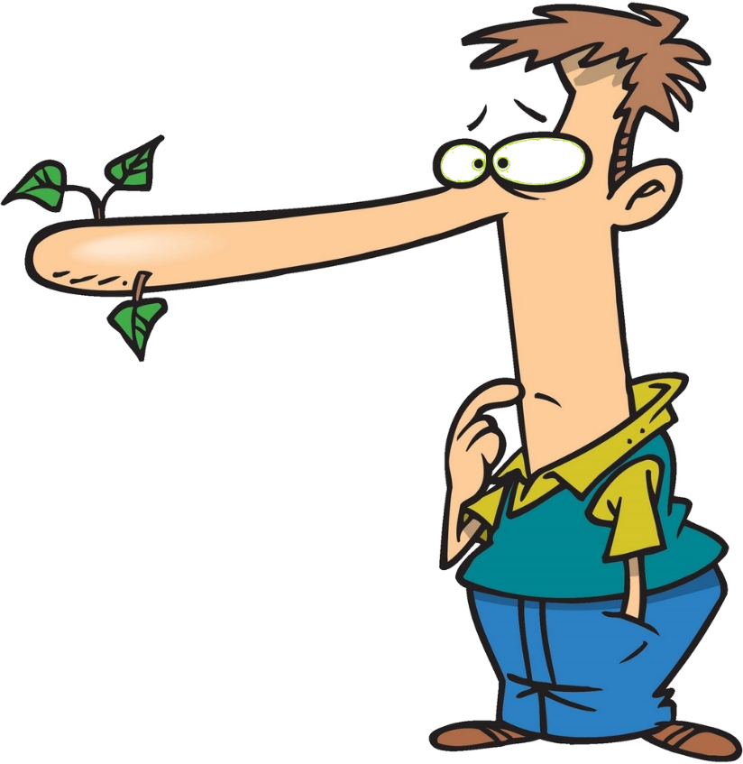
dusta
It appears that everybody tells a “dusta” at one time or another.

Slide 5
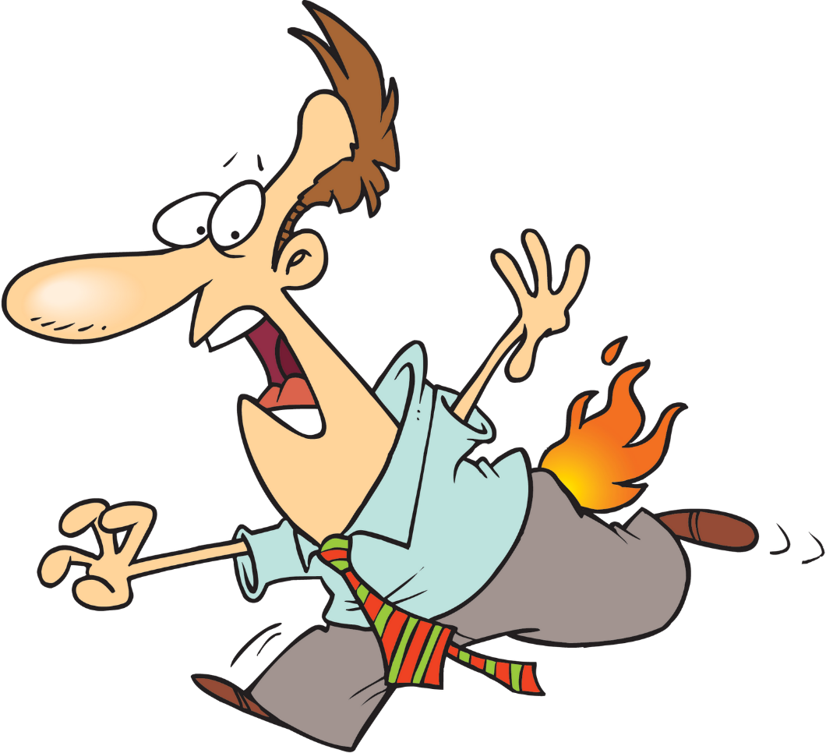
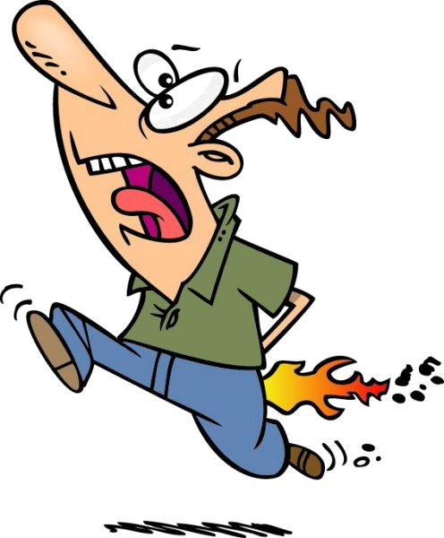
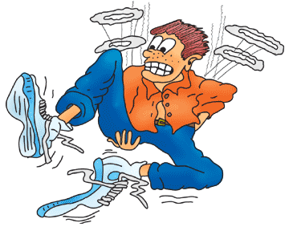
dusta
Telling lies can really put you in the “hot seat”!

