Slide 2
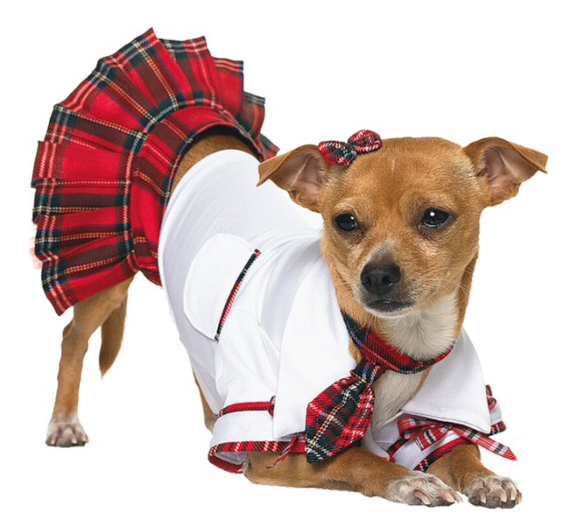
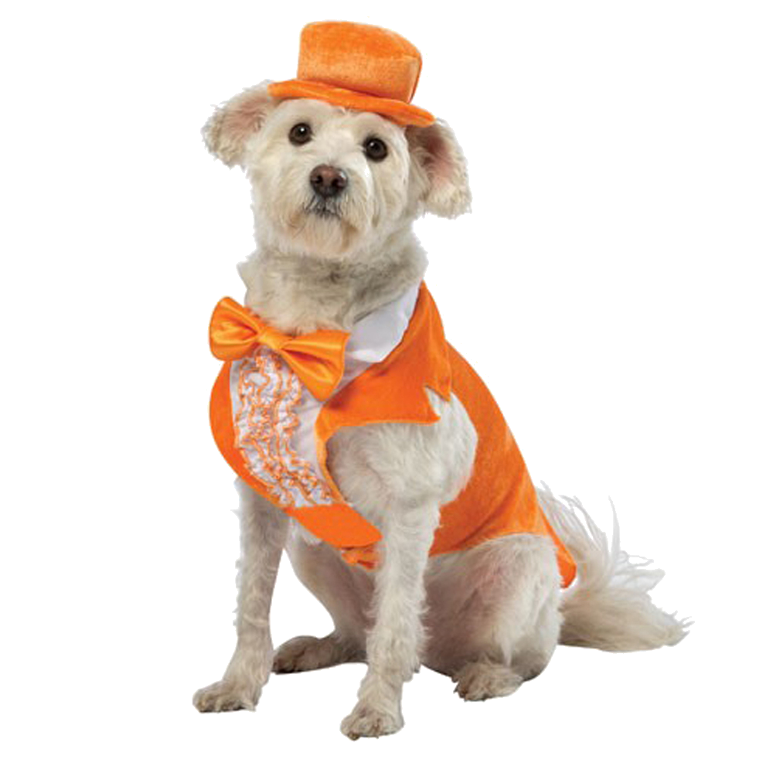
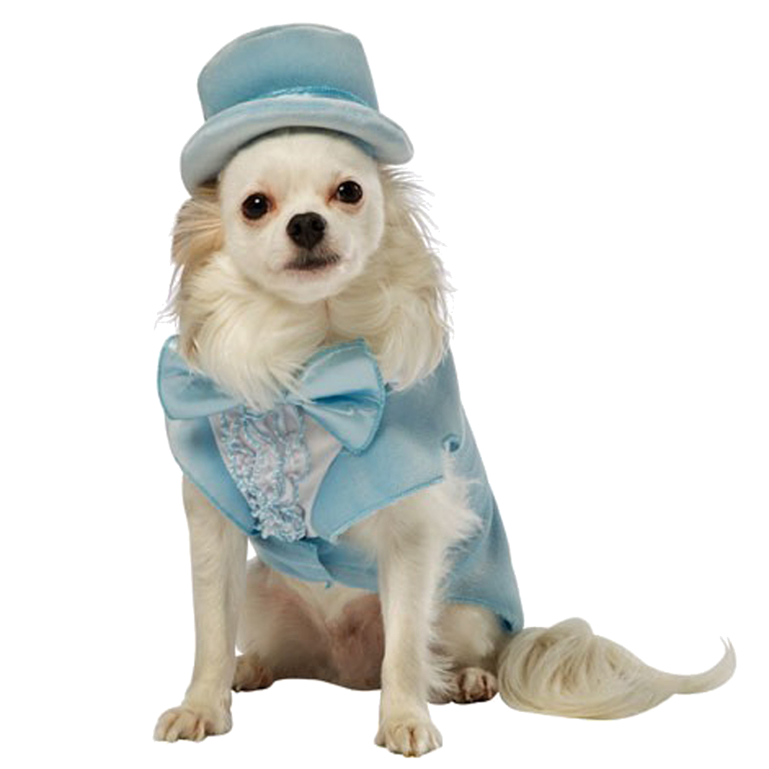
dompet

Slide 3
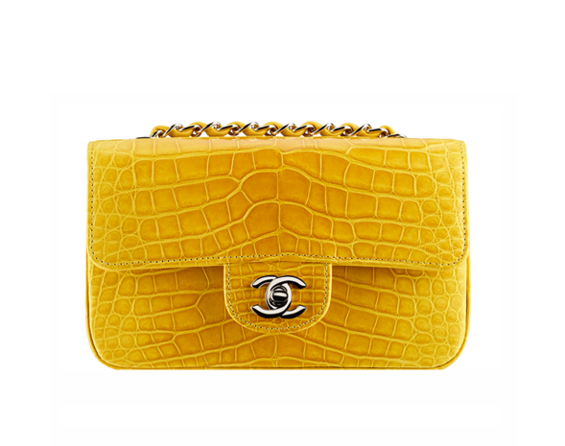
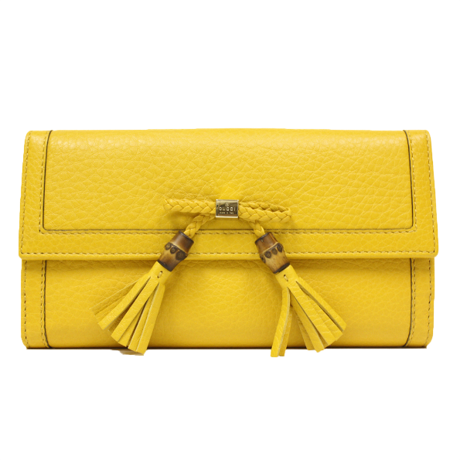
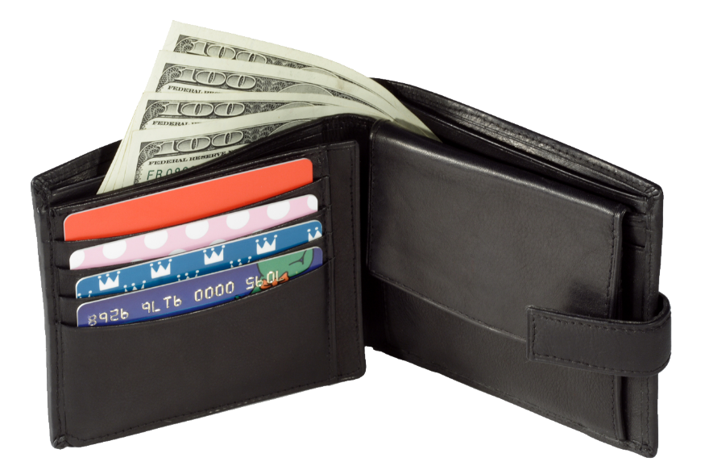
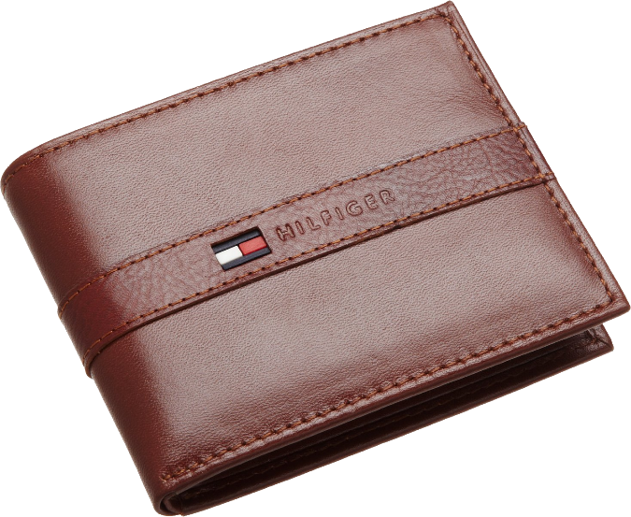
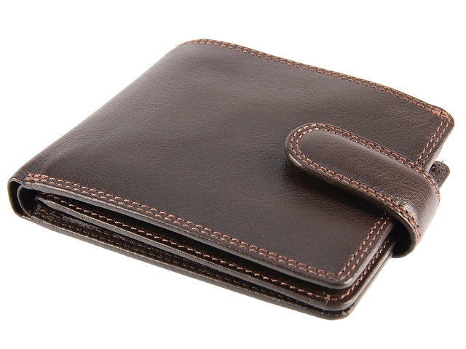
dompet
You are probably thinking that “dompet”, pronounced “dom-pet”, is the Indonesian word for “dumb pet”, right?
Don’t bet your money on it, because the noun “dompet” means “wallet” or “purse” in Indonesian.
If you want to have a “dumb pet” you better have a deep “dompet”!

