Slide 2
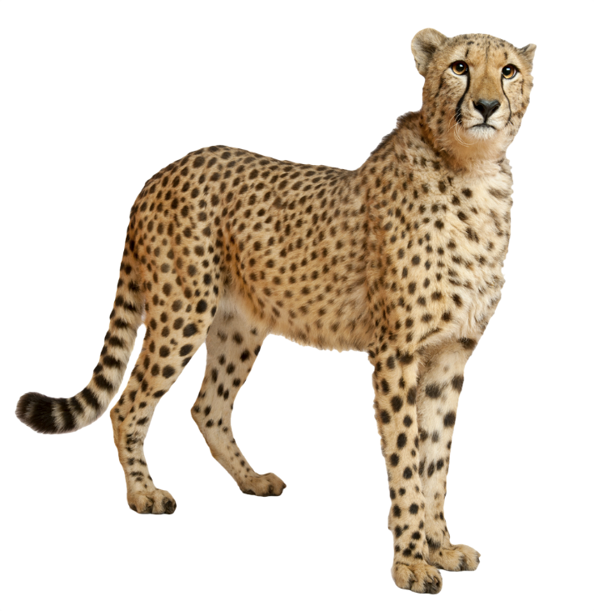
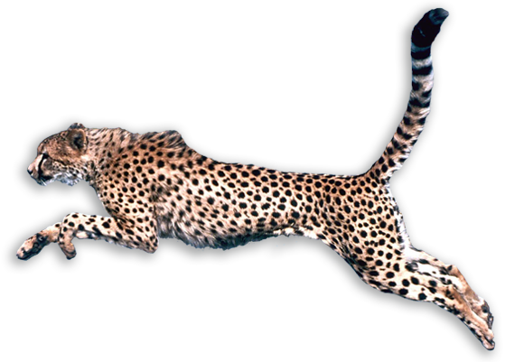
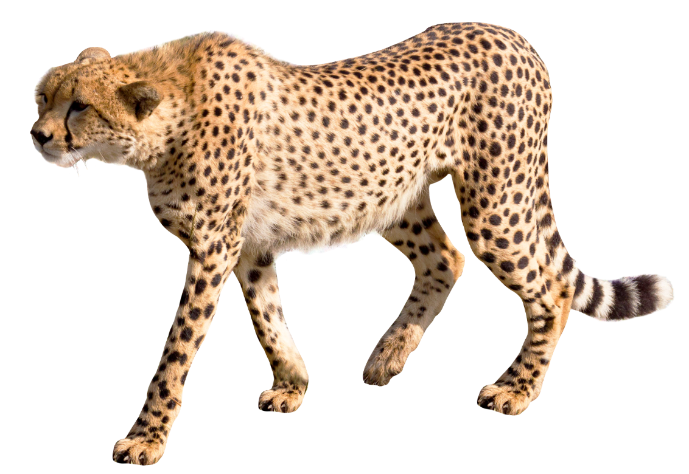
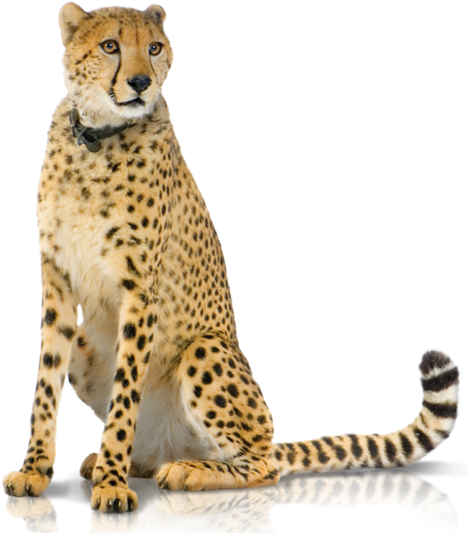
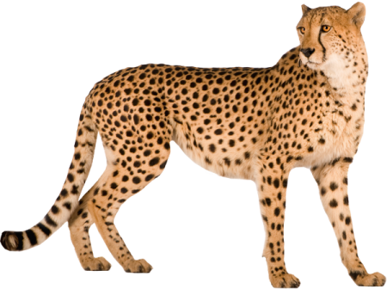
cita-cita

Slide 3
cita-cita
You are probably thinking that “cita-cita”, pronounced “chee-tah chee-tah”, is the Indonesian plural for “cheetah”, right?
Allow me put you on the path to career success because
“cita-cita” means future ambitions, goals or dreams
in Indonesian.

Slide 4
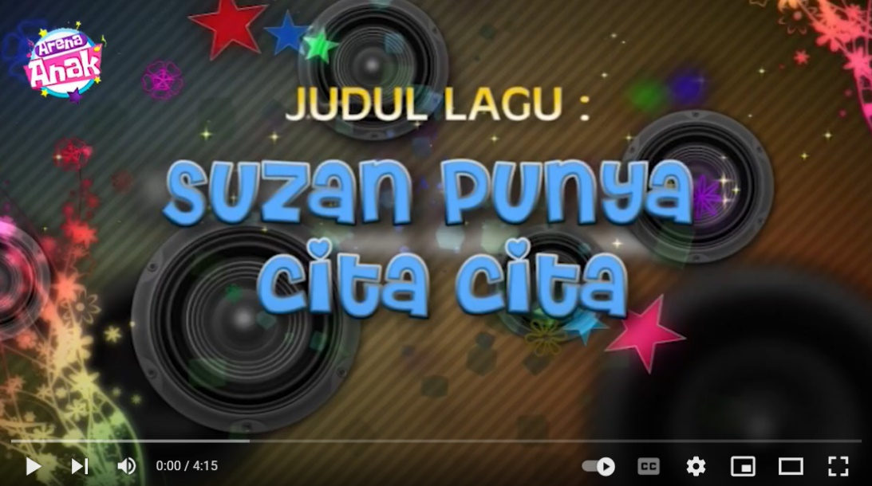
cita-cita
You can see from YouTube videos such as the
one below that Indonesian children develop
their “cita-cita” from a very early age …

