Slide 2
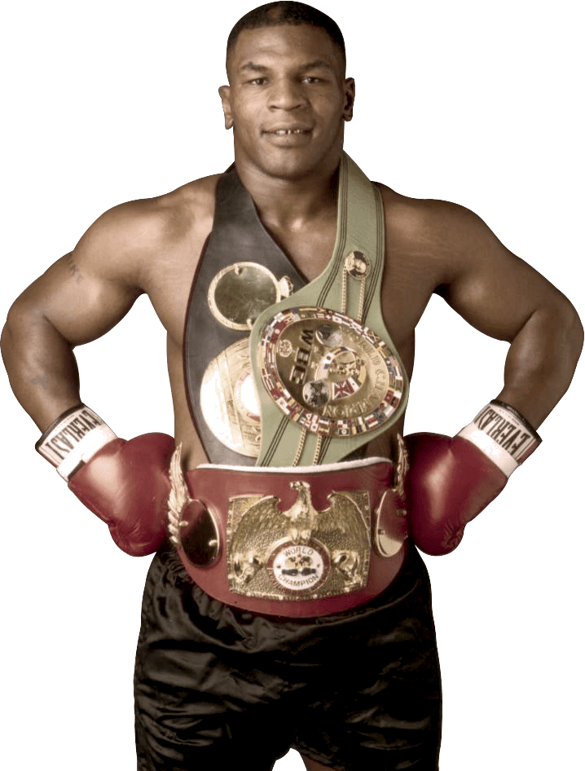
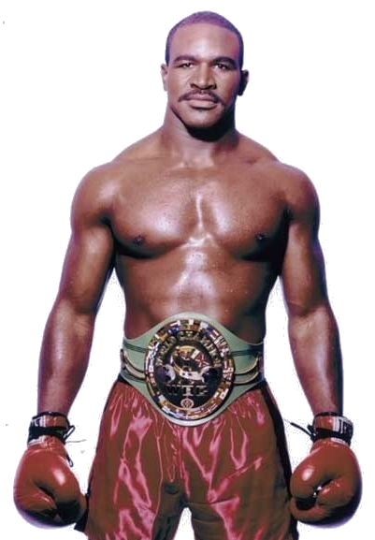
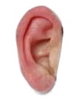
cangkir

Slide 3
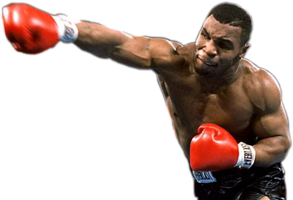
cangkir
For those of you who know about the 1997 World Heavyweight Boxing Title Match between Mike Tyson and Evander Holyfield, you might think that “cangkir” , pronounced “chunk-ear”, means a “chunk of ear” in Indonesian!

Slide 4
cangkir
I know you’re all “ears” so listen up while I tell you that the noun “cangkir” means a “cup” or a “mug” in Indonesian!

Slide 5
cangkir
These days, it is said that Evander Holyfield has forgiven Mike Tyson and they regularly “chew the fat” (not the ear) over a “cangkir” of Starbucks coffee.

