Slide 2
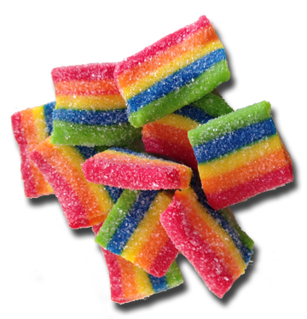
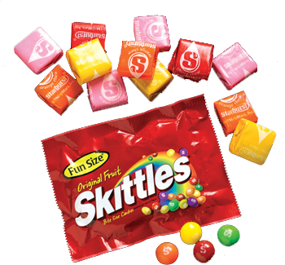
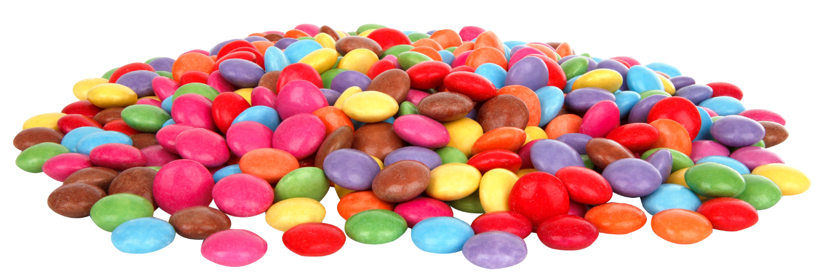
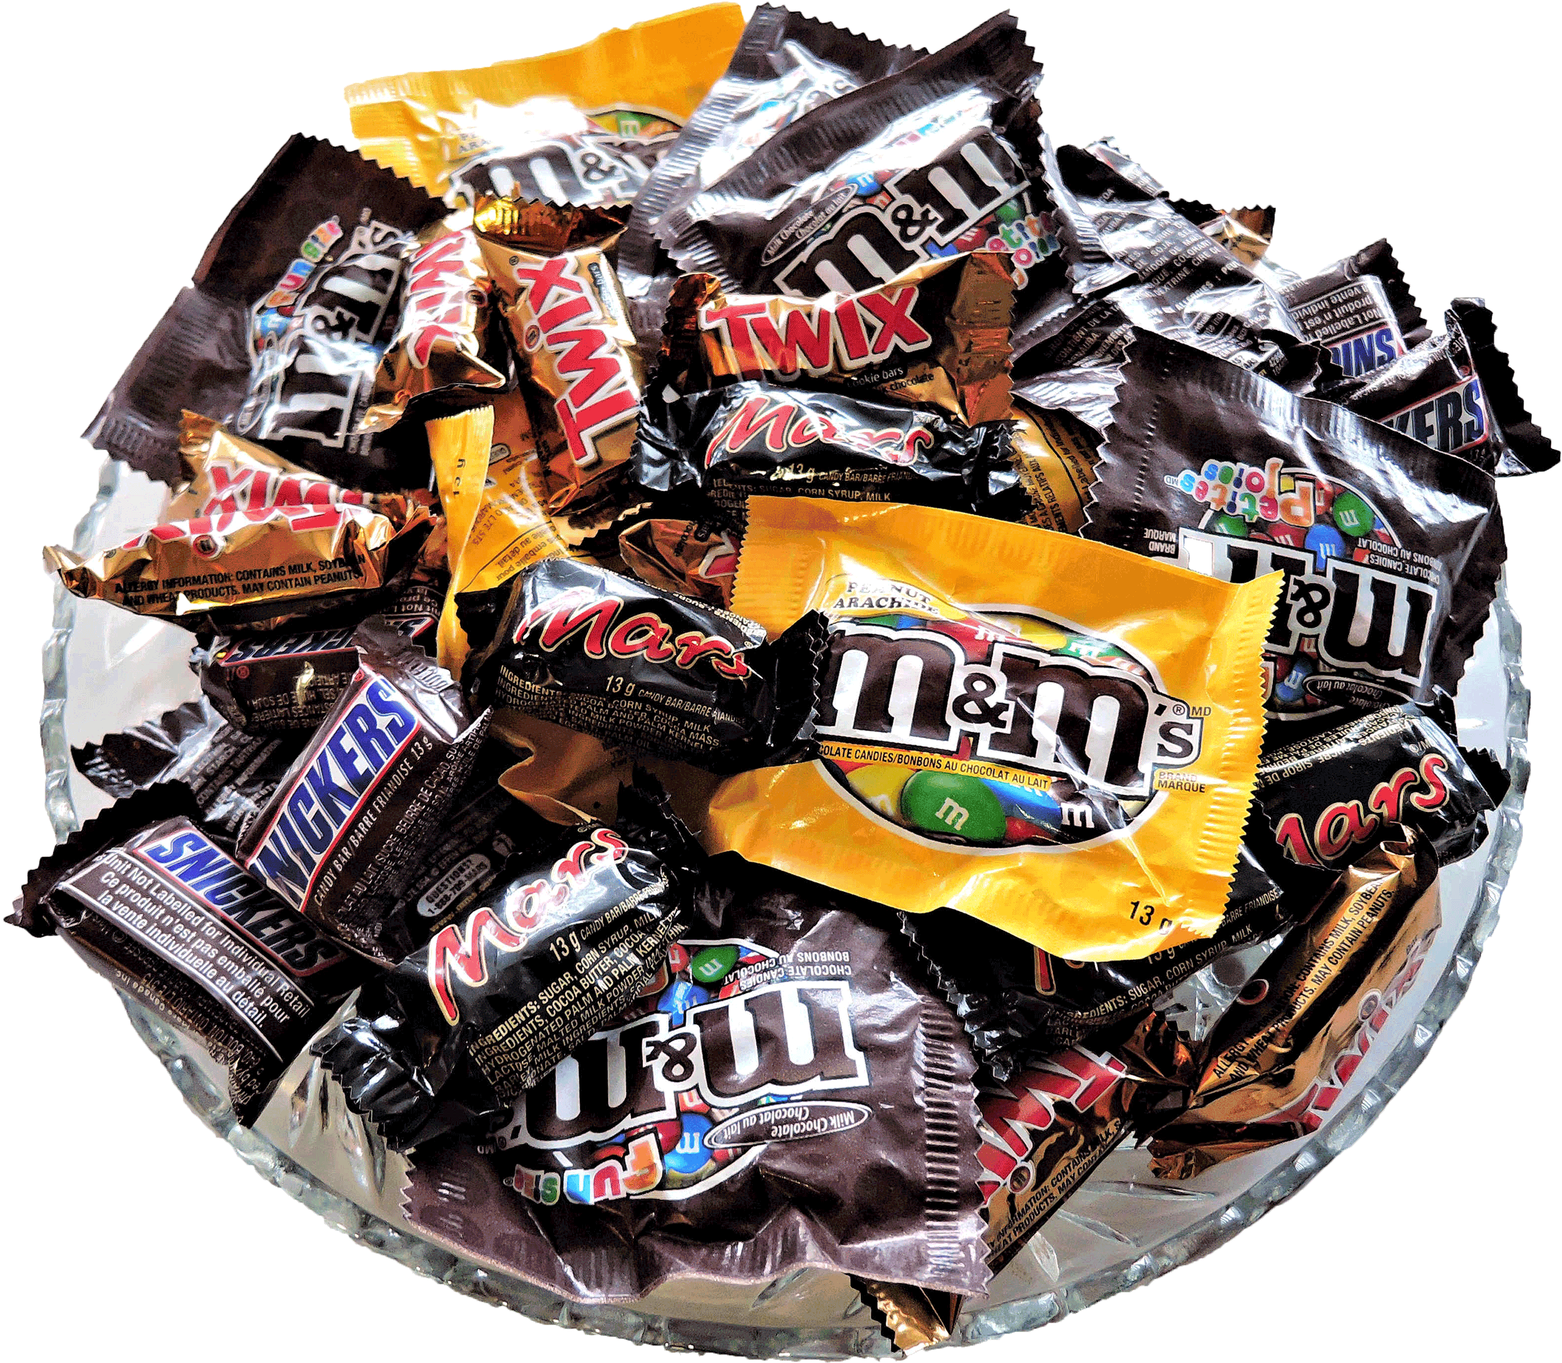
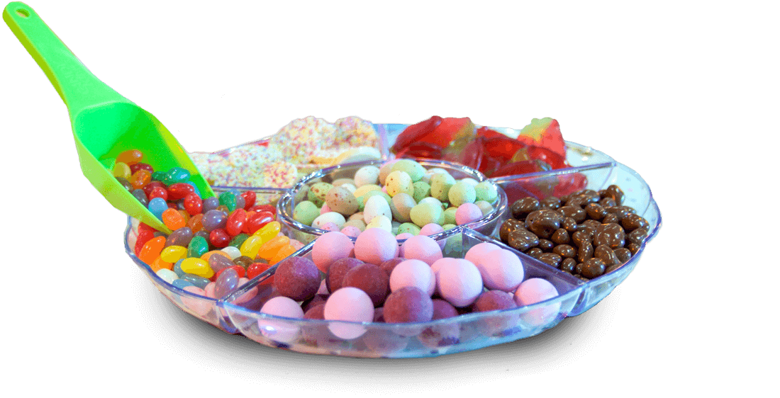
candi

Slide 3
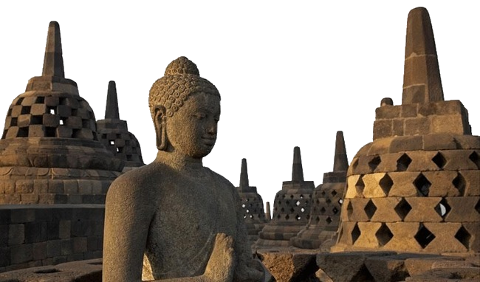
candi
I know you must be thinking that “candi” must be the Indonesian word for “candy”, right?
Sorry to disappoint you, but “candi”, pronounced “chun-dih”, means “temple” in Indonesian.
Indonesia contains some of the world’s most famous temples, including Borobudur which is listed as one of the seven wonders of the world.

Slide 4
candi

Slide 5
candi
Remember, when visiting temples such as Borobudur not to leave your “candy” and wrappers all over the “candi” !

