Slide 2
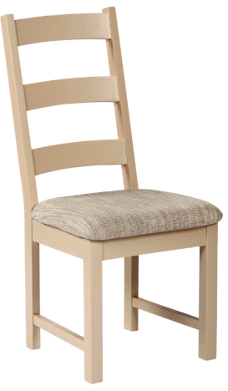
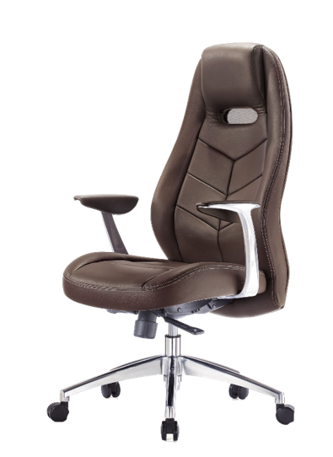
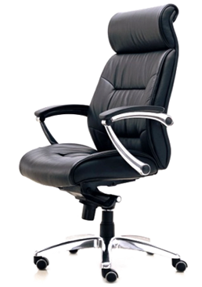
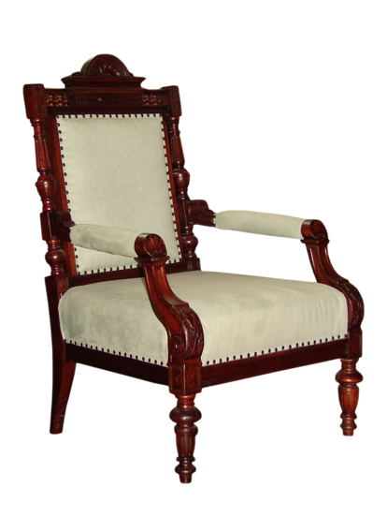
cair

Slide 3
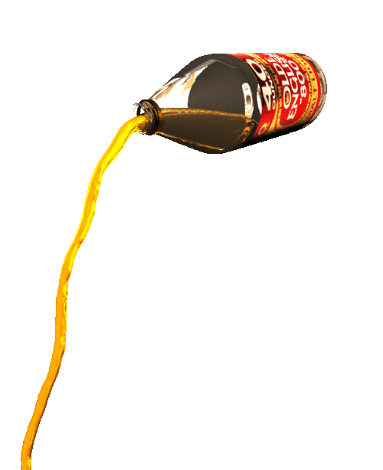
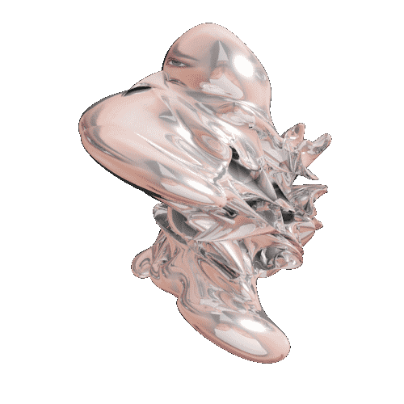
cair
Knowing that the letter “c” is pronounced as “ch” in Indonesian, you probably think that “cair” must mean “chair”, right?
Well, you should have sat this one out because the noun “cair”, pronounced “cha-ear”, means “liquid” in Indonesian.

Slide 4
cair
I don’t know about you, but I would find it extremely difficult sitting on a “cair”!

