Slide 1
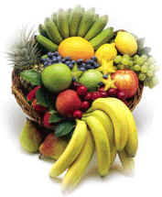
It’s a Great Bag of Fruit
Buah-Buahan Tropis

Slide 2
Belimbing

Slide 3
Delima

Slide 4
Durian

Slide 5
Jambu

Slide 6
Jeruk

Slide 7
Mangga

Slide 8
Manggis

Slide 9
Nanas

Slide 10
Nangka

Slide 11
Papaya

Slide 12
Pisang

Slide 13
Rambutan

Slide 14
Salak

Slide 15
Sawo

Slide 16
Semangka

Slide 17
Srikaya

Slide 18
Tamat

